Slide 1
Operation and Upgrade of the SLS RF Systems
Lukas Stingelin :: RF-Systems 1 :: Paul Scherrer Institute
25th European Synchrotron Light Source RF (ESLS-RF) workshop
organized by DESY November 2021

Slide 2
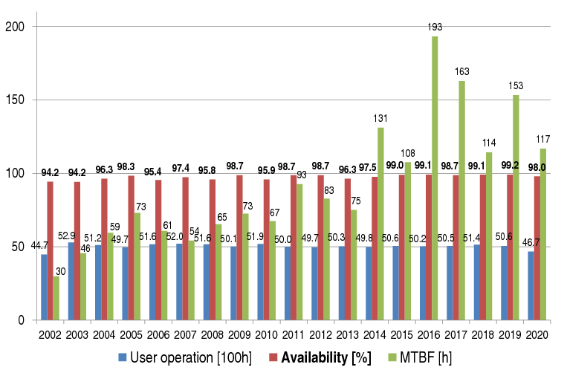
SLS-Operation Statistics until 2020
2020:
During Corona lock-down, slightly reduced User Operation
Good MTBF, but lowest value of time between distortions (16h)!
34% of down-time due to RF
Outages more than 5h:
Broken LINAC RF window (26h)
Water leaks SR cavity (5h)
Several Interlocks due to bad Klystron filament connector

Slide 3
2021 SLS Failures
Obstacle (diagnostics mirror) in the LINAC beam path (not in control system)
Power glitches, thunderstorms, power outage due to short in 16kV distribution
Refill of demineralized water caused flow interlock at RF stations
Interlocks of RF-stations due to coupler valve error (pressurized air, or PLC error?)
LINAC Klystron failure
LINAC local structure cooling unit broken
Failure of reflected power measurement in Booster SSA
Failure of 6-way splitter in the Booster SSA
Cooling Rack Temperatur controller got unstable
So far: 10% due to RF

Slide 4
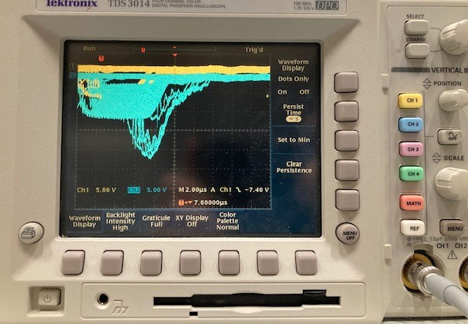
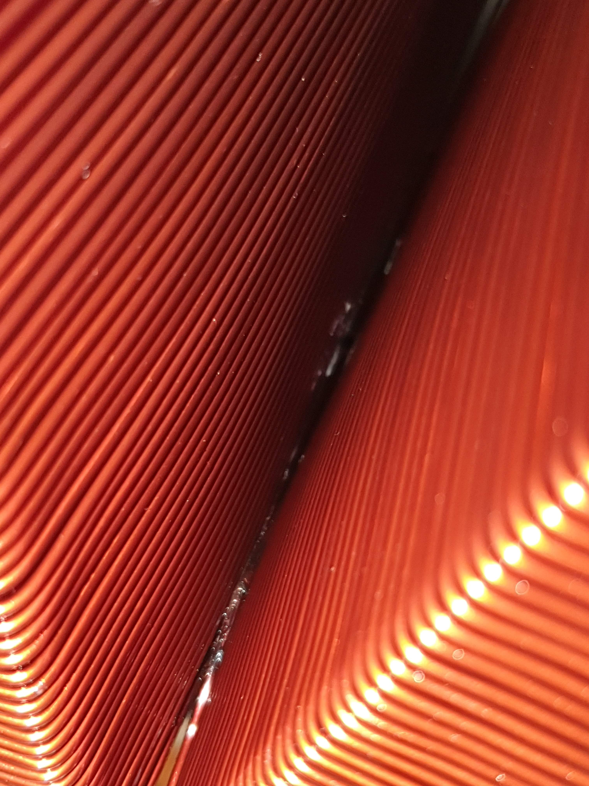
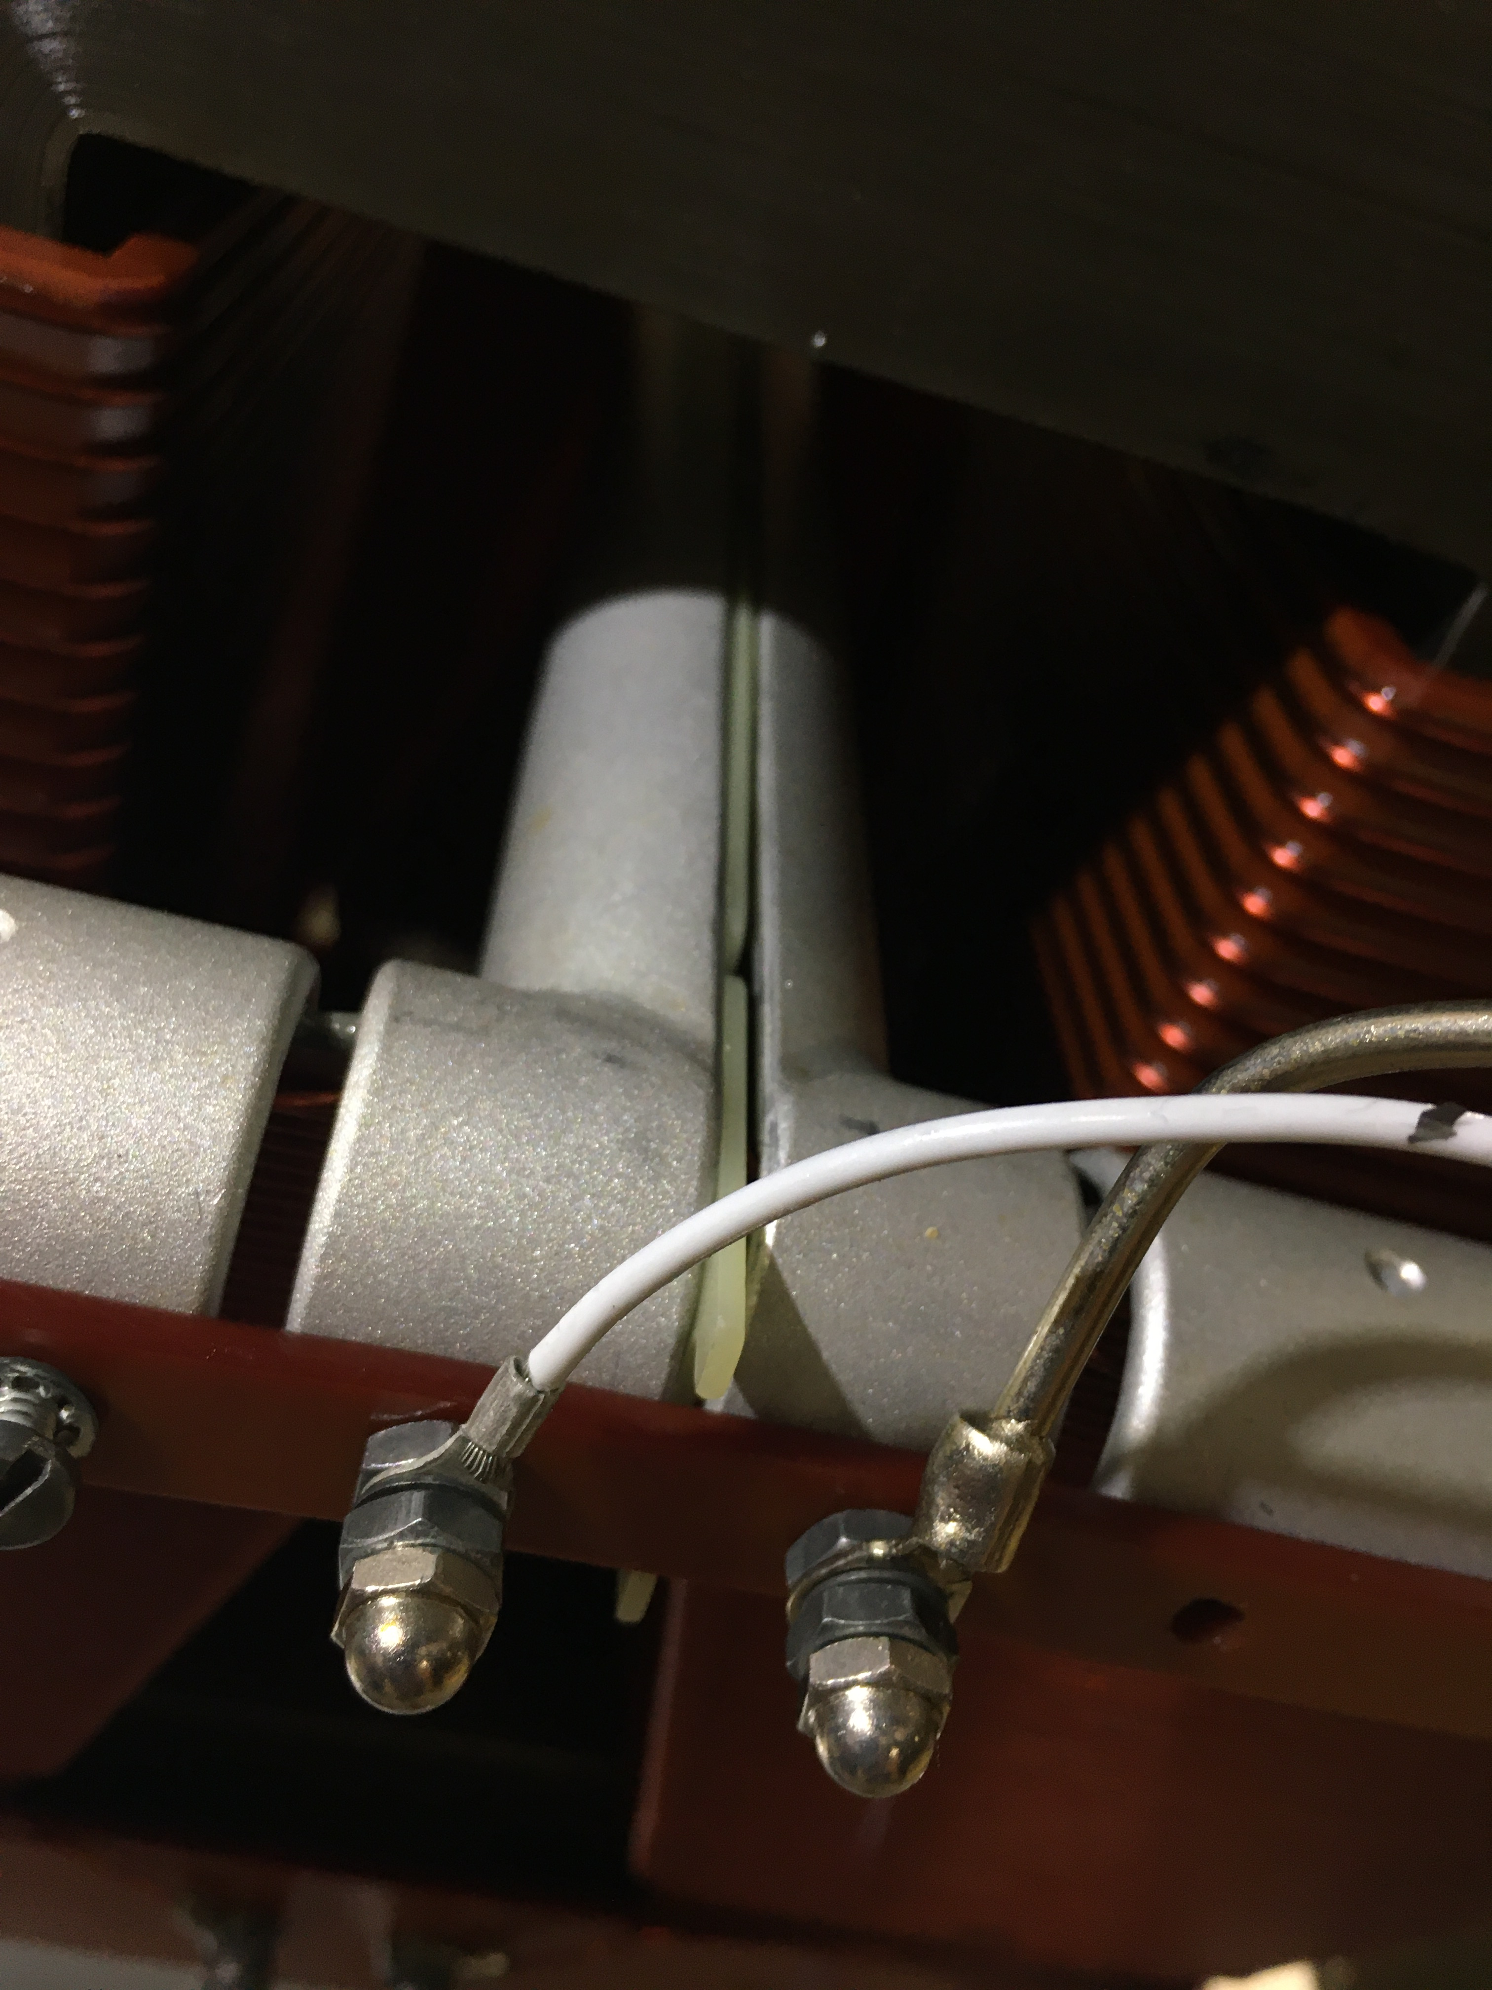
Arcing at LINAC Tank HV transformer Part 2
→In 2020:
Installed isolation plate:
→In Mai 2021: EOLC (+VSWR)-Interlocks: Black marks at plate. Replaced HV-Transformer
→In July 2021: Again EOLC-Interlocks: Replaced Klystron

Slide 5
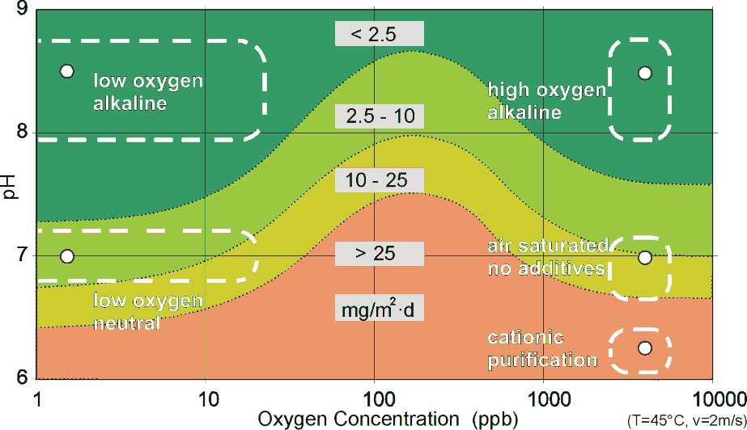
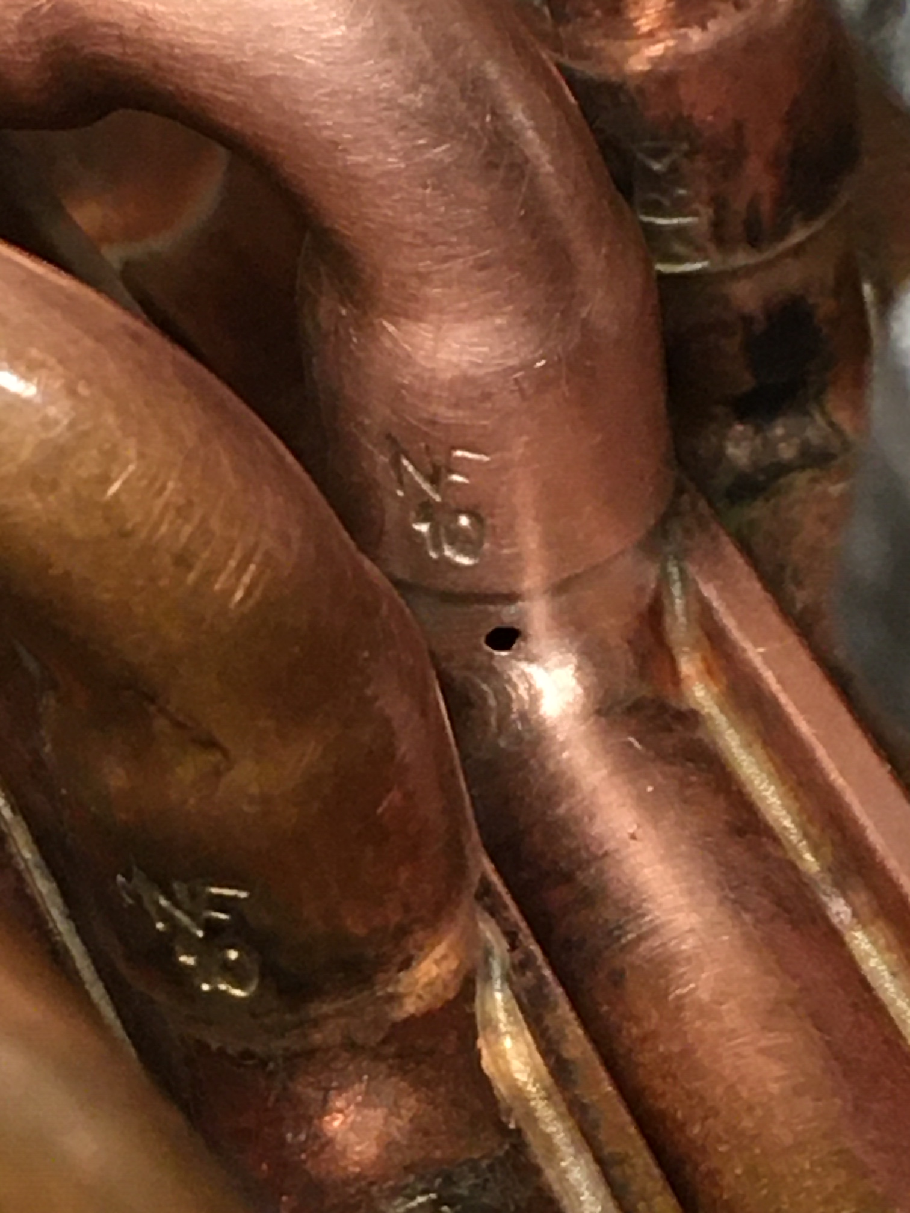
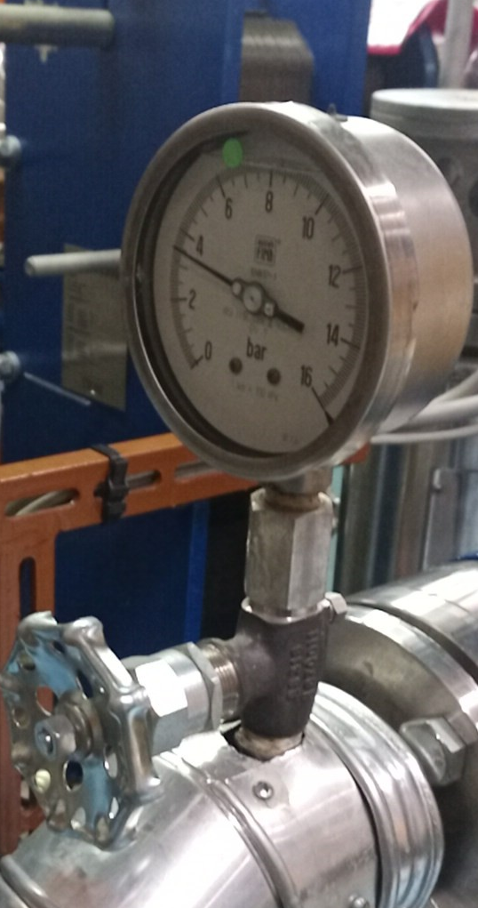
Water Leaks in the SR ELETTRA cavities
3 water leaks in the cavity wall-cooling circuit in 2020
(old cavities had problems with the flange cooling circuit, improved in the new cavities)
→Improved water chemistry
Demiwater instead of tap water
Increased pH to 10
Replaced Polyflex by:
  NALCO TRAC100 (Molybdate)
  NALCO 73199 (Azole)
  NALCO Biocide 733O
→Upgrade of Cooling Racks
(see following slides)
Courtesy: SvoBaTech
← Pressure (here after the pump) is not an issue.

Slide 6
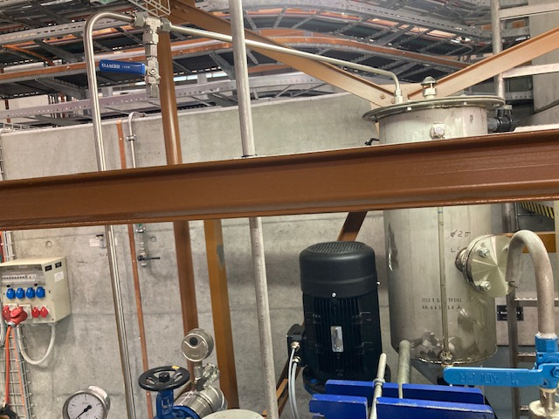
Upgrade 1: New sample point
New sample point
on the highest point of the circuit
Defined method to take samples:
The sampling valve should be quickly opened and closed three times.
Leave the water run with a constant flow of 100ml to 200ml per minute for about 3–5 minutes.
Take the samples without touching or closing the valve before the samples are taken.
Courtesy: D. Kunz

Slide 7
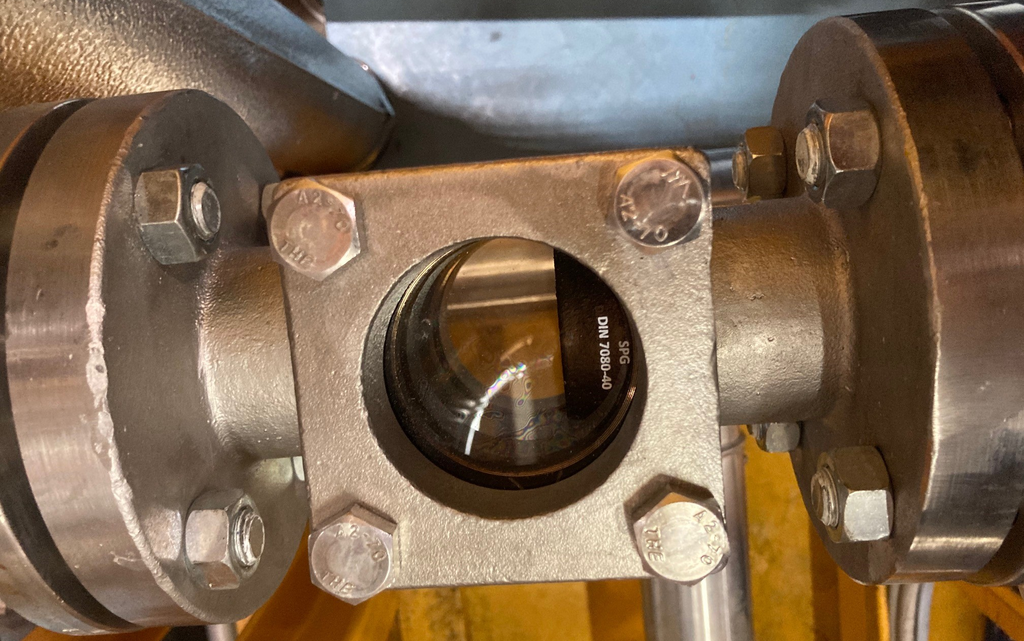
Upgrade 2: Viewing Window
Recommended by SvoBaTech:
To see gas-bubbles in circulation
To see copper-, iron-dust, or sludge
To observe color-change through the window during the cleaning process.
Courtesy: D. Kunz

Slide 8
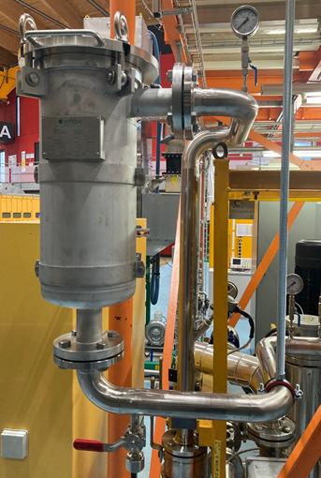
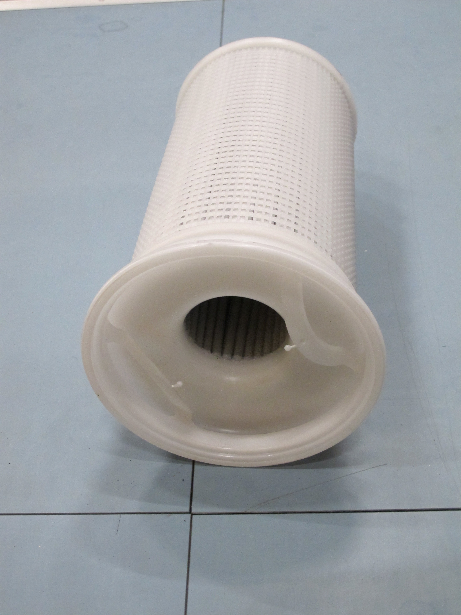
Upgrade 3: New filtering
The small bypassfilter was removed and replaced by a full stream filter.
The new filter contents a filter cartridge.
If there is a large difference between the inlet and outlet pressure the cartridge has to be replaced.
Courtesy: D. Kunz

Slide 9
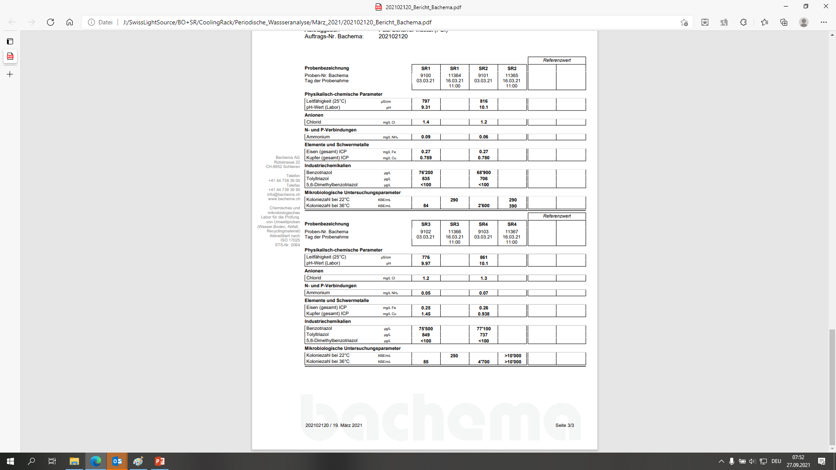
Current Problems 1: High Bacterial Count on one station
Regular check of the water quality, for example:
Conductivity
Acidity
Copper and iron
Azoles
Bacterial count
Oxygen saturation
Courtesy: D. Kunz
SR4: Very high bacterial count since march 2021. The CLRK was cleaned with NALCO 2567 and four times flushed with demineralized water
→ Situation improved

Slide 10
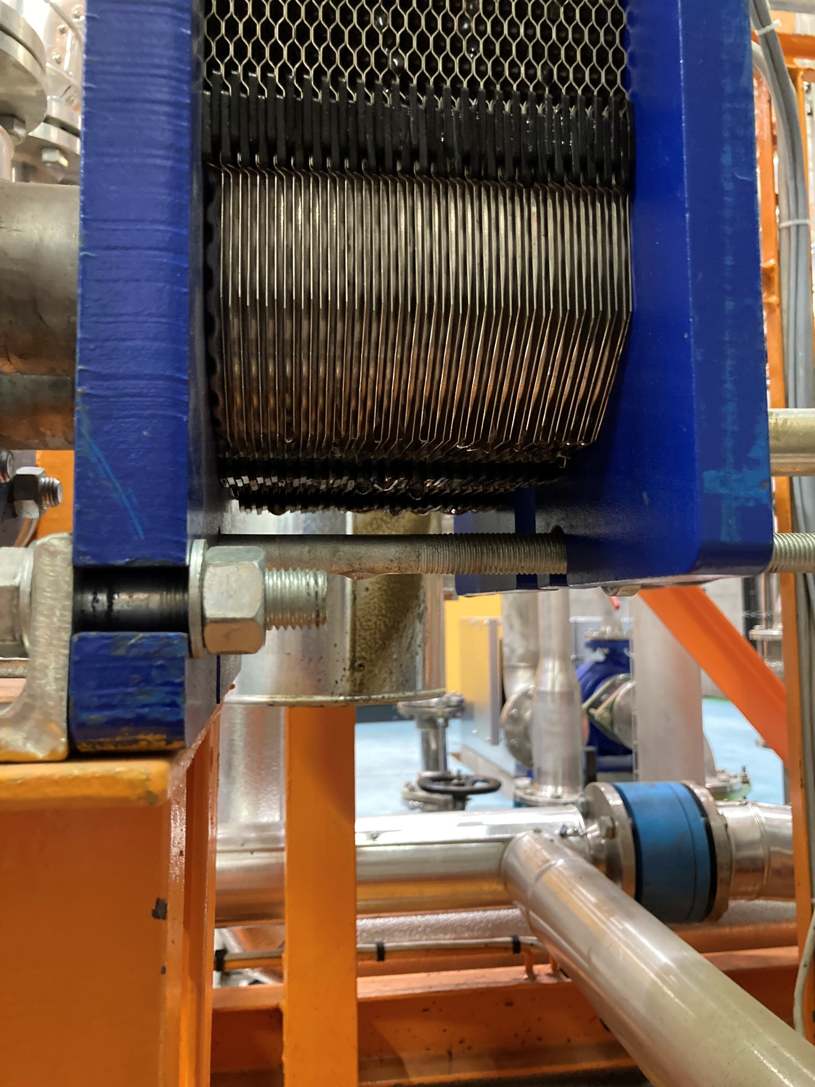
Current Problems 2: Water loss
SR1: On CLRK of SR1 we lose continuously water. Probably in the heat exchanger between primary and secondary circuit. Repair will be done in January Shutdown 2022, by exchange of the gaskets.
SR3: On CLRK of SR3 we lose water when the heat exchanger is cold. Repair will be done in January Shutdown as well.

Slide 11
SLS RF works
Done:
Improvements on «Pantak» connectors
Installation of filters etc. to the cavity cooling rack
Removal of «3GHz Teststand» in SLS LINAC
Upgrade of Super-3HC vacuum controller
Installation of additional crane for SLS 2 installation
In Progress:
LINAC pulser board upgrade to shorter bunches
LINAC timing fine-shift according to bucket-number
LINAC: HV-Pulse recording
Renewal of water cooling piping
Storage-Ring+Booster cavities: HOMFS upgrade
Storage-Ring: LLRF upgrade
Modification of 500MHz Teststand
SLS2 RF Upgrade → See next slides

Slide 12
SLS 2.0 Master Milestones (version Oct. 2021)
8
start user operation, BL-Grp.1
01.08.2025
1
storage ring lattice defined
30.06.2020
3
SLS2.0 funding secured
01.01.2021
6
tunnel closure
20.12.2024
10
re-start user operation
01.06.2026
2020 | 2021 | 2022 | 2023 | 2024 | 2025 | 2026
2
beamlines & beamline positions defined
30.09.2020
4
ready for DT
30.09.2022
5
start dark time
02.10.2023
7
nominal beam available
01.05.2025
9
start shutdown phase 2
21.12.2025
Now: 8.11.2021
Kick-Off Meetings with RI and Cryoelectra
Teststand bunker modified for new cavities
Infrastructure not available
Page 12

Slide 13
SLS 2.0 Main RF parameters
Main RF-System | SLS 2.0 |  | SLS
Total voltage [kV] | 1440 | 1780 | 2080
Energy acceptance (without harmonic cavity) | 5% → 3.7% | 6.3% → 5.2% | 3%
Number of cavities | 4 |  | 4
Voltage per cavity [kV] | 360 | 445 | 520
Wall loss per cavity [kW] | 20 | 30 | 40
Required RF-power with beam and minimum ID Power [kW] | 88 | 98.1 | 95
Required RF-power with beam and maximum ID Power [kW] | 114 | 124 | 100
Optimal coupling | 4.62…6.0 | 3.4…4.3 | 2.5
Detuning for matching [kHz] | -49.1…-57.1 | -32.4…-44.6 | -33
HOM control | By strong HOM damping |  | Temp. detuning
Amplifier Spec: 150kW (new solid state amplifiers)
→ For limited emergency operation with 3 stations only, coupler must work also at 150kW!
Main RF-System | SLS 2.0
Arcing rate at Max. operating voltage | <0.5/month
Cooling water properties | Demineralized water, pH neutral, oxygen depleted
Max. relative water pressure | 10 bar for test, 6 bar operational
Max. water speed in the cooling channels | ≤ 1.5 m/s
Max. water flow of the entire Cavity assembly | ≤140 l/min
Max. inlet – outlet pressure drop | ≤ 4 bar

Slide 14
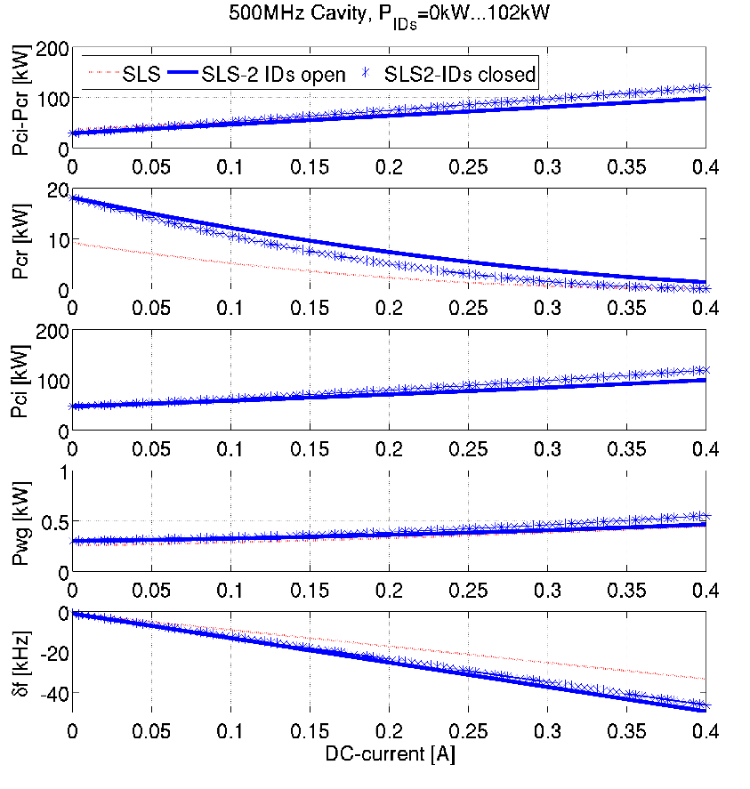
RF Power Considerations for 4 Cavity Operation
Static, without consideration of power limiter:
(Courtesy: R. Kalt)
Goal: Protect the cavity and coupler, but at a sudden beam loss do not block the high-power RF operation
→ fast re-start of beam accumulation.
Expected LLRF pwr. limiter controller reaction is faster than 20us pwr. error below 1%.
→Coordination of RF-ILK and LLRF expert settings required.

Slide 15
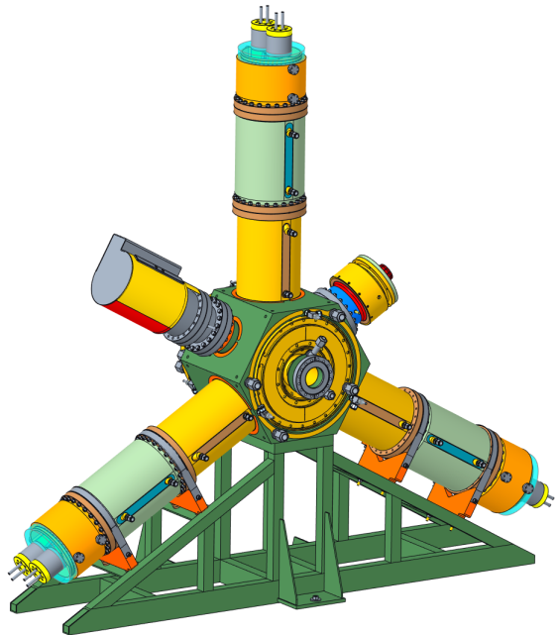
Project SLS 2.0: Cavity Procurement
Ordered 5 HOM damped cavities from Research Instruments
Coupler should handle 150kW input power:
Evaluate PETRA-Type coupler, like DESY
Cavities will be connected to the demineralized water circuit of the storage ring. (No cooling rack anymore!), Air cooling from pressurized air distr.
Flow velocity < 1.5m/m :
Hopefully no water leaks
Cavities to be mounted in the teststand and in the storage-ring: Additional supports required.
Water cooling for
HOM ferrites
Fundamental power coupler and transition for 150kW
Tuner
HOM damper
Page 15

Slide 16
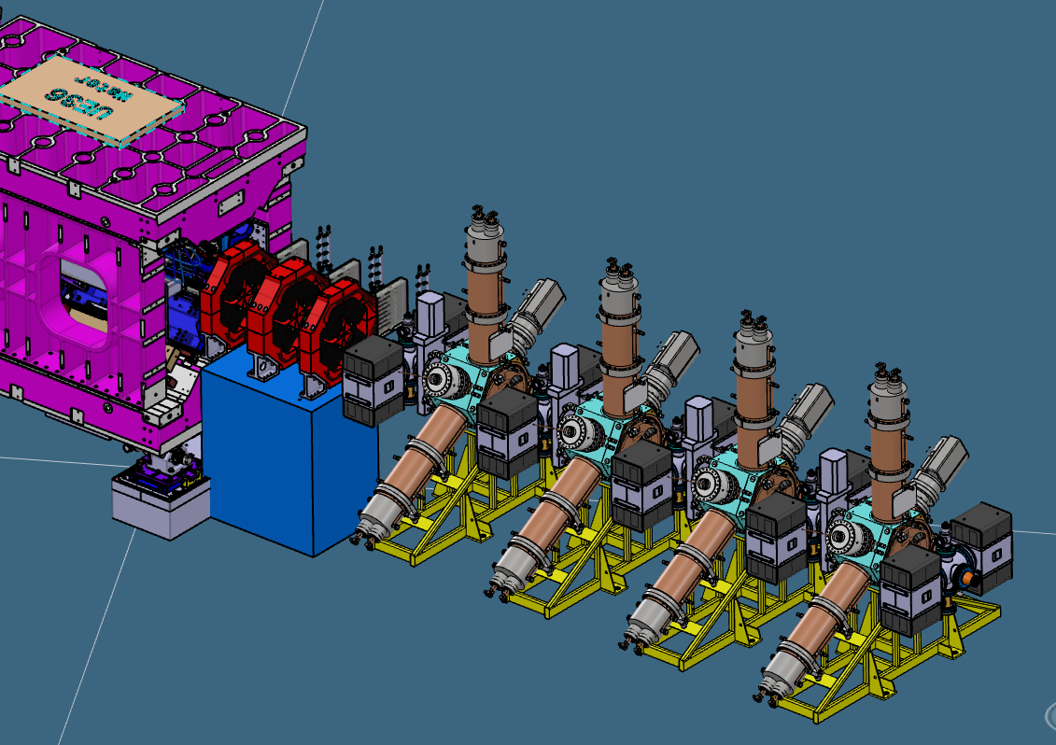
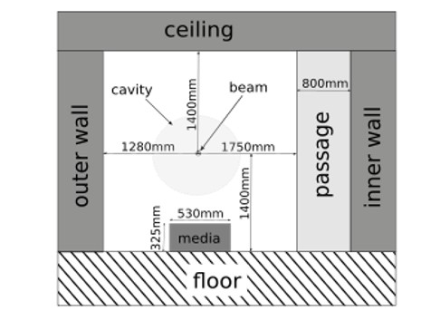
Preliminary Layout: 500MHz RF-System
Collimators (under the Quads)
All main cavities in the same long straight X05
Modification of tunnel wall to host cavities and neighboring beam line.
Connection via Waveguide – Coax transition to the cavity coupler. (WaTraX, Doorknob?)
Next to the cavities, there will be collimators

Slide 17
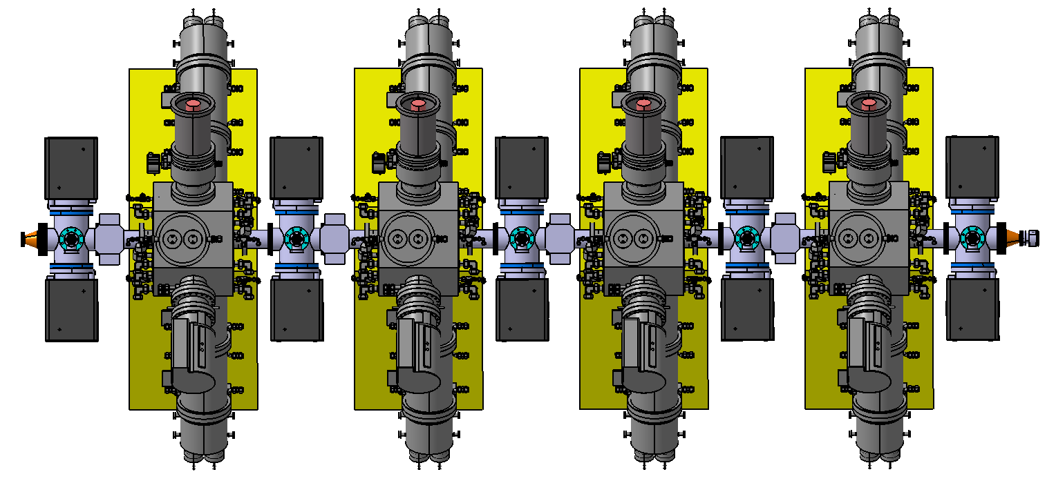
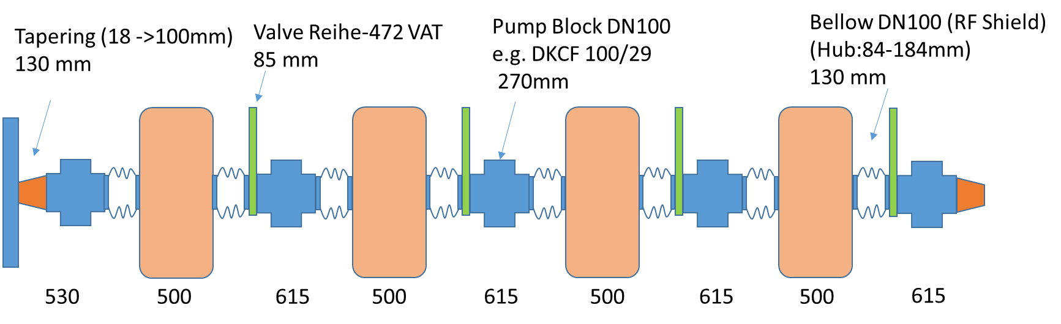
500MHz Cavities in Long Straight X05: Vacuum
Preliminary draft layout for the case of HOM-damped cavities:
  Taper at the beginning and end of the 4 cavities
  Vacuum pumps (IGP+ZAO) and -sensors at both sides of the cavities
  Valves and bellows to separate the cavities for installation and conditioning.
Characterization of the cavities in a clean-room, high power tests + conditioning in the teststand
  485 mm upstream and downstream at each cavity:
  pump cross with:
  2x 300 l/s ion getter pump
  +1x 1000 l/s NEG pump
  1 vacuum probe on the pumping cross
  1 vacuum probe on each cavity
  View-port on coupler (like at DESY)
  Coupler and Beam-pipe flanges to be defined

Slide 18
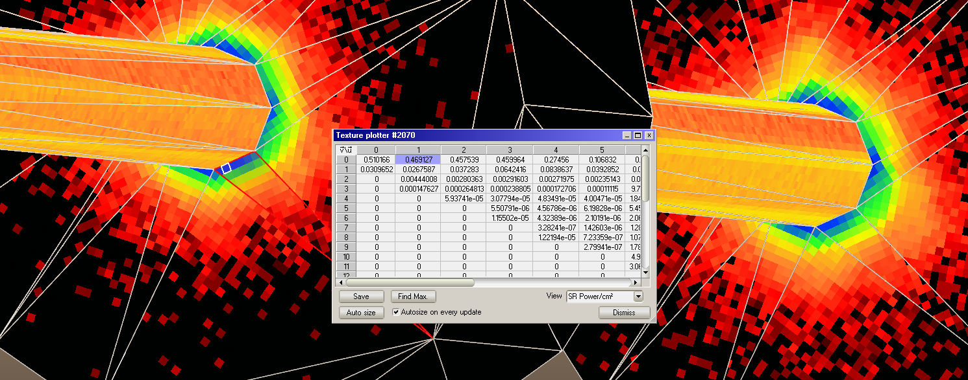
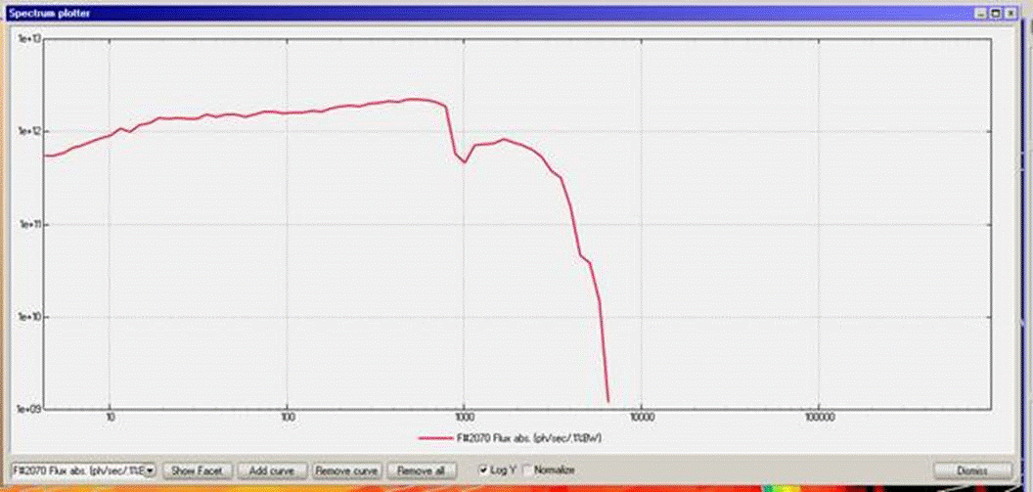
Investigation of Synchrotron Radiation on Cavity Surfaces (Synrad Calculation by Vacuum Section)
There is no direct synchrotron light hitting the cavity surfaces
But indirect, from reflection on the walls of the beam-pipe, there will be some light on the cavity.
What is the limit, how does it affect the arcing rate?
Radiation distribution at the cavity.
Radiation spectrum; X axis in eV Y axis in photons/ sec/ 0.1%BW.

Slide 19
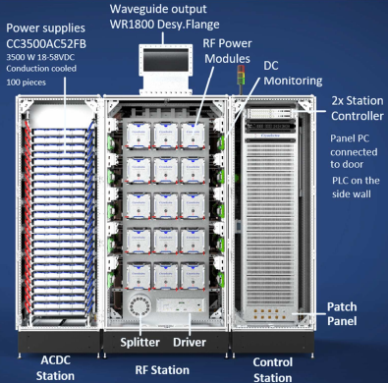
500MHz Amplifier Procurement
Signed contract with Cryoelectra for 4 high power solid state UHF 150kW amplifiers + spares
Approved ProkW funding proposal for energy saving (hope for efficiency > 56%).
It is planned to add an external high power circulator
→ Layout with RF platform
→ Earthquake safety investigations ongoing
→ Water cooling concept is in progress.

Slide 20
Thanks for your attention!
Questions?

