Slide 1
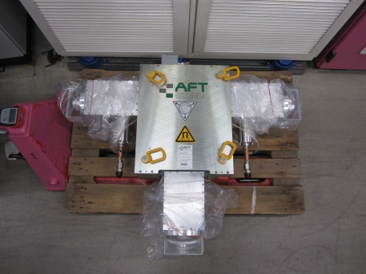
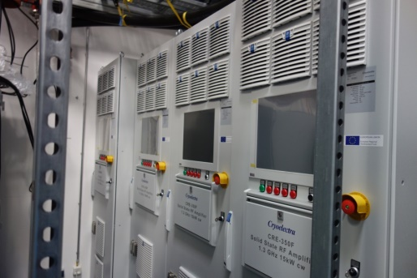
Status of RF at HZB: BESSY II, MLS, bERLinPro and BESSY VSR
Wolfgang Anders
Helmholtz-Zentrum Berlin for Materials and Energy (HZB)
24th ESLS-RF Meeting 4.-5.11.2020 online by KIT

Slide 2
Outline
RF operation BESSY II
Additional Booster transmitters and cavities
Test of 3rd harmonic ALBA HOM cavity
Digital LLRF plans
RF operation MLS
MLS goes SSA
Status of bERLinPro
Status of transmitters at bERLinPro
New project structure bERlinPro
BESSY VSR goes VSR DEMO
Farewell to Grzegorz

Slide 3
RF operation BESSY II
Reliable operation of the 500 MHz 80 kW SSA
Picture show the module statistic 2014-2020: green no fail, blue 1x, orange 2x, red 3x
Last 12 month 19 out of 630 modules fail (~3%) and have been repaired (2018 18 modules)
Losses mostly Monday at switch on to full power
No losses in continually operation
After introducing a power ramp ~sec ➔ fails reduces

Slide 4
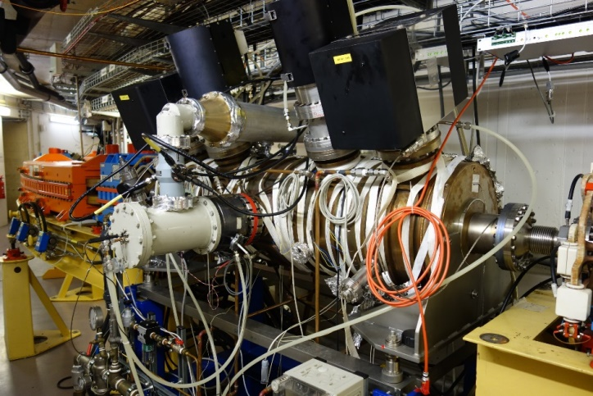
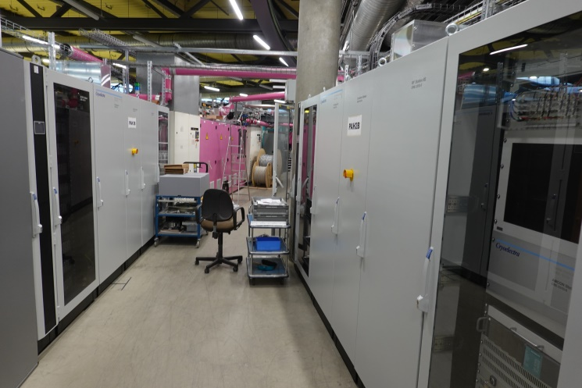
Additional SSA transmitters for BESSY II booster
To achieve shorter bunches in the booster it is planned to install two additional 5-cell PETRA cavities each powered by a 80 kW SSA.
One cavity is installed
Two transmitters are delivered
piping is ongoing
First transmitter should be switched on this year
Controlsystem connection, interlocks, LLRF beginning next year
Commissioning of the transmitter using HOM cavity in the conditioning cage
Operation with beam summer 2021
PETRA cavity in the booster
New booster transmitters

Slide 5
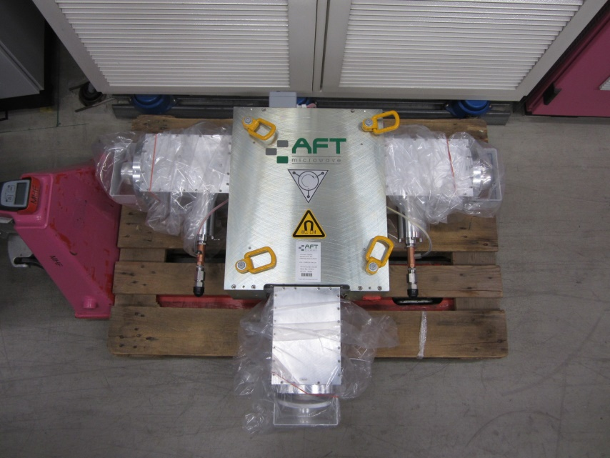
AFT 500 MHz circulators new outfit
Many labs are using the 500 MHz AFT circulators.
The circulators got a new outline. From 120 deg to 90/180 deg between the RF ports.
500 MHz AFT circulator. Old model left --- new model right

Slide 6
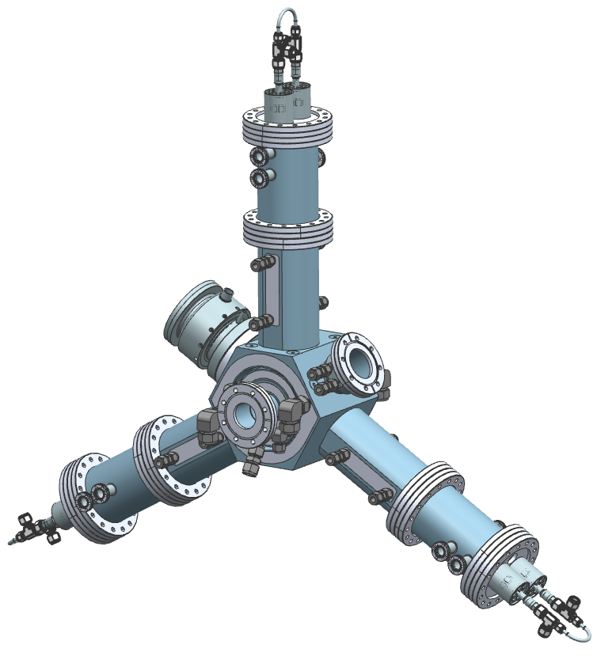
3HC project -- beam test of 3rd harm HOM cavity
ALBA -- HZB -- DESY are members of the 3HC collaboration
ALBA scaled the HZB 500 MHz HOM cavity to 1.5 GHz (active)
Design, production is by ALBA
Transmitters by HZB
LLRF by ALBA
Wave guides by DESY
Conditioning will be at HZB (HoBiCaT) in summer 2021
Beamtest at BESSY II is planned for summer 2022
ALBA 3rd harmonic scaled HOM cavity

Slide 7
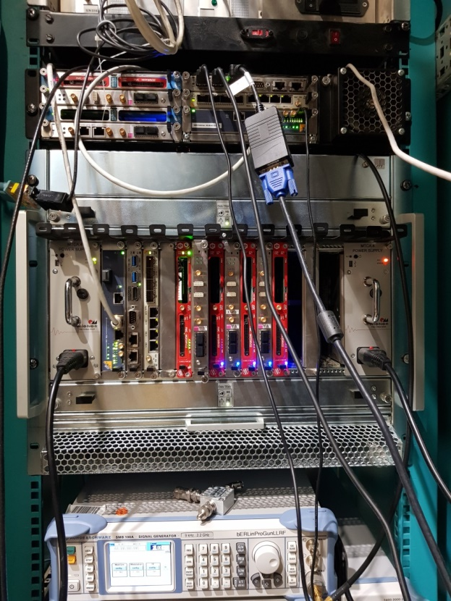
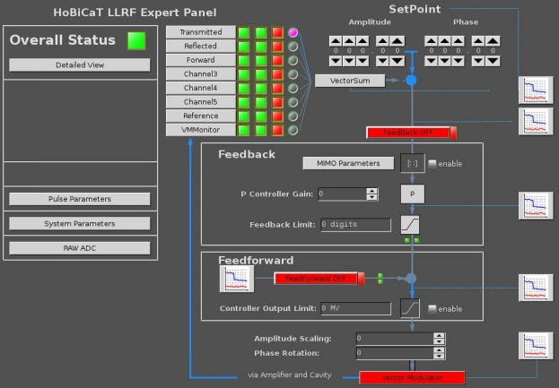
BESSY digital LLRF plans
For the sc cavities of bERLinPro and VSR Demo HZB is developing a digital LLRF RF system based on the DESY µTCA system.
This system will be converted to 500 MHz to replace on long term the old analog LLRF of the BESSY II and MLS transmitters.
First tests have been planned for the new booster transmitters, but setting up the LLRF is delayed.
For the 3HC collobaration beamtests, we will implement the ALBA digital LLRF.
Digital LLRF hardware & panel at HoBiCaT

Slide 8
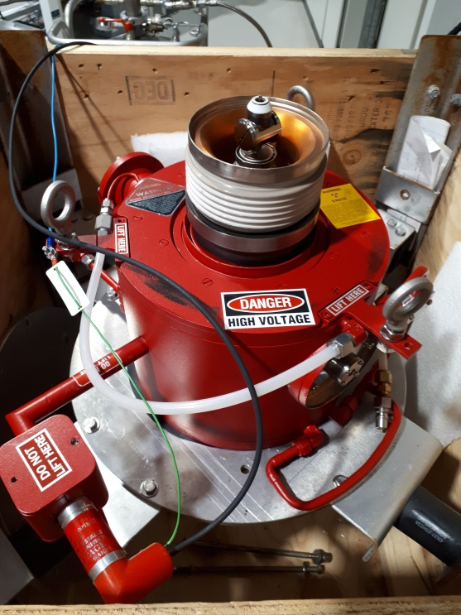
MLS goes SSA
End of 2018 the 500 MHz 80 kW IOT tube at the MLS failed.
We installed the (used) spare tube.
Now we have only an also used prototype tube as spare
It needed long time to get an offer for a spare by CPI
Due to the fact that the IOT´s aren´t in production at CPI anymore, the price was tremendous high
Price ~ 80% of a new 80 kW SSA
➔ decission to exchange the IOT transmitter by a SSA
Money expected to be availble beginning of 2022
80 kW 500 MHz IOT at MLS

Slide 9
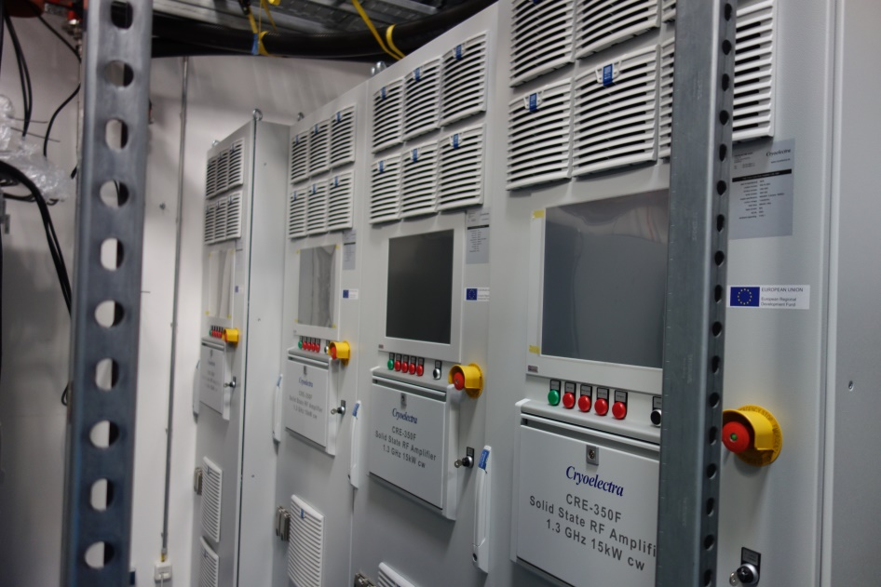
Status bERLinPro transmitters
At bERLinPro we have:
Three klystron transmitters 290 kW cw 1.3 GHz
One transmitter in operation for coupler tests
Two transmitters nearly ready, still small parts of installation missing
Five 15 kW 1.3 GHz SSA
All delivered
Piping and mains have to be connected (problems to find companies for this work)
15 kW 1.5 GHz & 1.75 GHz SSA for SupraLab/VSR Demo module test will be delivered within the next half year.
Four 15 kW 1.3 GHz SSA

Slide 10
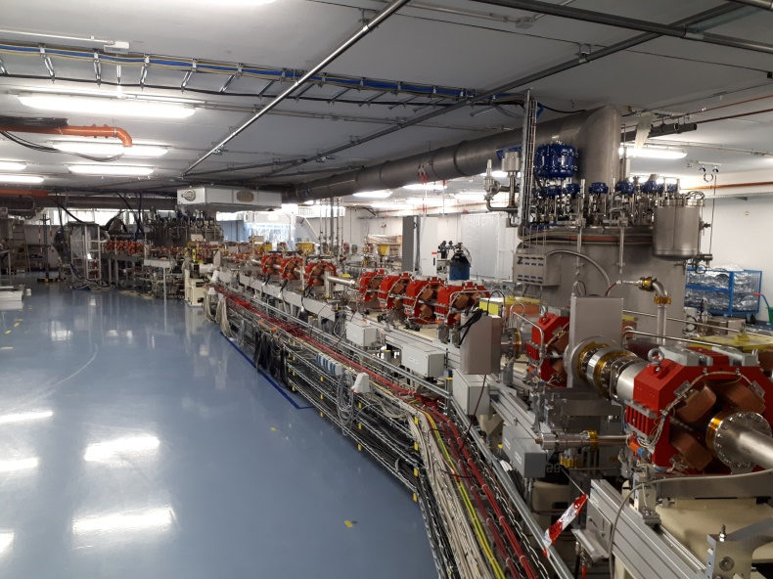
New project structure bERLinPro
The bERLinPro project ia an energy recovery linac project using sc cavities. We started in 2011 and had long delays on building and hardware.
Now the building is ready, the hardware components as magnets, vacuum system, RF system, cryogenics, power supplies, … is close to completion, but there is still more delay on the cryo modules and sc cavities.
We have to accept that building cryomodules with high gradient cw operated superconducting cavities is a field of research and not comparable to constructing a conventional accelerator facility.
We will finish the bERLinPro project end of this year as a project of setting up the hardware of an accelerator facillity
The development of the sc cryo modules will be continued as a research project
bERLinPro accelerator hall

Slide 11
BESSY VSR goes VSR DEMO
BESSY VSR is a project to operate sc cavities 1.5 HZ and 1.75 GHz in BESSY II to have long and short bunches alternately at the same time in the ring.
Situation is similar to bERLinPro. Hardware, mostly transmitters and cryoplant is close to compledtion but many delays on the module and cavities.
Order for cavities and couplers ist just out resulting in an expected completion of the first module (test module only 2 sc 1.5 GHz cavities) erliest in 2023
BESSY VSR project is stopped now!
VSR DEMO is a research project to to develope a sc 3rd harmonic two cavity module for cw high beam current operation.
The module will be tested in the bERLinPro bunker.
After a sucessfull module test at bERLinPro, there will be decided, if the module will be installed in BESSY II and if 1.75 GHz cavities will be developed.
VSR Demo module

Slide 12
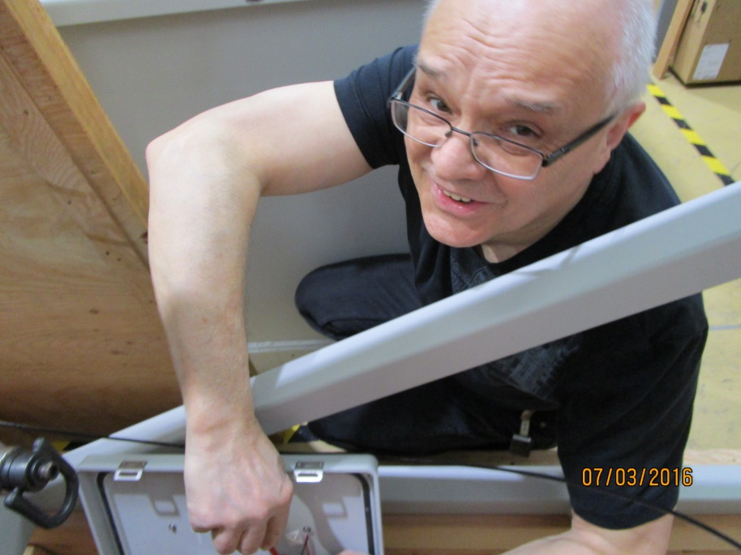
Farewell to Grzegorz
In every group you have workers that you don´t see, but they making a lot of the work.
One of these guys in the HZB RF group was Grzegorz Mielczareck.
He started at BESSY in 2000 and now after 20 years he died, after being ill over the last years.
He was a very good college. We are missing him.

Slide 13
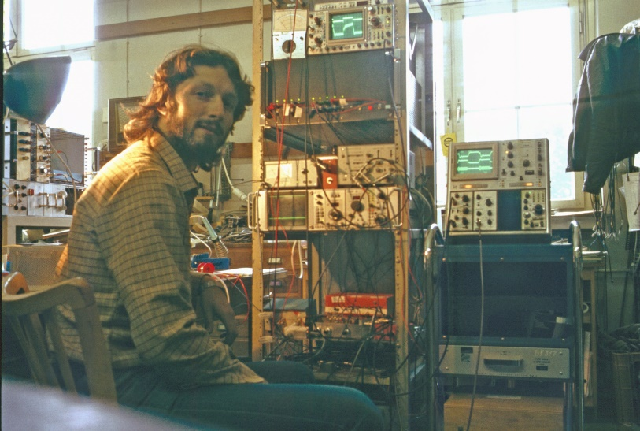
Summary
Smooth operation of BESSY II RF
Additional cavities and transmitters for the booster on installation
MLS will change from IOT transmitter to SSA due to the high costs of spare tubes
bERLinPro and VSR will be continued as research projects
Due to the fact I will retire in summer next year (Hannes Stein will continue) , this is my last ESRS-RF workshop
Thank you for all the cooperations and help over all the years. It is my favorite workshop I joined over all the years.
1984 at the diploma work in the ELSA RF group in Bonn

