Slide 1


PETRA-IV
Development of a Single Mode Cavity for the Third Harmonic RF-System of PETRA IV
26’th ESLS Workshop 2023
Peter Hülsmann – DESY - MHF
Triest, November 8 - 9, 2023

Slide 2

Content
Motivation
The Choke Mode Cavity from T. Shintake (1992)
Comparison of Choke Mode Cavity to the conventional HOM damped Cavity, advantages and disadvantages
Optimizing the Cavity Design
Power Load for the HOM-Damper
Variable coupling factor
Conclusion and outlook

Slide 3
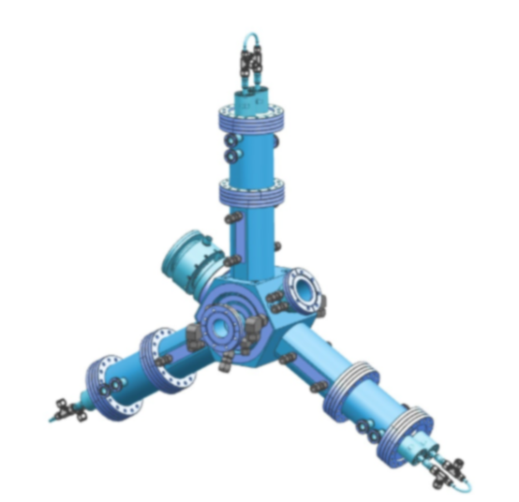
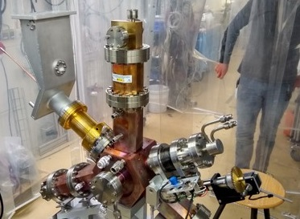
1. Motivation
The ALBA HOM-damped-cavity is expensive to build and due to its complexity many independent cooling water circuits are required.
In PETRA IV, 24 of these cavities are required.
It is reasonable to look for an alternative cavity design.
It should:
Have a simple cavity design that is easy to fabricate.
Have few cooling circuits.
Have a higher HOM damping efficiency compared to the ALBA cavity.
Have an adjustable coupling factor from zero to five.
Parameter | Value
Frequency High Harmonics RF System f₀ | 1,499GHz
RF Amplitude High Harmonics RF System V₀ | 2,3MV
Number of Third Harmonic Cavities | 24
Voltage per Cavity | 94 kV
Fig 1: Above, the CAD model of the ALBA Cavity (Courtesy of B. Bravo, ALBA) and below, the preparation of the cavity for high power tests at HZB (courtesy of A. Matveenko, BESSY II)
Tab. 1: Some Important Parameters of the third harmonic rf-system

Slide 4

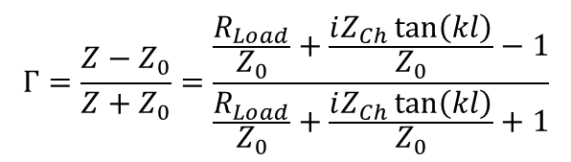
2. The choke mode cavity created by T. Shintake (1992)
The choke mode cavity is a representative of a certain class of cavities, namely a “single mode structure” [1]
The single-mode accelerating structure is designed so that all modes except the wanted mode leave the cavity in the direction of an rf absorber [1]
$$Γ=\frac{Z−Z_{0}}{Z+Z_{0}}=\frac{\frac{R_{Load}}{Z_{0}}+\frac{iZ_{Ch}\tan\left(kl\right)}{Z_{0}}−1}{\frac{R_{Load}}{Z_{0}}+\frac{iZ_{Ch}\tan\left(kl\right)}{Z_{0}}+1}$$
Relexion factor Γ:
$$Γ=1 , since for l→ \frac{λ}{4} , Z_{Ch}\tan\left(kl\right)→∞$$
Z₀ | cylindrical parallel plate transmission line
Z_{Ch} | Coaxial choke line | 9.5 Ω
R_{Load} | Termination resistance of SiC ring | 2 Ω
Fig. 2: The TM₀₁₀ mode is rejected by the choke. Due to the distance of λ/2 between the short circuit of the choke and the annular output of the cavity, the TM₀₁₀ mode "sees" a short circuit.(Picture: T. Shintake [2])
Tab. 2: Numbers for calculating the reflection factor Γ

Slide 5
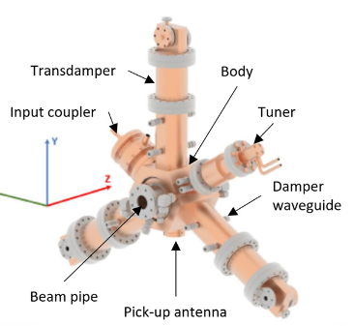
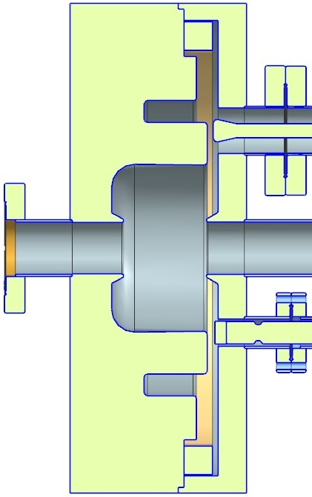
3. Comparison of Choke Mode Cavity to the HOM damped Cavity, advantages and disadvantages
Tab. 3: HOM damped 1.5 GHz ALBA cavity
 | Arguments | Evaluation of arguments
Advantages | Well proved HOM damped cavity concept | (++++…)
Disadvantages | Transdamper is frequency limited from 1.7–5 GHz | (- -)
 | High power input coupling factor is fixed | (- -)
 | Manufacturing is expensive | (- - -)
 | Complicate cooling circuits | (- - -)
Fig 3: ALBA Cavity (Courtesy of B. Bravo, ALBA)
HOM-Damper Ring
Tab.4: HOM damped 1.5 GHz Shintake cavity
 | Arguments | Evaluation of arguments
Advantages | The HOM damper capabilities are not frequency limited | (++)
 | Mechanical construction is simple | (+++)
 | Only a small number of cooling circuits required | (+++)
 | High power coupling factor could be variable from 0 to 5 | (++)
Disadvantages | Frequency of the cavity body and the choke must be precisely matched to each other. | (- -)
High Power Coupler
Choke
Frequency Tuner
Fig 4: Shintake Cavity (Courtesy of M. Schmidtke, DESY)

Slide 6
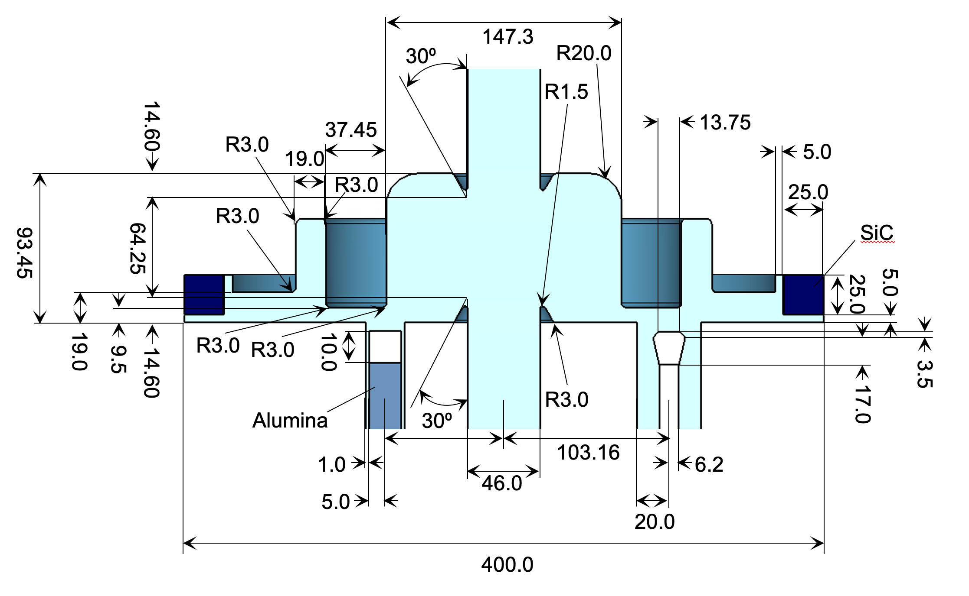
4. Optimizing the Cavity Design (cavity dimensions)
Tab. 5: Key-parameters Shintake cavity
frequency | f₀ | 1,5GHz
shunt impedance (CST) | R_{S} | 1,7 MΩ
unloaded quality factor | Q₀ | 20.000
R over Q value | R_{S}/Q₀ | 85Ω
Tab. 6: Key-parameters ALBA-HH-cavity
frequency | f₀ | 1,5GHz
shunt impedance (meas.) | R_{S} | 1,1 MΩ
unloaded quality factor | Q₀ | 14.000
R over Q value | R_{S}/Q₀ | 79Ω
Fig. 5: Optimized cavity design with all dimensions in mm

Slide 7
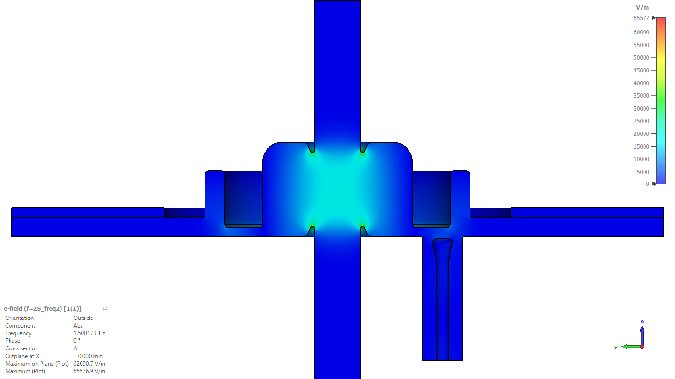
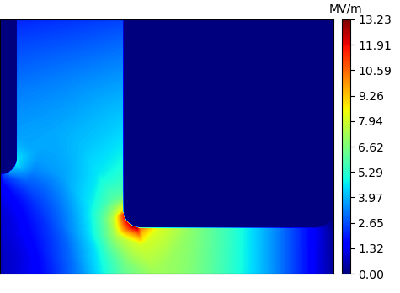
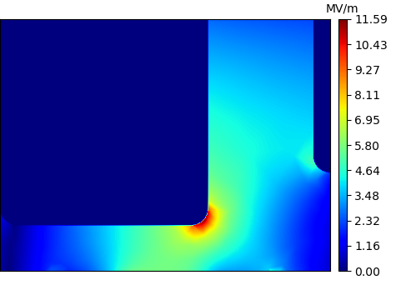
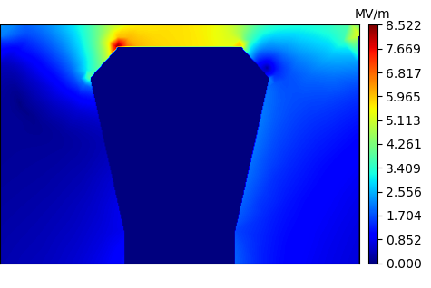


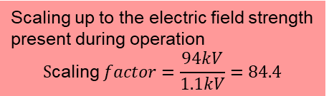



4. Optimizing the Cavity Design (risk of sparks)
At 1,5 GHz E_{D} ≥ 30 MV/m (Kilpatrick)
1,1 kV during simulation and 94 kV during operation.
Local Max E-Field:
$$\max\left\{\left|\vec{E}\right|\right\}=13.2 kV/m$$
Local Max E-Field:
$$\max\left\{\left|\vec{E}\right|\right\}=11.6 kV/m$$
⟹ 1.1 MV/m
⟹ 1 MV/m
CST MWS calculates the field strength of Eigenmodes for an Energy of 1 Joule. Therefore the field strength have to be scaled.
Global Max E-Field:
$$max⁡\{|\vec{E}|\}=\text{65.}\text{6 }kV/m$$
Scaling up to the electric field strength present during operation
$$\text{S}\text{caling} factor=\frac{94kV}{1.1kV}=84.4$$
⟹ maximum at the nose cones = 5.5 MV/m.
Fig. 6: Here one find a maximum field strength of 5.5 MV/m, that means we have a safety margin = 5 (Courtesy of M. Bousonville))
$$P_{in,avg}=0.5W$$
Local Max E-Field:
$$\max\left\{\left|\vec{E}\right|\right\}=8.5 kV/m$$
⟹ 0.72 MV/m
Boundary condition: smooth surfaces. Design-goal roughness depth < 1 𝜇m

Slide 8
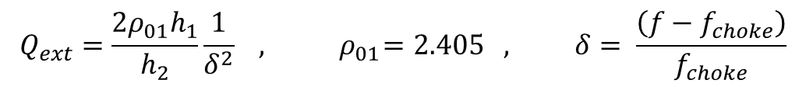
5. Power Load for the HOM-Damper
5.1 Power Load due to the power leakage of the fundamental mode
Power leakage is nearly zero if cavity body and choke are exactly tuned to the same frequency [2].
But during operation with beam a certain detuning of the cavity body up to 236 kHz is required.
Thus the detuning between caviy body and choke is 236 kHz.
Now the question is: How large is the power leakage?
h₂
h₁
$$Q_{ext}=\frac{2ρ_{01}h_{1}}{h_{2}}\frac{1}{δ^{2}} , { ρ}_{01}=2.405 , δ= \frac{\left(f−f_{choke}\right)}{f_{choke}}$$
Δf | h₁ | h₂ | Q_{ext} | Leakage power
236 kHz | 9.5 mm | 93.45∙10⁻³ m | Q_{ext}=19.800.000 | 2.5 W | Can be neglected
2 MHz | 9.5 mm | 93.45∙10⁻³ m | Q_{ext}=274.707 | 183 W
Tab. 7: Leakage power for two frequency diffrences between choke and cavity body
Fig. 7: The meaning of h₁ and h₂ (Coutesy of M. Schmidtke)

Slide 9
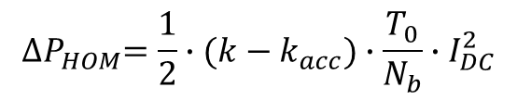
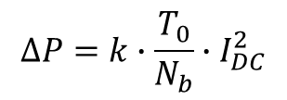
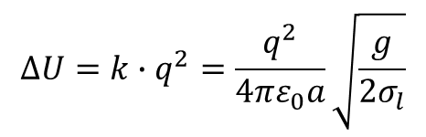
5. Power Load for the HOM-Damper
5.2 Power Load of the HOM-damper due to the HOM-power exclusively
Energy loss per bunch (B. Palmer 1989 [3]):
Tab. 8: Numbers needed for the loss factor calculations
Beampipe radius | a | 23 mm
Gap width | g | 93.4 mm
Overall loss factor (Timing Mode) | k (σ_{l}=19.3 mm) | 6.1∙10¹¹ V/As
Overall loss factor (Brilliant Mode) | k (σ_{l}=13.2 mm) | 7.4∙10¹¹ V/As
Loss factor fundamental | k_{acc} | 4.1∙10¹¹ V/As
$$∆U=k∙q^{2}=\frac{q^{2}}{4πε_{0}a}\sqrt{\frac{g}{2σ_{l}}}$$
Overall power loss:
$$∆P=k∙\frac{T_{0}}{N_{b}}∙I_{DC}^{2}$$
Operational Mode | Number of Bunches | Beam Current I_{DC} | Bunch Length (FWHM) σ_{l} | ΔP_{HOM}
Timing Mode | 80 | 80 mA | 19.3 mm | 62 W
 | 40 | 200 mA | 13.2 mm | 1270 W
Brilliant Mode | 480 | 200 mA | 13.2 mm | 106 W
 | 960 | 200 mA | 13.2 mm | 53 W
HOM power loss into the HOM-damper:
$${∆P}_{HOM}=\frac{1}{2}∙(k−k_{acc})∙\frac{T_{0}}{N_{b}}∙I_{DC}^{2}$$
Tab. 9: HOM power loss into the HOM damper in the different operational modes of PETRA IV

Slide 10
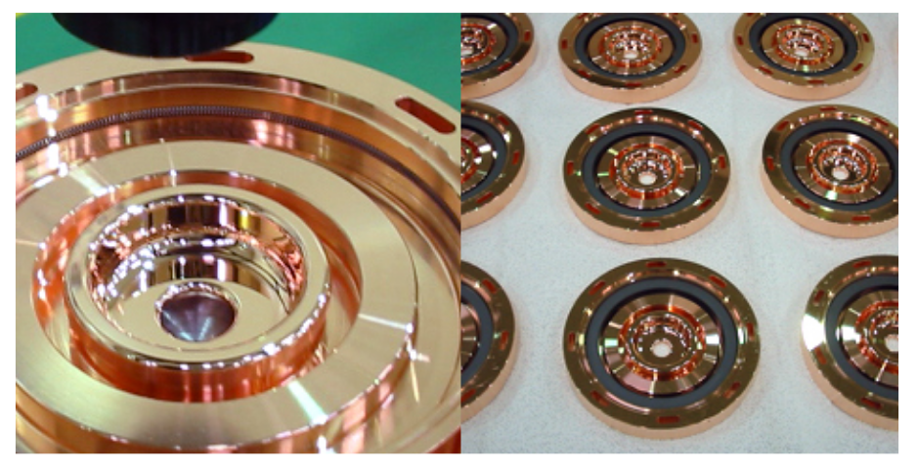
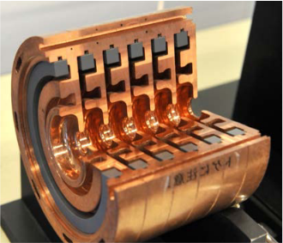
5. Power Load for the HOM-Damper
5.3 How to fix the SiC-ring to the copper structure
Due to the different thermal expansion of copper and SiC, the ring cannot be soldered in place, because it may become very hot. Therefore, the ring is fixed by a tungsten or stainless steel spring [4].
Maximum HOM-power to the SiC-ring: 110 W
Fig. 8: Example how to fix the siliconcarbide rings in the cavity. A tungsten spring in a groove fixes the rings in their position.
Picture: T. Iganaki, C. Kondo, H. Maesaka, T. Ohshima, Y. Otake, T. Sakurai, K. Shirasawa and T. Shintake: “High-gradient C-band linac for a compact x-ray free-electron laser facility”, Physical Review special topics-Accelerators and Beams, 17, 080702 (2014)

Slide 11
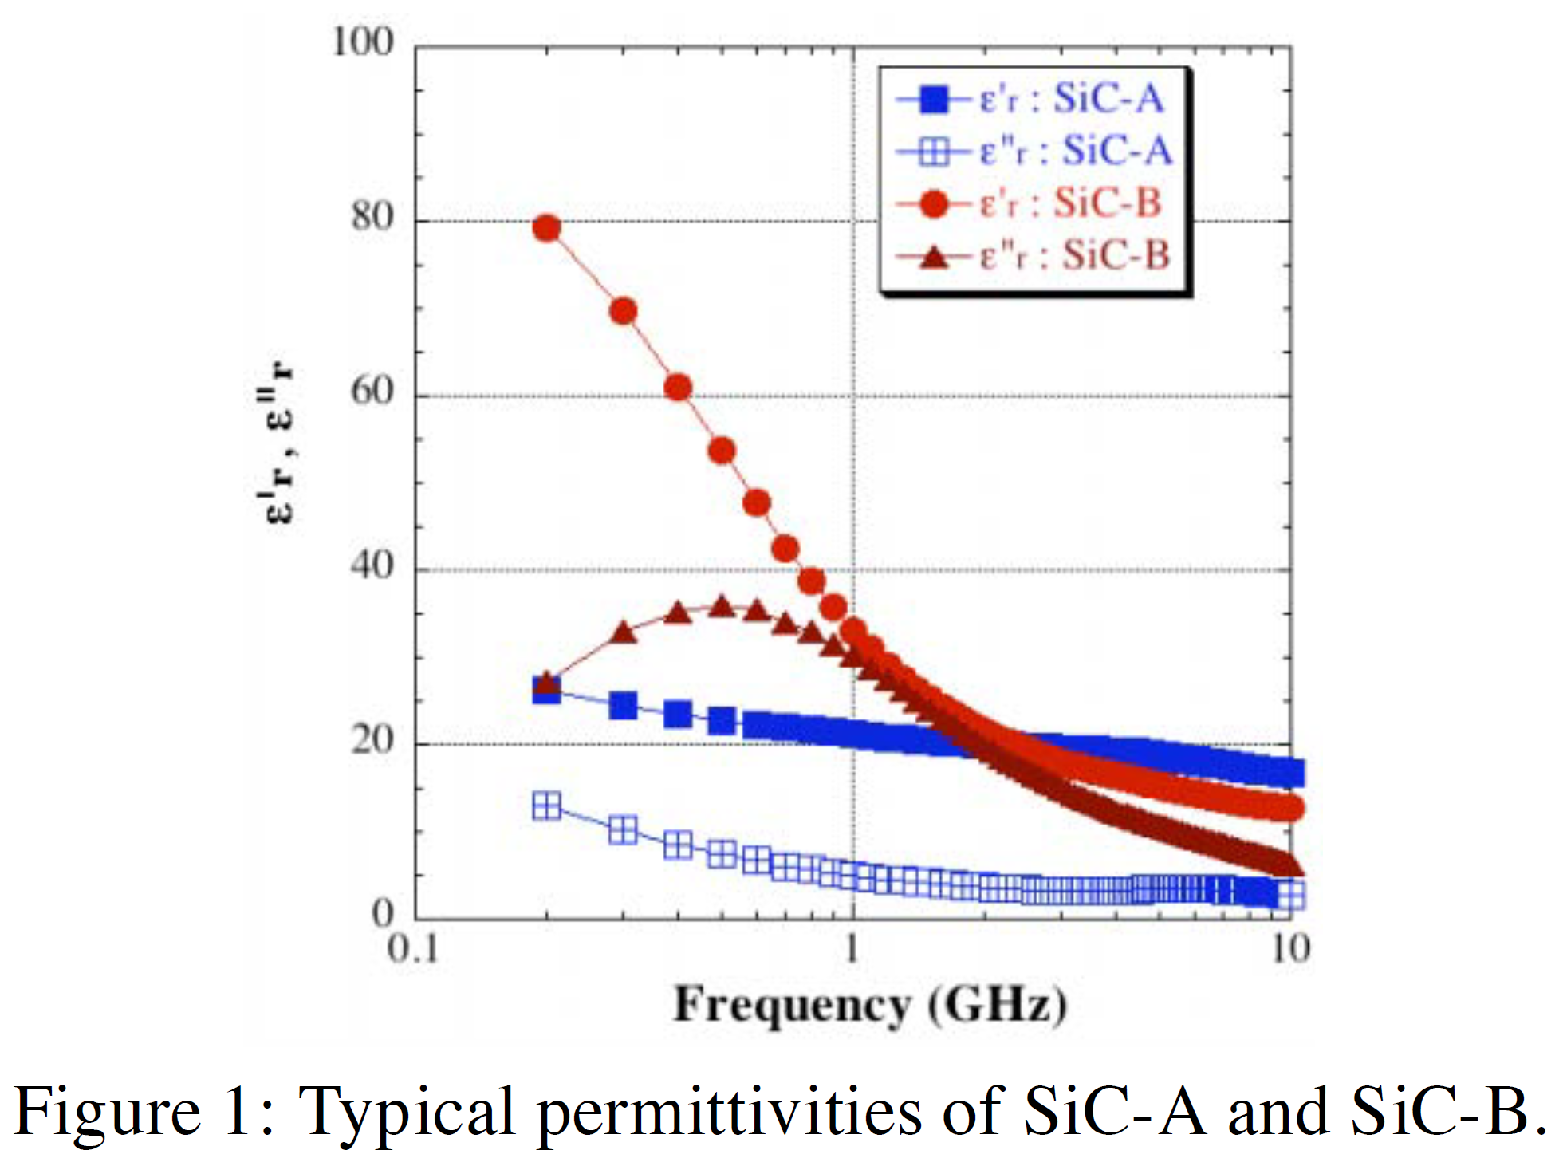
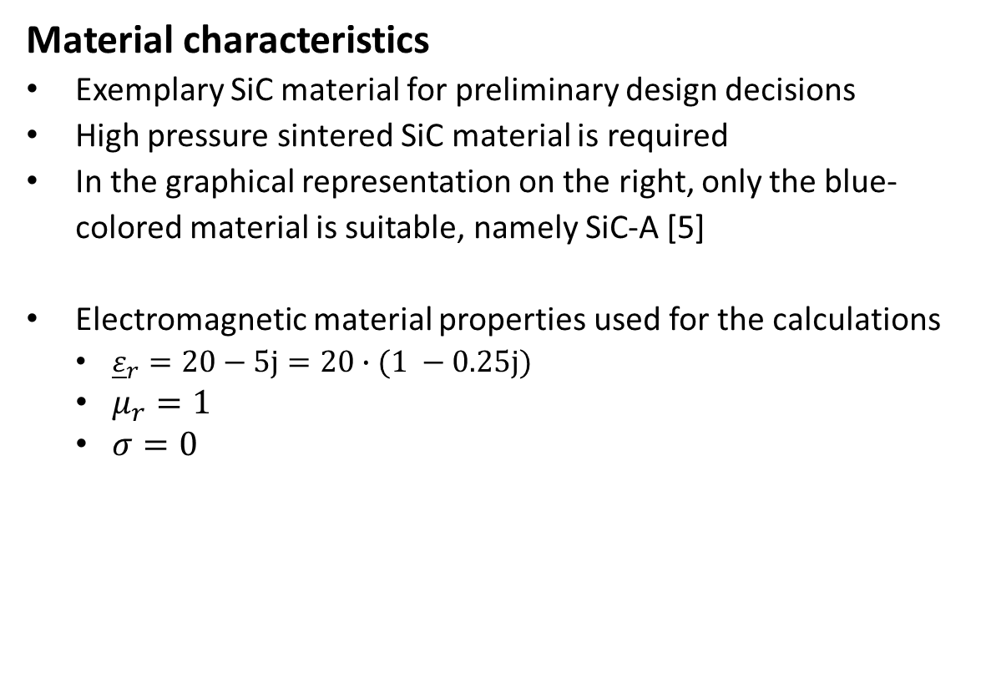
5. Simulation with SiC Material, properties
Material characteristics
Exemplary SiC material for preliminary design decisions
High pressure sintered SiC material is required
In the graphical representation on the right, only the blue-colored material is suitable, namely SiC-A [5]
Electromagnetic material properties used for the calculations
  ${\underline{ε}}_{r}=20−5j=20∙(1 −0.25j)$
  $μ_{r}=1$
  $σ=0$
Fig. 11: Typical permittivities of SiC-A and SiC-B [5]

Slide 12
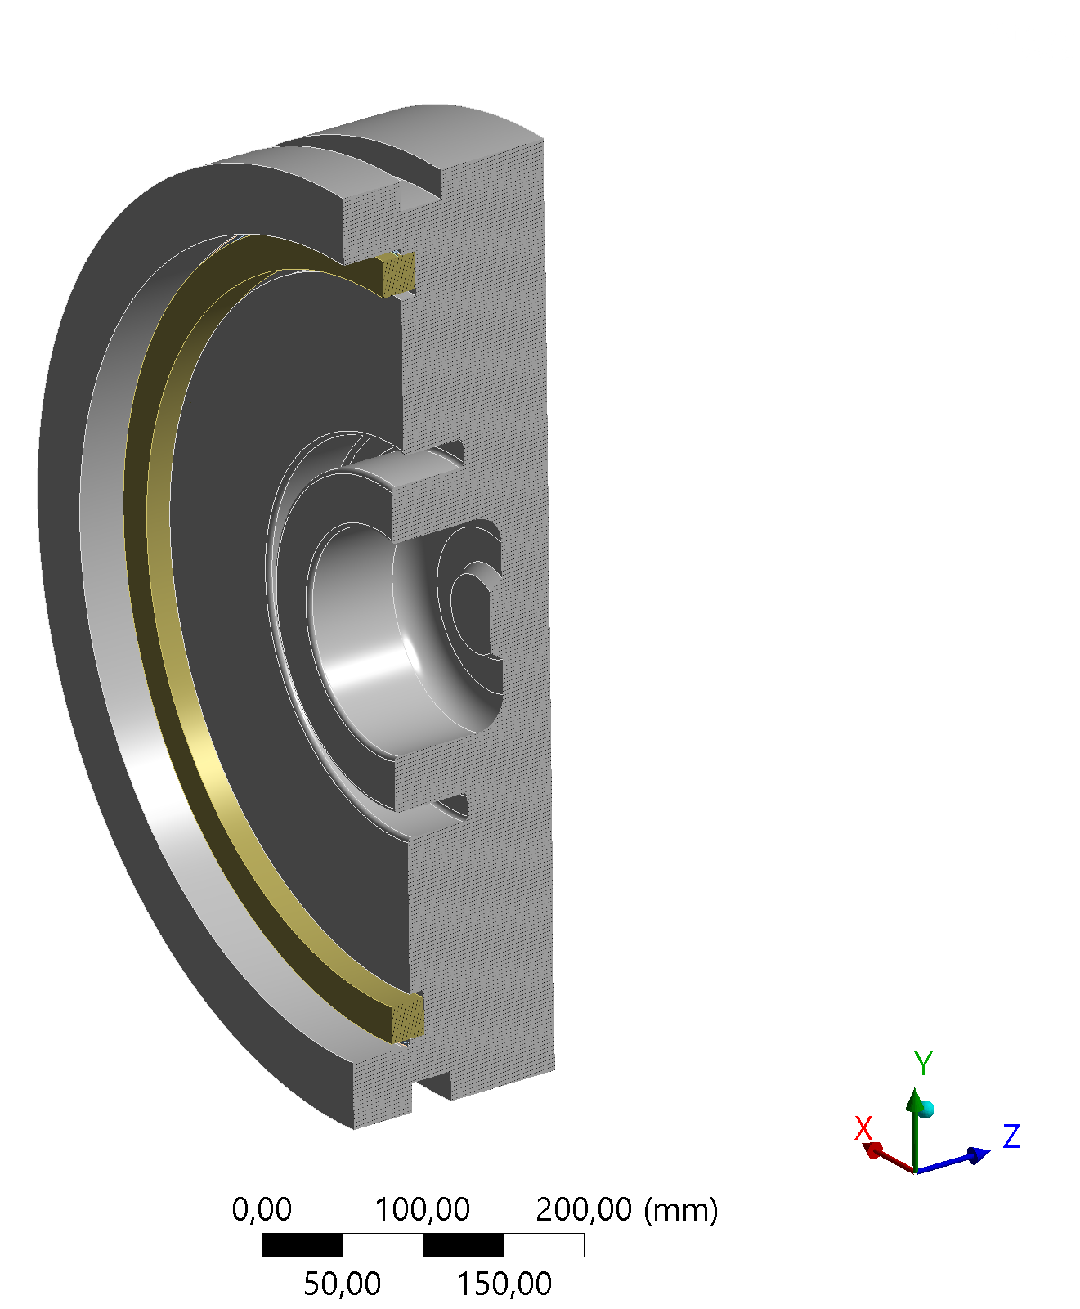
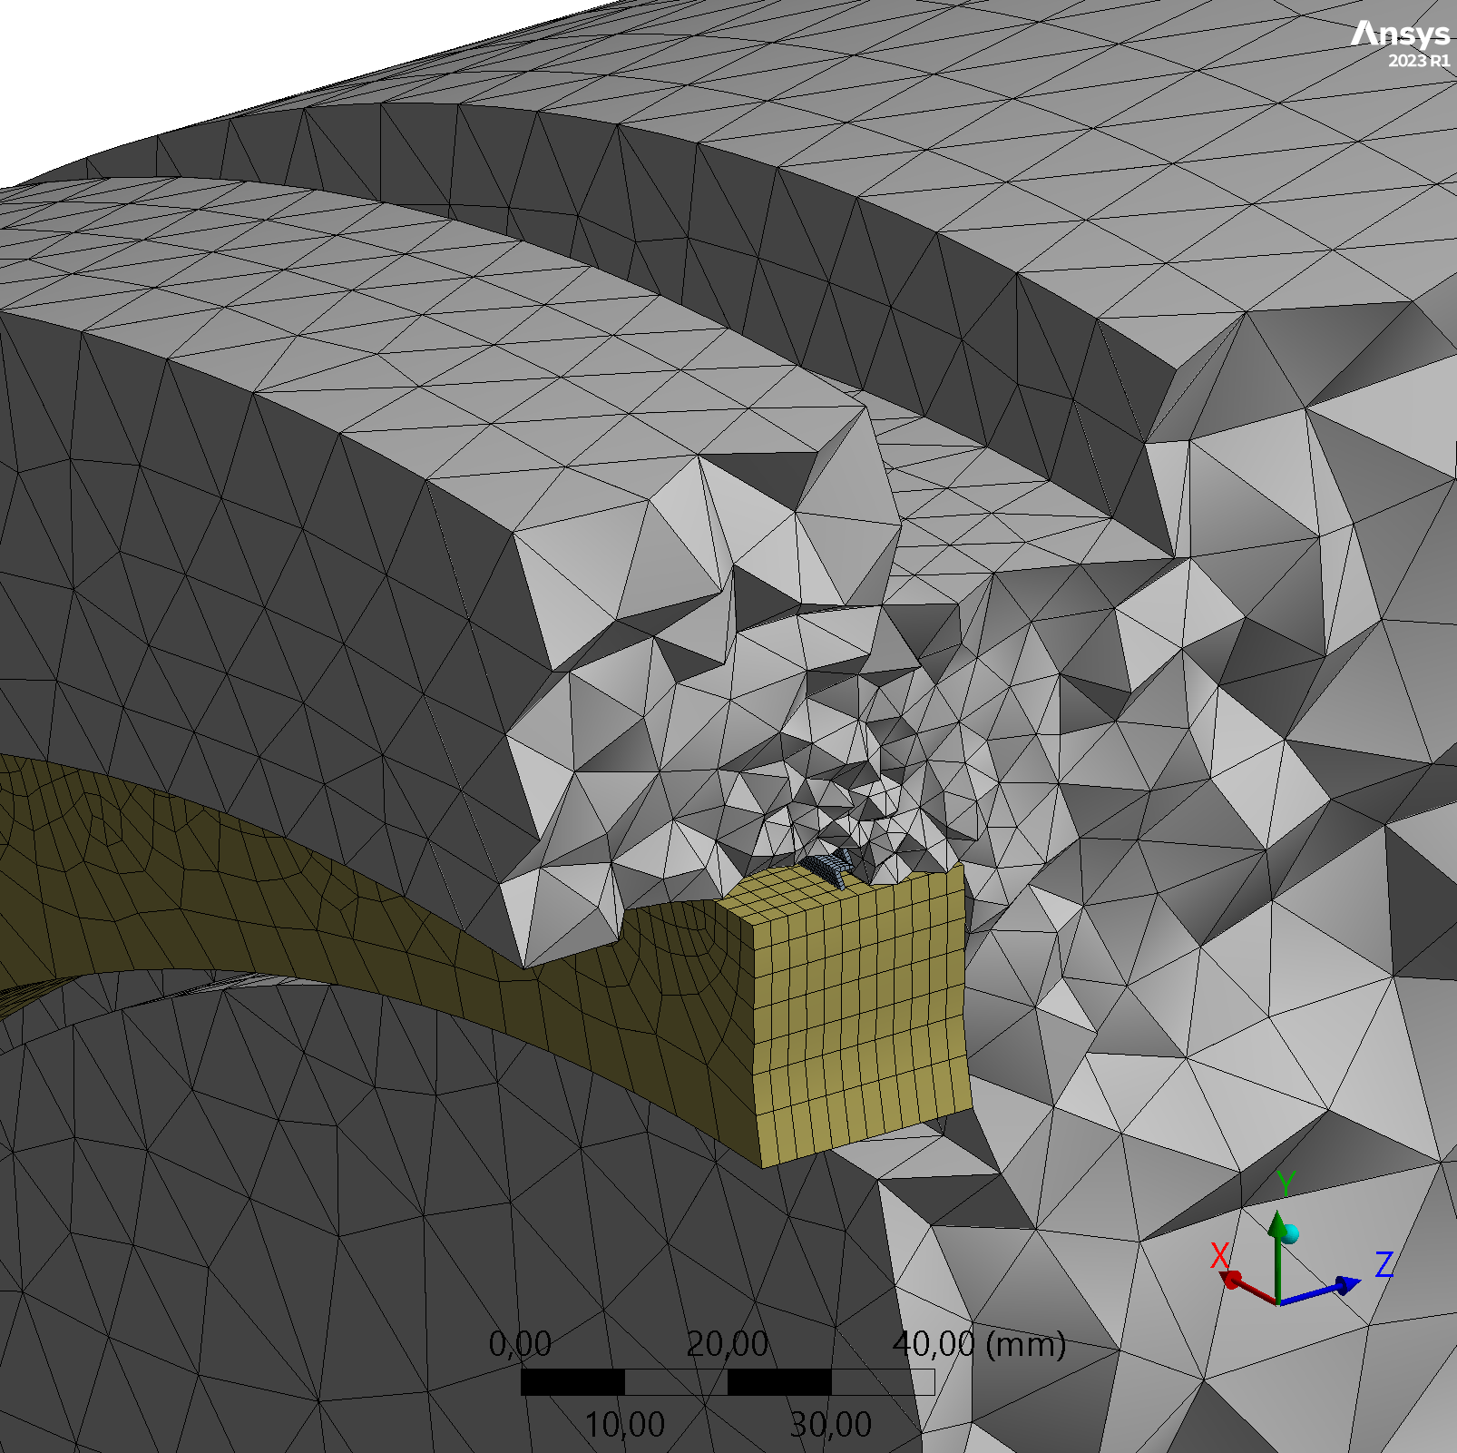
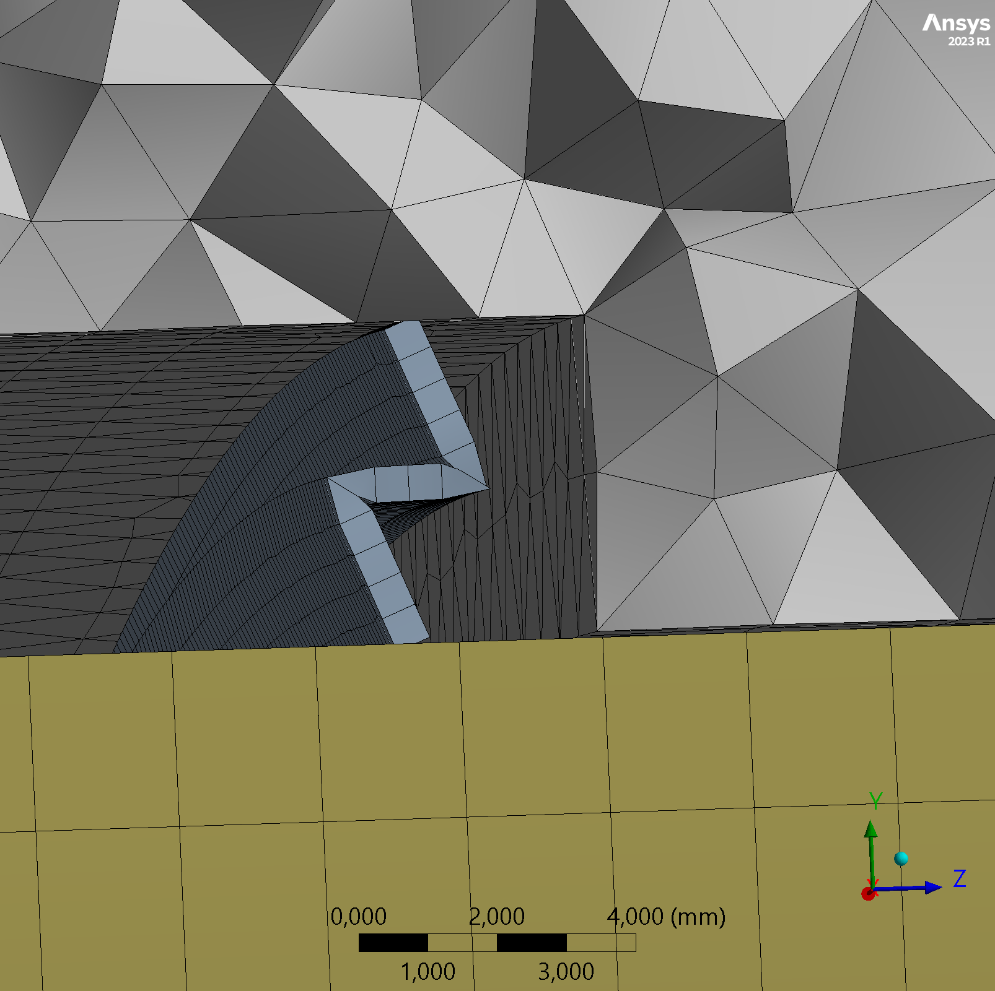
5. Power Load for the HOM-Damper
5.4 Final temperature of the SiC-ring at different HOM-power-loads
water cooling pipe
HOM damper ring
Fig. 9: Developement of absorber- and cavity temeperature for different power loads (Courtesy of M. Lembke, DESY)
choke
Heat contact tungsten spring
Fig. 8: The ANSYS-Model of the Shintake-Cavity with the SiC-ring, fixed by a tungsten spring (Courtesy of M. Lembke, DESY)
Fig. 10: Most of the heat is radiated into the environment, heat conduction can be neglected (Courtesy of M. Lembke, DESY)

Slide 13
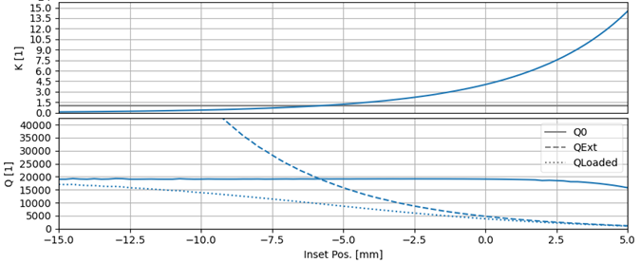
6. High power coupler for the choke mode cavity
β(l)
5
0.5
-10 mm
0.88 mm
Fig. 9: Input coupler inset position (Courtesy of S. Karau, DESY)

Slide 14
6. Conclusions and outlook
CAD model not completely finished.
Adjustable coupling factor seemed to be possible, 0 ≤ β ≤ 5
Tuning from -300 kHz up to 300 kHz is possible without tuning the choke. The power leakage of the fundamental can be neglected
Maximum field strength in the cavity during operation is 5,5 MV/m ( > 30 MV/m would be possible, safety factor is 5,5)
The highest possible HOM-power to the HOM-Load is 110 W leading to a SiC-ring-temperature of 230°C
The manufacturing costs for the shintake cavity are about 39% of the manufacturing costs for the ALBA cavity
Next steps
A cavity prototype will be build as soon as possible.
The most suitable SiC is sought, probes have to be ordered.

Slide 15
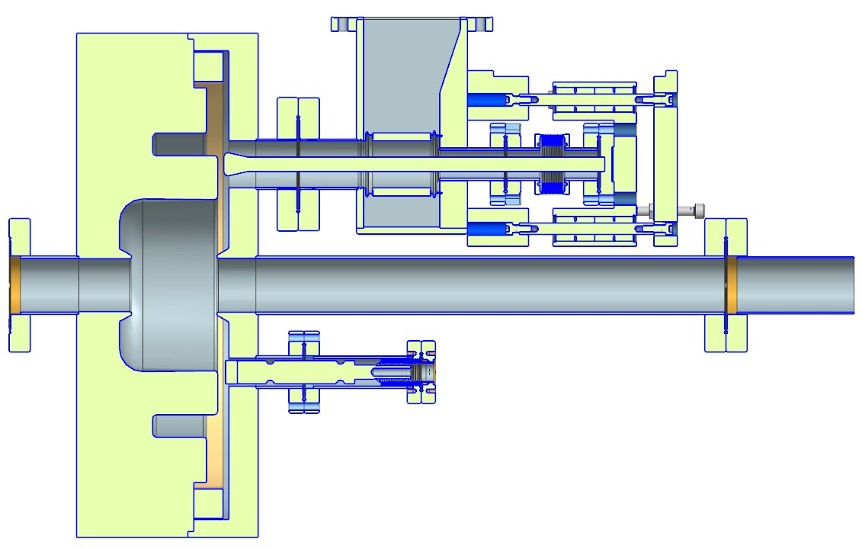
Thank you
Literature
[1] R. M. Sundelin, J. L. Kirchgessner, and M. Tigner, “Parallel Coupled Structure,” IEEE Trans. on Nuc. Science, Vol. NS- 24, No.3, June 1977, pp.1686-1688
[2] Tsumoru Shintake: „ The Choke Mode Cavity“, 1992 Jpn. J. Appl. Phys. 31 L1567
[3] R. B. Palmer: “A Qualitative Study of Wake Fields for Very Short Bunches”, Particle Accelerators, 1990, Vol. 25, pp. 97-106
[4] T. Iganaki, C. Kondo, H. Maesaka, T. Ohshima, Y. Otake, T. Sakurai, K. Shirasawa and T. Shintake: “High-gradient C- band linac for a compact x-ray free-electron laser facility”, Physical Review special topics-Accelerators and Beams, 17, 080702 (2014)
[5] Y. Takeuchi et al, “RF Dielectric Properties of SiC Ceramics and their Application to Design of HOM Absorbers”, KEK, 2005
[6] T. Pieloni and R. Zennaro, “Absorbers Materials for HOM Damping in CLIC PETS and Accelerating Structures” , CERN, 2009

Slide 16

Hilmar
Bienert
Martin Lembke
Michéle Schmidke
Michael Bousonville
Nils Oliver Fröhlich
Silke Vilcins
Much thanks to
Simon Karau
Rüdiger Onken
Peter Hülsmann

Slide 17
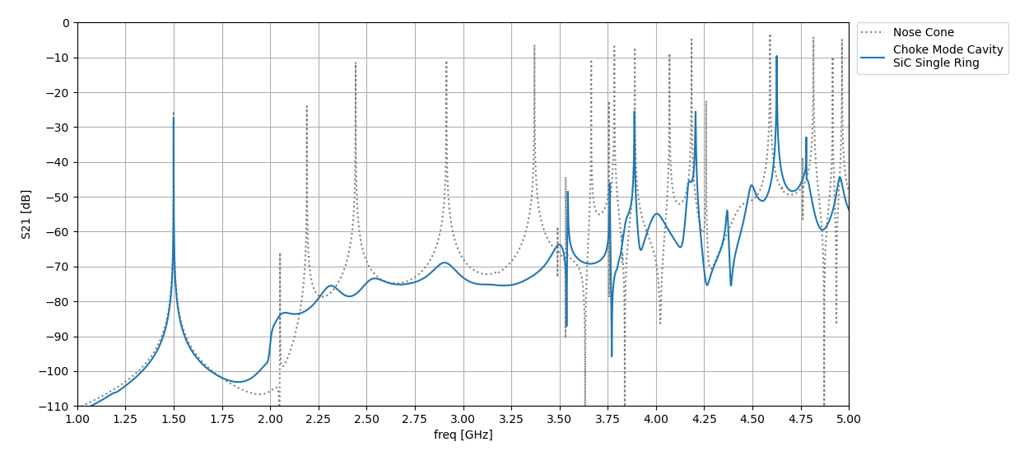
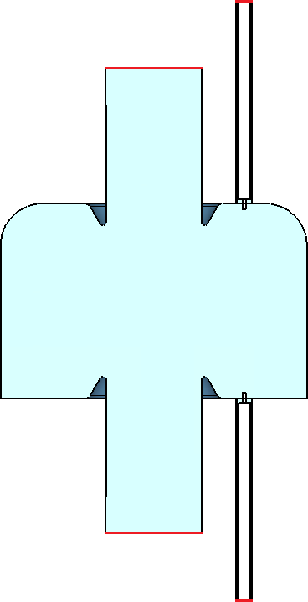
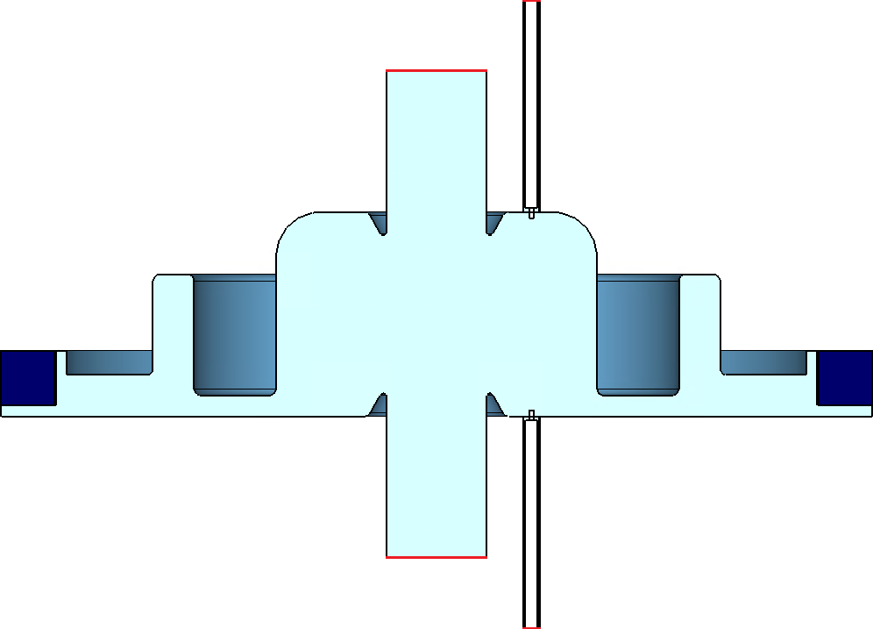
4. HOM-Damping Capabilities with one SiC-Ring
TM-310
TM-311
TM-212
TM-210
TM-212*
TM-410
TM-212*
TM-022*
TM-110
TM-111
TM-020*
TM-021
TM-311
TM-010
TM-011
TE-121**
TE-312
TM-310
Port2
Port4
TM-020*
TE-111
Port3
Port2
Undamped cavity
Port4
Port1
Port3
Port1
HOM damped cavity
The pictures are provided with kind permission of Simon Karau (DESY MHF)

