Slide 1
Notes:
Slide 1: Company Logo Full Page
Before you start editing the slides of your talk change to the Master Slide view:
Microsoft Office :Menu: View > Slide Master;
Macintosh – View > Master > Slide Master
Edit the following items:
On the Slide Master (first master slide) – lower area
a) On the left Delete the text and write the title of the event/Conference, Location
b) On the right delete the text and write the name and surname of the speaker and the date (day, month , year)
Close Master View

Slide 2
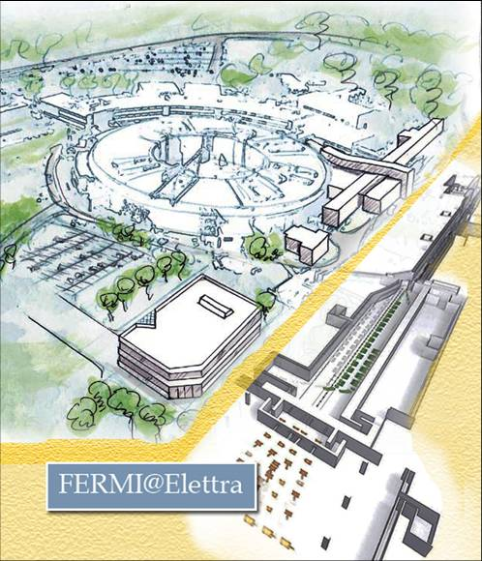

Fabrication & Commissioning of 1st HG Module
Nuaman Shafqat
on behalf of
FERMI Team
Notes:
Slide 2: Title of the Presentation
Before you start editing the slides of your talk change to the Master Slide view:
Microsoft Office :Menu: View > Slide Master;
Macintosh – View > Master > Slide Master
Edit the following items:
On the Slide Master (first master slide) – lower area
a) On the left Delete the text and write the title of the event/Conference, Location
b) On the right delete the text and write the name and surname of the speaker and the date (day, month , year)
Close Master View
To start adding slides insert a new slide and select a Layout:
For Title & Subtitle
For text with bullet points
For Text
For Picture, graphs, visuals
Two columns
Blank

Slide 3
Layout
FERMI Upgrade
  Beam energy upgrade
  Beam quality upgrade
FERMI linac
High Gradient module
  RF design
  Fabrication & testing of short prototype
  Fabrication & testing of full HG module
  Installation of the HG module at FERMI linac
Spherical Pulse Compressor
  RF design
  Fabrication and testing
Summary and conclusions
https://www.elettra.eu/images/Documents/FERMI%20Machine/Machine/CDR/FERMI2.0CDR.pdf.
Notes:
Slide 3 – (..) : Content of the presentation
Insert a new slide: Home > “New Slide” and choose a slide Layout:
For Title & Subtitle
For text with bullet points
For Text
For Picture, graphs, visuals
Two columns
Blank
If you want Copy & paste an element from the Clip Board to the particular slide:
1. Click on a box to mark it.
2. Position the mouse pointer on the box frame: Copy!
3. Click on the particular slide: Paste!
How you intend to use the elements is your choice.
You can combine the text block style with the background colour in different manner.

Slide 4
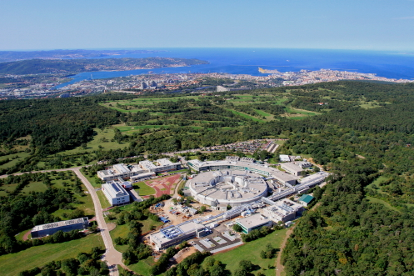
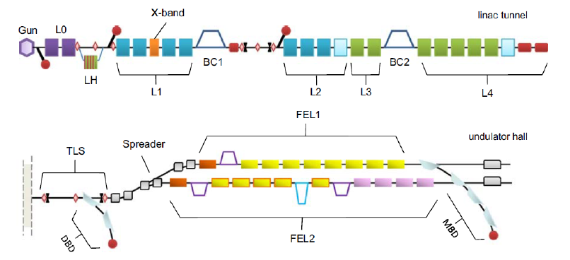
The FERMI FEL
The FERMI linac-based FEL at the Elettra Laboratory (Trieste, IT) is an international user facility for scientific investigations in material science.
The electron bunches are produced in a laser-driven photo-injector and accelerated, with a 3-GHz, normal conducting Linac, to energies up to 1.5 GeV,
The FERMI facility comprises two separate coherent radiation sources, FEL-1 and FEL-2.
FEL-1 operates in the wavelength range between 100 and 20 nm via a single cascade harmonic generation, while the FEL-2 is designed to operate at shorter wavelengths (20-4 nm) via a double cascade mechanism.
Notes:
Slide 3 – (..) : Content of the presentation
Insert a new slide: Home > “New Slide” and choose a slide Layout:
For Title & Subtitle
For text with bullet points
For Text
For Picture, graphs, visuals
Two columns
Blank
If you want Copy & paste an element from the Clip Board to the particular slide:
1. Click on a box to mark it.
2. Position the mouse pointer on the box frame: Copy!
3. Click on the particular slide: Paste!
How you intend to use the elements is your choice.
You can combine the text block style with the background colour in different manner.

Slide 5
The FERMI Linac (Present)
The FERMI Linac is a S-Band (3 GHz), 1.5 GeV normal conducting, linear accelerator.
K1
K2
K3
K4
K5
K6
K7
K8
K9
K10
K11
K12
K13
K14
K15
BC1
BC2
Gun
L0
LH
L1
L2
L3
L4
Injector:
1 S-Band, RF Gun
2 S-Band, Forward TW structures
Linac 1 & Linac 2
8 S-Band, Forward TW Structures
1 X-Band, Linearizer
Linac 3 & Linac 4
7 S-Band, Backward TW Structures
1 S-Band, Forward TW structure
Power Sources: 45 MW peak power, 4.5 μs pulse width, Klystron
Linac 1 & Linac 2: one klystron feeds two FTW accelerating structures
Linac 3 & Linac 4: one klystron feed one BTW accelerating structure
Notes:
Slide 3 – (..) : Content of the presentation
Insert a new slide: Home > “New Slide” and choose a slide Layout:
For Title & Subtitle
For text with bullet points
For Text
For Picture, graphs, visuals
Two columns
Blank
If you want Copy & paste an element from the Clip Board to the particular slide:
1. Click on a box to mark it.
2. Position the mouse pointer on the box frame: Copy!
3. Click on the particular slide: Paste!
How you intend to use the elements is your choice.
You can combine the text block style with the background colour in different manner.

Slide 6
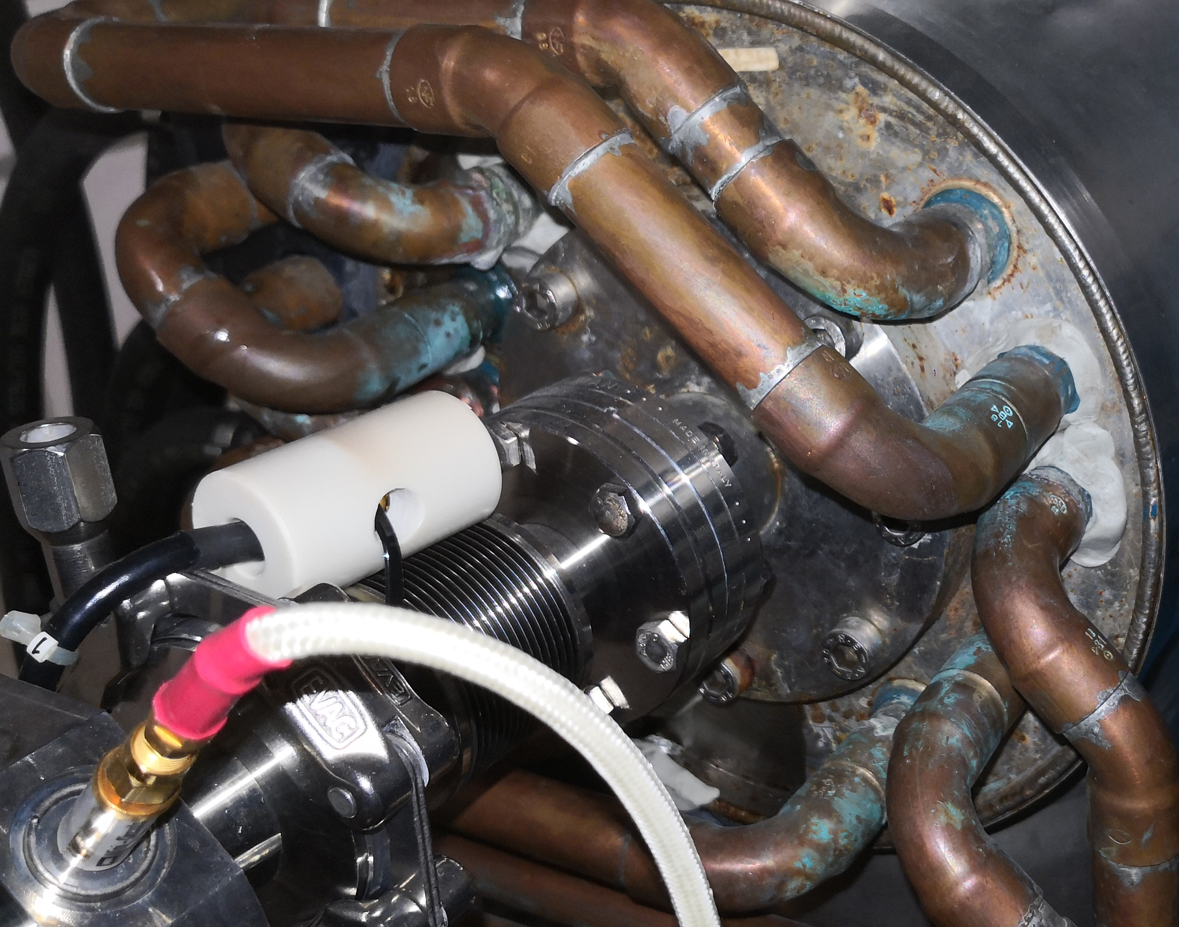
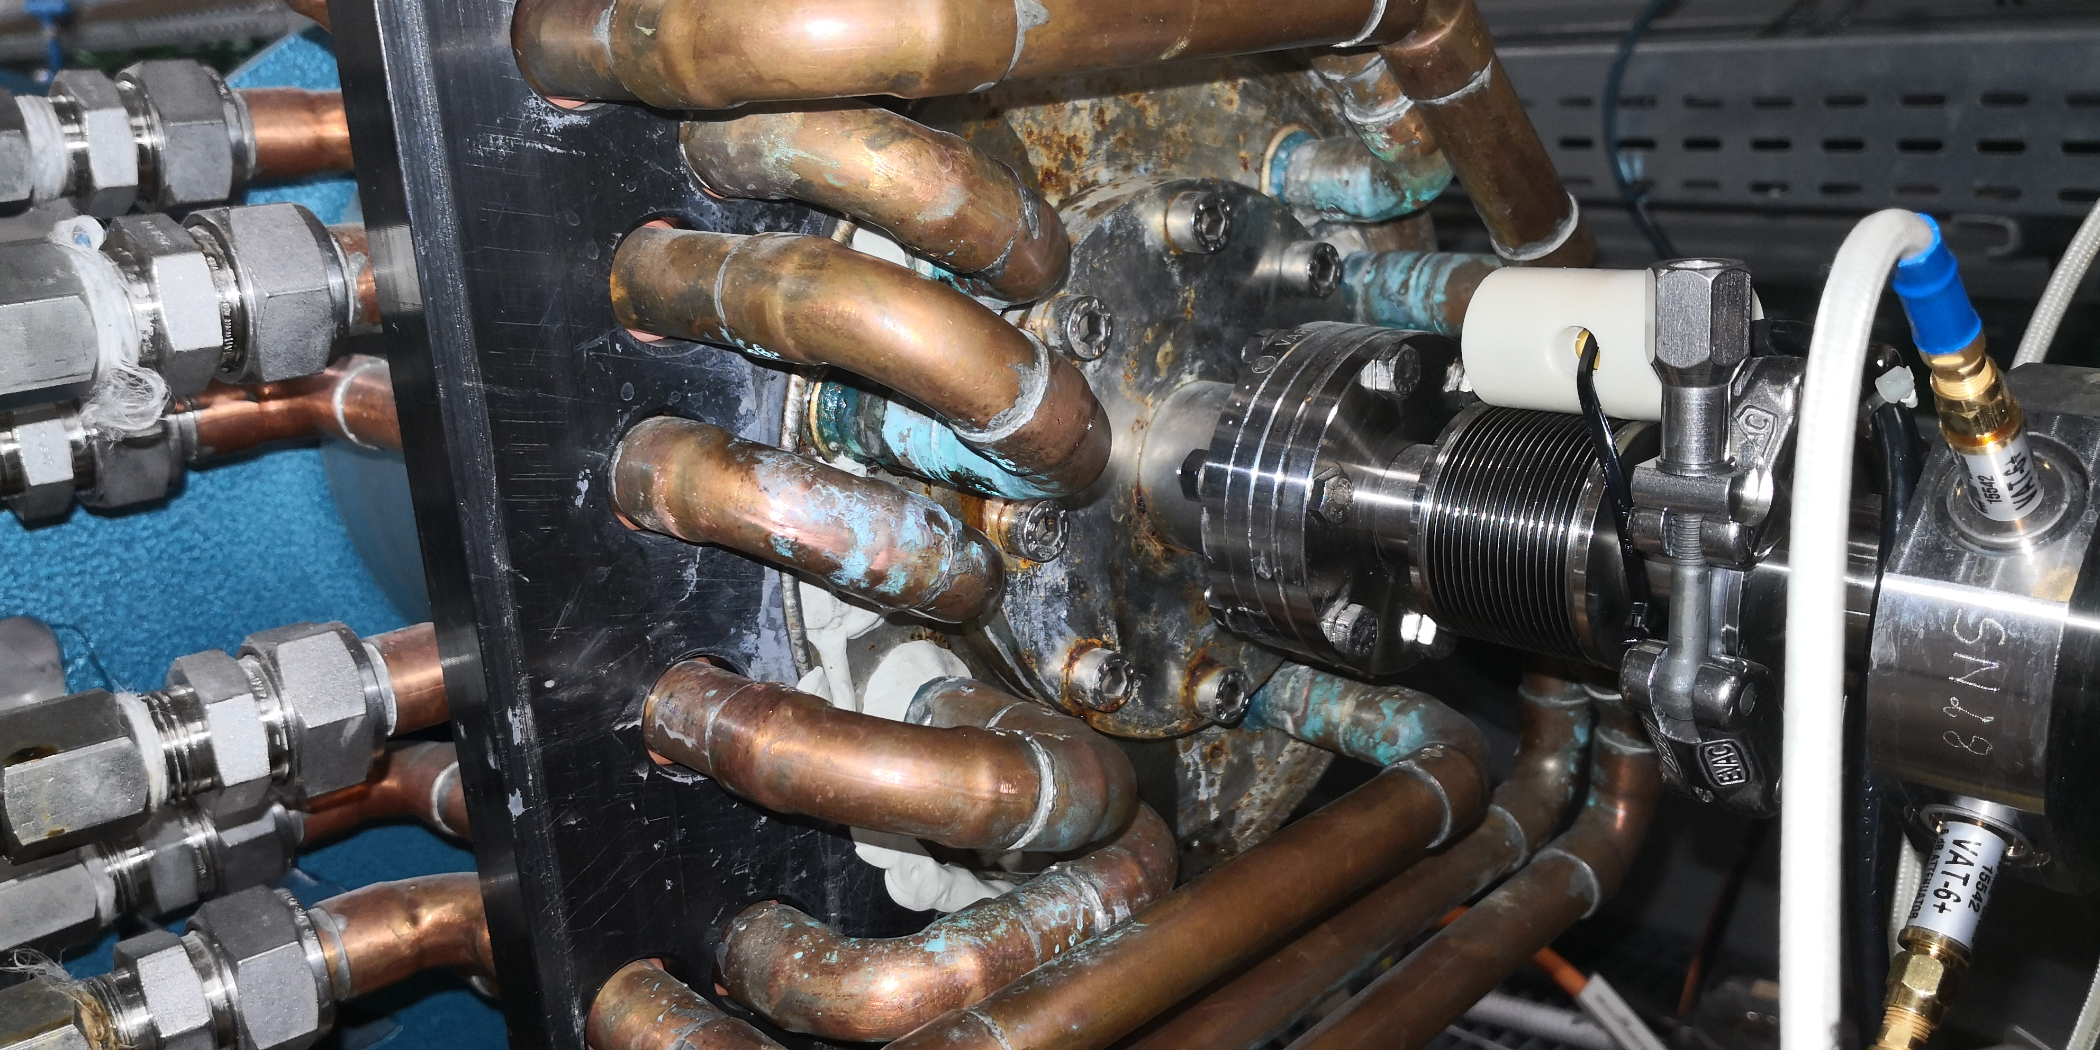
The FERMI Linac (Present)
Acc. Sections Type
CERN Sections
Developed as injector of LEP Injector Linac (LIL) in 1984
One 45 MW klystron feeds two 4,5 m CERN sections.
Accelerating gradient is 12,6 MV/m.
Arcing Issue
Klystron
S0a and S0b Sections
Came from the old Elettra injector.
One 45 MW klystron feeds two 3,2 m S sections.
Accelerating gradient is 15,0 MV/m.
SLED
Rusting Issue
BTW Structure
 | CERN sections | S0A-S0B | BTW sections
Mode | TW 2π/3 | TW 2π/3 | TW 2π/3
Frequency (MHZ) | 2998,01 | 2998,01 | 2998,01
Length (m) | 4,5 | 3,2 | 6,15
Filling time (µs) | 1,5 | 0,903 | 0,757
Attenuation (Np) | 0,7 | 0,603 | 0,611
Acc. Gradient (MV/m) | 12,6 | 15,0 | 18,0
Energy gain (MeV) | 56,7 | 48 | 120
BTW Sections
Came from old Elettra injector
Each BTW section is fed by 45 MW klystron followed by SLED.
Limited to 18,0 MV/m at 50 Hz due to breakdowns
In order to reach a beam energy of 2.0 GeV, all the BTW structures and the CERN sections will be pushed to higher gradient of 30 MV/m
Notes:
Slide 3 – (..) : Content of the presentation
Insert a new slide: Home > “New Slide” and choose a slide Layout:
For Title & Subtitle
For text with bullet points
For Text
For Picture, graphs, visuals
Two columns
Blank
If you want Copy & paste an element from the Clip Board to the particular slide:
1. Click on a box to mark it.
2. Position the mouse pointer on the box frame: Copy!
3. Click on the particular slide: Paste!
How you intend to use the elements is your choice.
You can combine the text block style with the background colour in different manner.

Slide 7
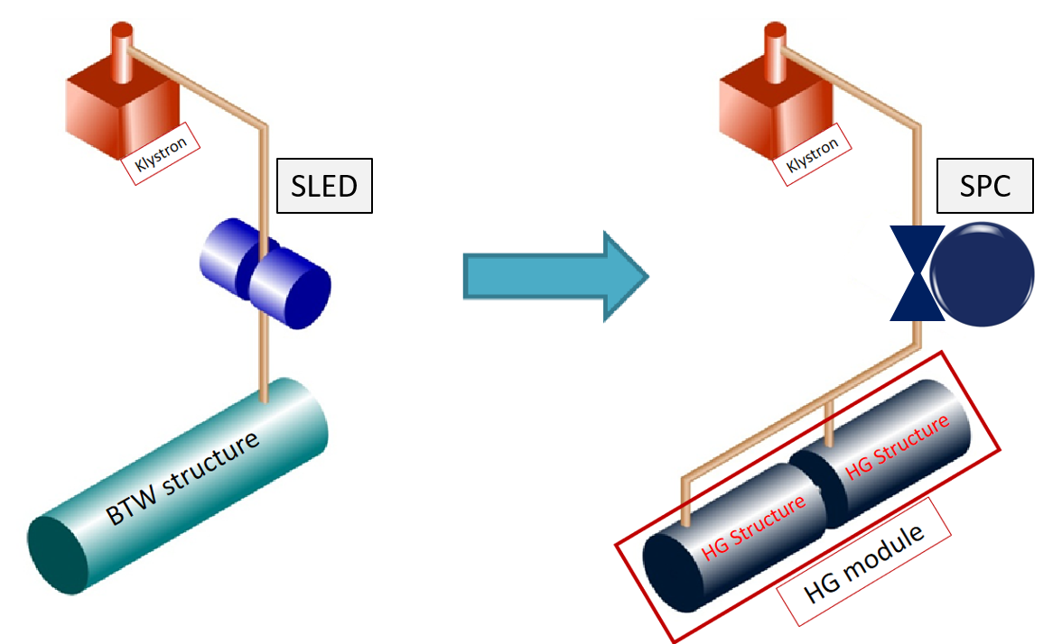
The FERMI Upgrade Proposal
TO EXTEND THE RANGE TO SHORTHER WAVELENGTH UP TO 2 nm
Actual Linac Energy
1.5 GeV @ 10Hz
Target Linac Energy
2.0 GeV @ 50Hz
Solution
High Gradient 30MV/m
K1
K2
K3
K4
K5
K6
K7
K8
K9
K10
K11
K12
K13
K14
K15
BC1
BC2
Gun
L0
LH
L1
L2
L3
L4
Replace 12 acc. sections + one deflector with 10 HG modules
Energy budget of the upgraded linac
Total Energy (MeV) = 2xRI + 4xCERN + 20xHG
Total Energy (MeV) = 2x50MeV + 4x57Mev + 20x90MeV
Total Energy (MeV) = 2128
It means we can operate HG sections at 28 MV/m
Notes:
Slide 3 – (..) : Content of the presentation
Insert a new slide: Home > “New Slide” and choose a slide Layout:
For Title & Subtitle
For text with bullet points
For Text
For Picture, graphs, visuals
Two columns
Blank
If you want Copy & paste an element from the Clip Board to the particular slide:
1. Click on a box to mark it.
2. Position the mouse pointer on the box frame: Copy!
3. Click on the particular slide: Paste!
How you intend to use the elements is your choice.
You can combine the text block style with the background colour in different manner.

Slide 8
The FERMI Upgrade Proposal
TO EXTEND THE RANGE TO SHORTHER WAVELENGTH UP TO 2 nm
Actual Linac Energy
1.5 GeV @ 10Hz
Target Linac Energy
2.0 GeV @ 50Hz
Solution
High Gradient 30MV/m
K1
K2
K3
K4
K5
K6
K7
K8
K9
K10
K11
K12
K13
K14
K15
K16
BC1
BC2
Gun
L0
LH
L1
L2
L3
L4
Replace 12 acc. sections + one deflector with 10 HG modules
Energy budget of the upgraded linac
Total Energy (MeV) = 2xRI + 4xCERN + 20xHG
Total Energy (MeV) = 2x50MeV + 4x57Mev + 20x90MeV
Total Energy (MeV) = 2128
It means we can operate HG sections at 28 MV/m
Notes:
Slide 3 – (..) : Content of the presentation
Insert a new slide: Home > “New Slide” and choose a slide Layout:
For Title & Subtitle
For text with bullet points
For Text
For Picture, graphs, visuals
Two columns
Blank
If you want Copy & paste an element from the Clip Board to the particular slide:
1. Click on a box to mark it.
2. Position the mouse pointer on the box frame: Copy!
3. Click on the particular slide: Paste!
How you intend to use the elements is your choice.
You can combine the text block style with the background colour in different manner.

Slide 9
The FERMI FEL Upgrade Plan
Beam Energy Upgrade
To reduce pulse duration to the sub-10 fs range to resolve charge transfer processes, bond dynamics, vibrational dynamics
To extend photon energy range to N (410 eV), O (543 eV) which translates to the extension of operating of FERMI to ~2 nm.
Present
K6
K7
K8
K09
K10
K11
K12
K13
K14
K15
C5
C6
C7
Soa
BTW1
BTW2
BTW3
BTW4
BTW5
BTW6
BTW7
Sob
Energy (MeV) 550
Backward Travelling Wave Structures (BTWs)
1543 MeV @ 10 Hz
Sep. 2022
K6
K7
K8
K09
K10
K11
K12
K13
K14
K15
K16
C5
C6
C7
Soa
BTW1
BTW2
BTW3
BTW4
BTW5
BTW6
BTW7
CERN Sections
Backward Travelling Wave Structures (BTWs)
HG
1670 MeV @ 10 Hz
Final Plan
K6
K7
K8
K09
K10
K11
K12
K13
K14
K15
K16
High Gradient Structures (HG)
2000 MeV @ 50 Hz
L. Giannessi., “FERMI Upgrade Perspectives” , in FUture of Seeded free Electron lasers. (FUSEE), Trieste, Italy, 10 Nov. 2019
Notes:
Slide 3 – (..) : Content of the presentation
Insert a new slide: Home > “New Slide” and choose a slide Layout:
For Title & Subtitle
For text with bullet points
For Text
For Picture, graphs, visuals
Two columns
Blank
If you want Copy & paste an element from the Clip Board to the particular slide:
1. Click on a box to mark it.
2. Position the mouse pointer on the box frame: Copy!
3. Click on the particular slide: Paste!
How you intend to use the elements is your choice.
You can combine the text block style with the background colour in different manner.

Slide 10
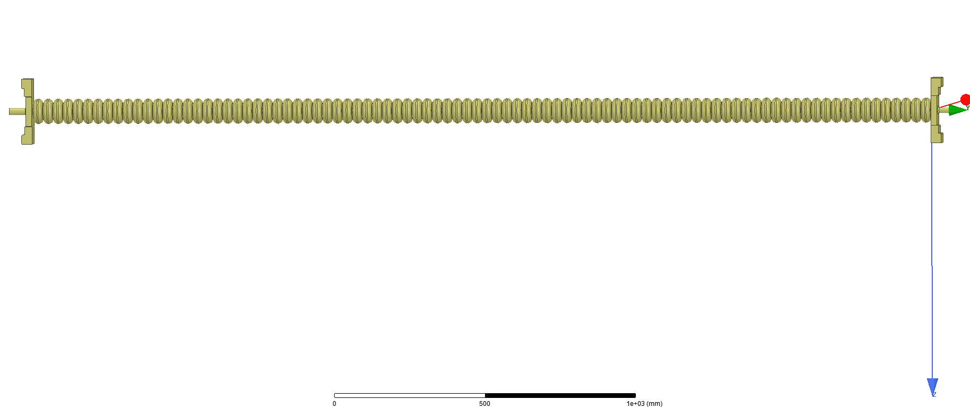
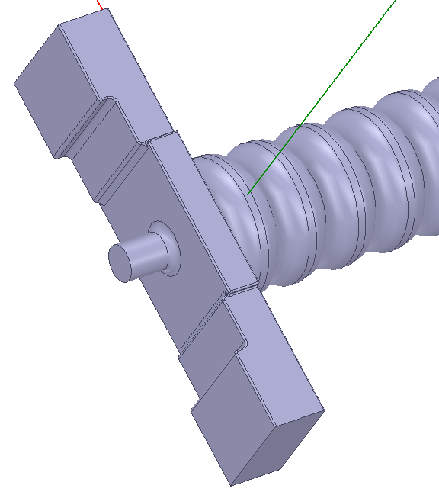
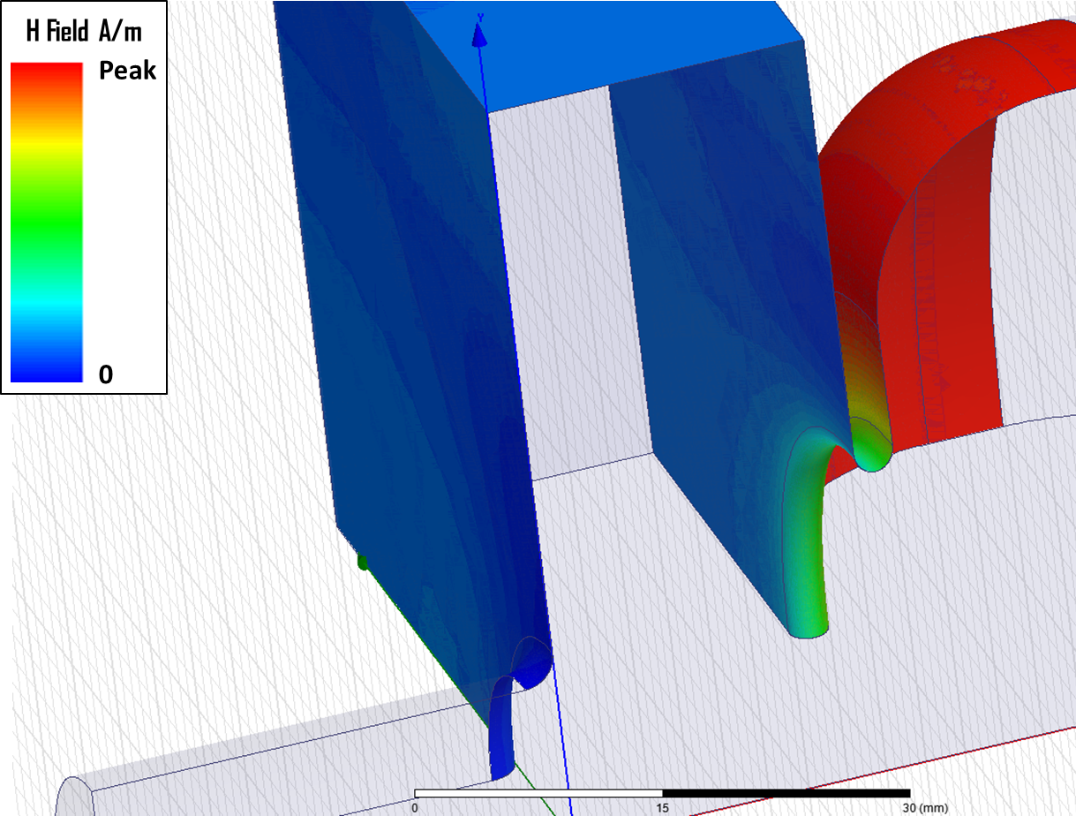
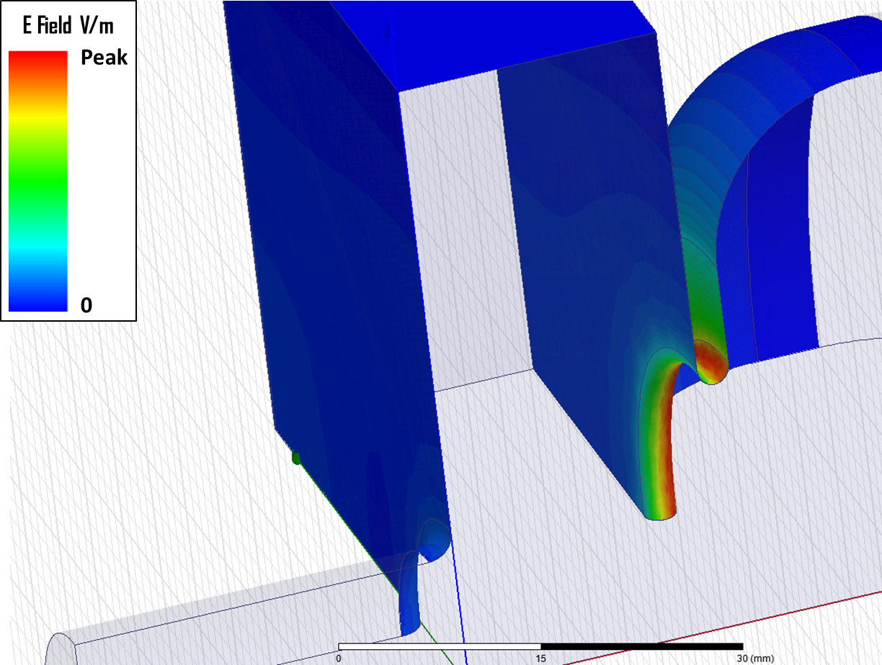
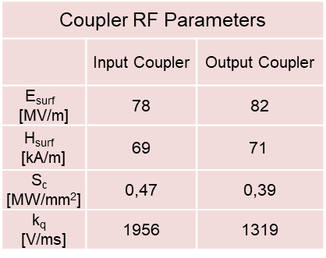
New Accelerating Module
RF design
The new accelerating module will be comprised of 3.0 m long, constant gradient type structures. Double rounding is introduced to reduce Ohmic losses and increase Q
A customized version of dual-fed-electric coupled (EC) coupler is chosen for the new high gradient (HG) structures
  Very low surface magnetic field
  Easy to machine
  Reduced cost of fabrication
Structure RF Parameters
L | 2988.3 | mm
N_{cell} | 84
a | 11.13 → 8.8 | mm
R_{sh} | 72.07 → 80.70 | MΩ/m
Q₀ | 15850
Filling Time | 644.8 | ns
Attenuation | 0.383 | Neper
Coupler RF Parameters
 | Input Coupler | Output Coupler
E_{surf} [MV/m] | 78 | 82
H_{surf} [kA/m] | 69 | 71
S_{c} [MW/mm²] | 0,47 | 0,39
k_{q} [V/ms] | 1956 | 1319
H_{surf max} = 78 kA/m
E_{surf max} = 81 MV/m
S_{c max} = 0.57 W/μm²
RF design was concluded in August 2019
C. Serpico, N. Shafqat, A. Grudiev, and R. Vescovo, “High gradient high reliability, and low wakefields accelerating structures for the FERMI FEL”, Review of Scientific Instruments, vol. 88, p. 073303, 2017
Notes:
Slide 3 – (..) : Content of the presentation
Insert a new slide: Home > “New Slide” and choose a slide Layout:
For Title & Subtitle
For text with bullet points
For Text
For Picture, graphs, visuals
Two columns
Blank
If you want Copy & paste an element from the Clip Board to the particular slide:
1. Click on a box to mark it.
2. Position the mouse pointer on the box frame: Copy!
3. Click on the particular slide: Paste!
How you intend to use the elements is your choice.
You can combine the text block style with the background colour in different manner.

Slide 11
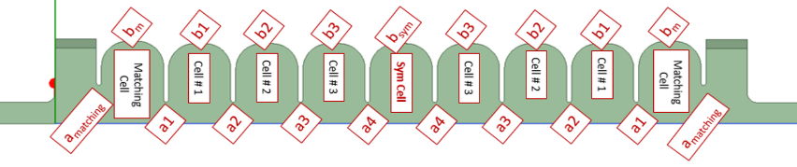
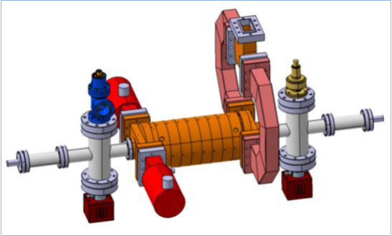
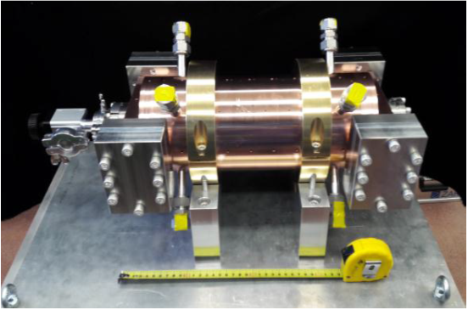
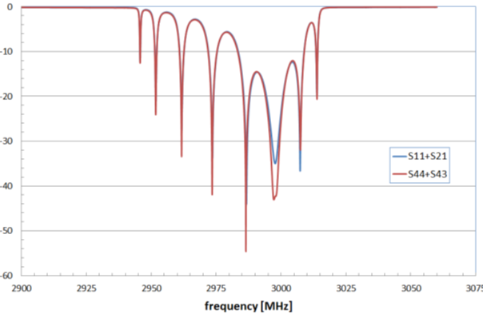
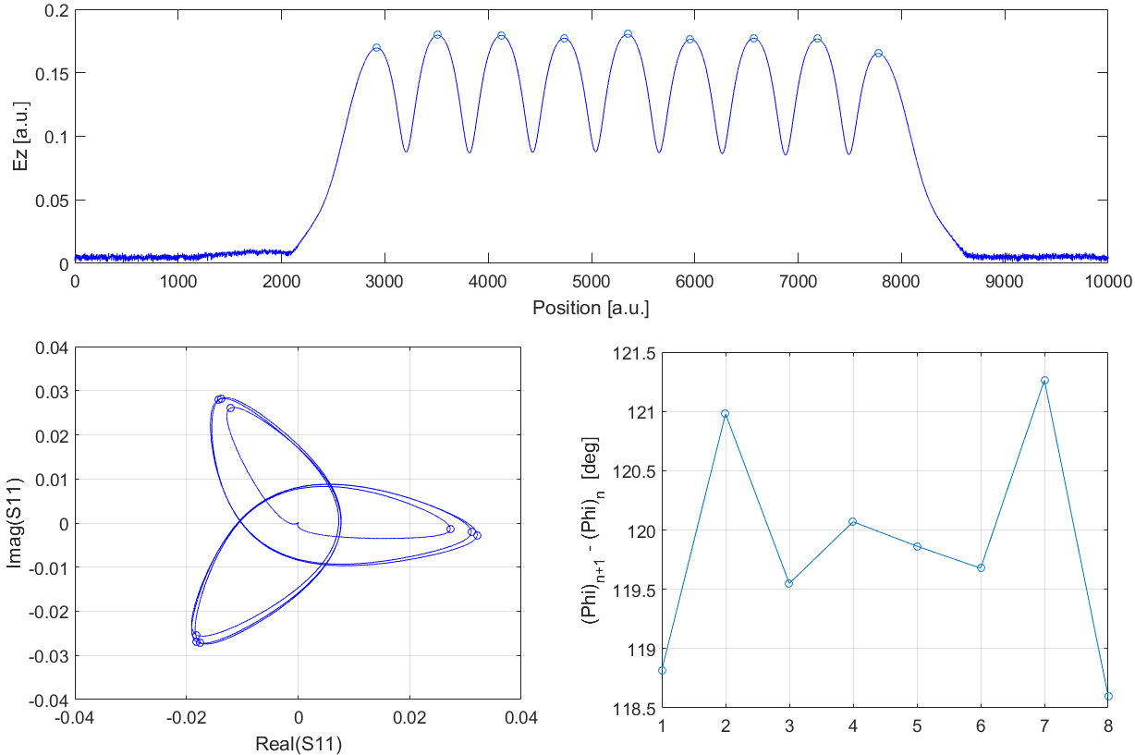
The Short Prototype
Low Power Measurements
To prove the reliability and feasibility of the upgrade plan, a short prototype was built in collaboration with Paul Scherrer Institute (PSI).
The prototype is realized using the same structure technology as developed for SwissFEL
The prototype is made by 7 regular cells & 2 EC-couplers.
Structure RF Parameters
L | 353.332 | mm
N_{cell(regular)} | 7
N_{cell(coupler)} | 2
a | 11.13 → 8.8 | mm
b | 41.61 → 41.60
R_{sh} | 71.14 → 71.38 | MΩ/m
Q₀ | ≈15850
Filling Time | ≈50 | ns
E_{s} | 81 → 85 | MV/m
H_{s} | 71 → 74 | kA/m
Courtesy PSI
Short HG Prototype
RF measurements and bead-pull test
Courtesy PSI
Courtesy PSI
N. Shafqat, S. Di Mitri, C. Serpico, and S. Nicastro, “Design study of high gradient, low impedance accelerating structures for the FRRMI free electron laser upgrade”, Nuclear Instruments and Methods in Physics Research A, vol. 867, pp. 78-87, 2017
Notes:
Slide 3 – (..) : Content of the presentation
Insert a new slide: Home > “New Slide” and choose a slide Layout:
For Title & Subtitle
For text with bullet points
For Text
For Picture, graphs, visuals
Two columns
Blank
If you want Copy & paste an element from the Clip Board to the particular slide:
1. Click on a box to mark it.
2. Position the mouse pointer on the box frame: Copy!
3. Click on the particular slide: Paste!
How you intend to use the elements is your choice.
You can combine the text block style with the background colour in different manner.

Slide 12
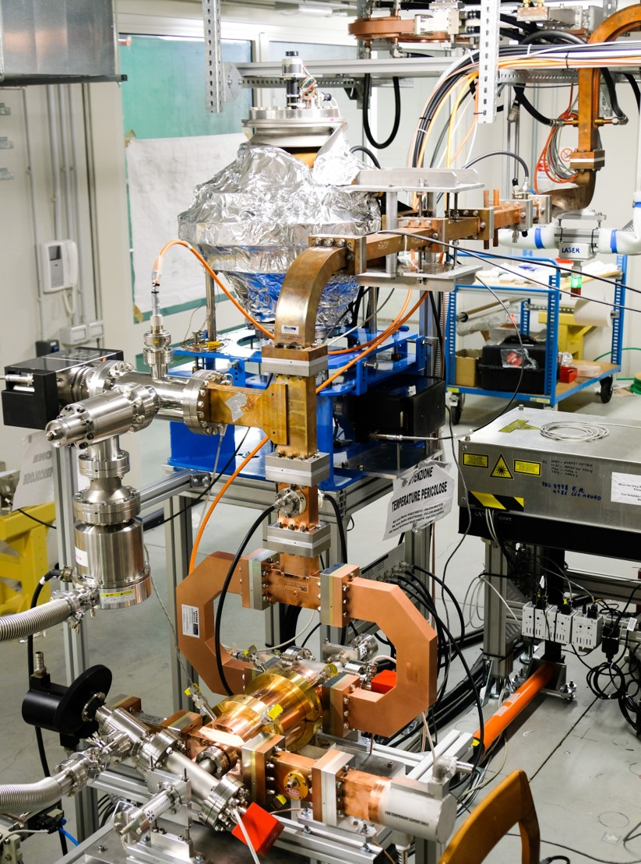
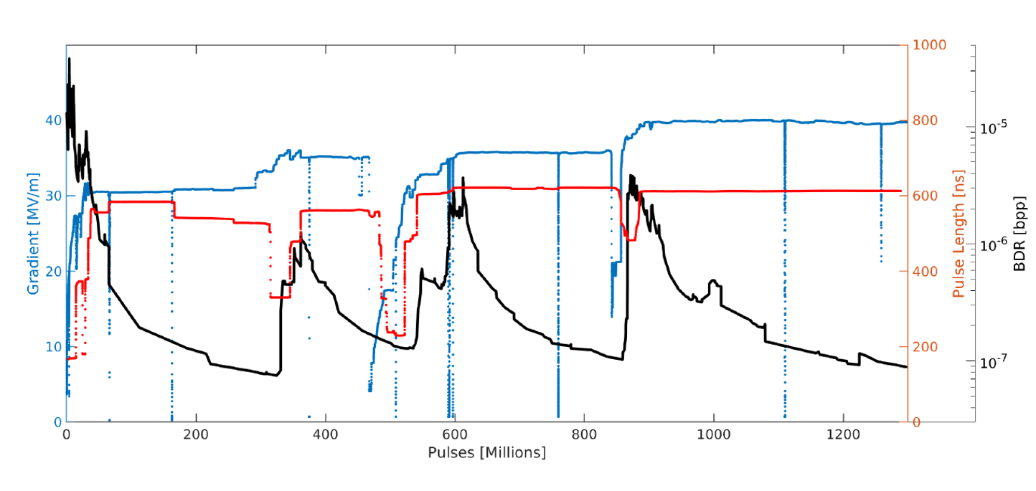
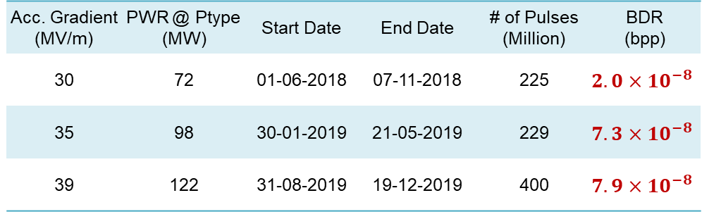
The Short Prototype
Conditioning History
Acc. Gradient (MV/m) | PWR @ Ptype (MW) | Start Date | End Date | # of Pulses (Million) | BDR (bpp)
30 | 72 | 01-06-2018 | 07-11-2018 | 225 | $$2.0×{10}^{−8}$$
35 | 98 | 30-01-2019 | 21-05-2019 | 229 | $$7.3×{10}^{−8}$$
39 | 122 | 31-08-2019 | 19-12-2019 | 400 | $$7.9×{10}^{−8}$$
During the Spring Shutdown (April 2018) the prototype was installed in FERMI Test Facility.

Slide 13
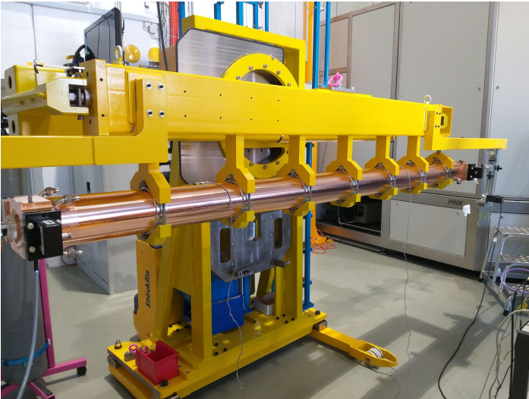
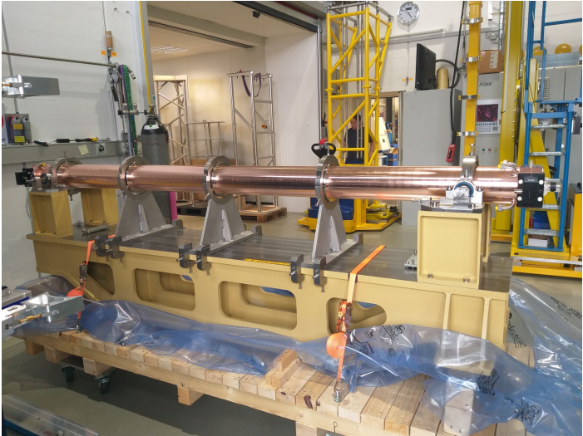
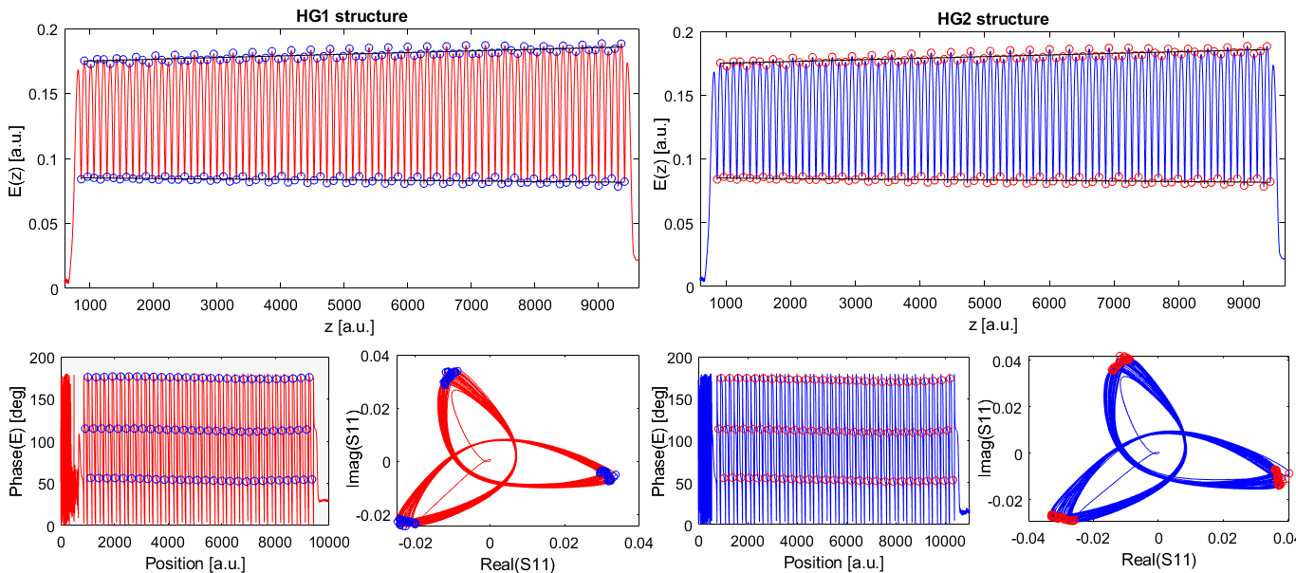
The First HG Module
Low Power Measurements
Courtesy PSI
Low power measurements of the HG module were performed at PSI.
Operating temperatures were
  HG1 34.6 ºC
  HG2 33.8 ºC
Courtesy PSI
Notes:
Slide 3 – (..) : Content of the presentation
Insert a new slide: Home > “New Slide” and choose a slide Layout:
For Title & Subtitle
For text with bullet points
For Text
For Picture, graphs, visuals
Two columns
Blank
If you want Copy & paste an element from the Clip Board to the particular slide:
1. Click on a box to mark it.
2. Position the mouse pointer on the box frame: Copy!
3. Click on the particular slide: Paste!
How you intend to use the elements is your choice.
You can combine the text block style with the background colour in different manner.

Slide 14
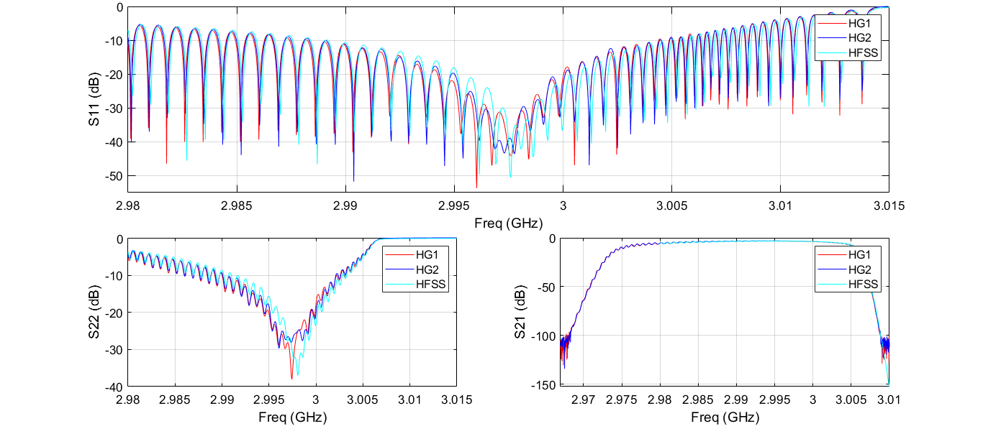
The First HG Module
Low Power Measurements
 | HFSS | HG1 | HG2
Operating temperature | 35 ºC | 34.6 ºC | 33.8 ºC
S11 (dB) | -38 | -32 | -33
S21 (dB) | -3.44 | -3.55 | -3.37
S22 (dB) | -35 | -25.7 | -25.3
Notes:
Slide 3 – (..) : Content of the presentation
Insert a new slide: Home > “New Slide” and choose a slide Layout:
For Title & Subtitle
For text with bullet points
For Text
For Picture, graphs, visuals
Two columns
Blank
If you want Copy & paste an element from the Clip Board to the particular slide:
1. Click on a box to mark it.
2. Position the mouse pointer on the box frame: Copy!
3. Click on the particular slide: Paste!
How you intend to use the elements is your choice.
You can combine the text block style with the background colour in different manner.

Slide 15
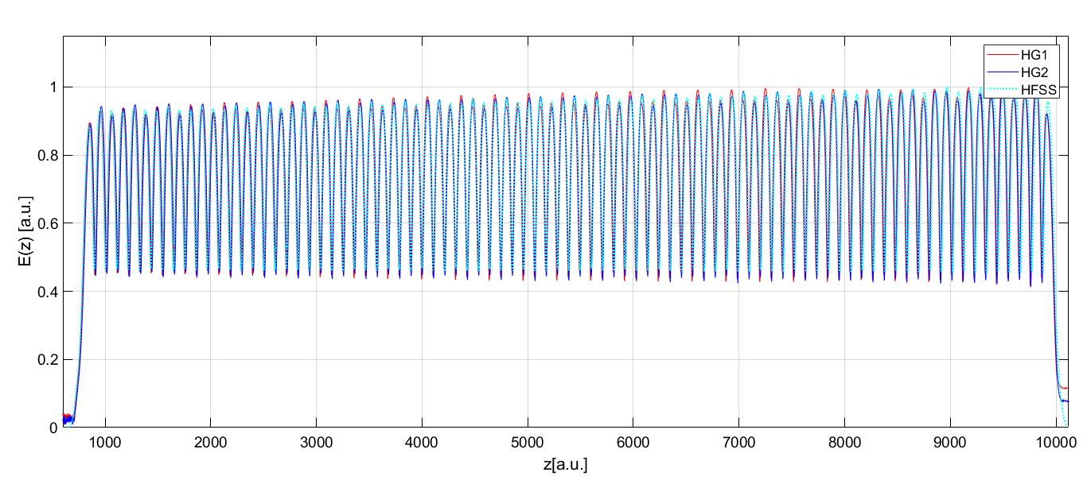
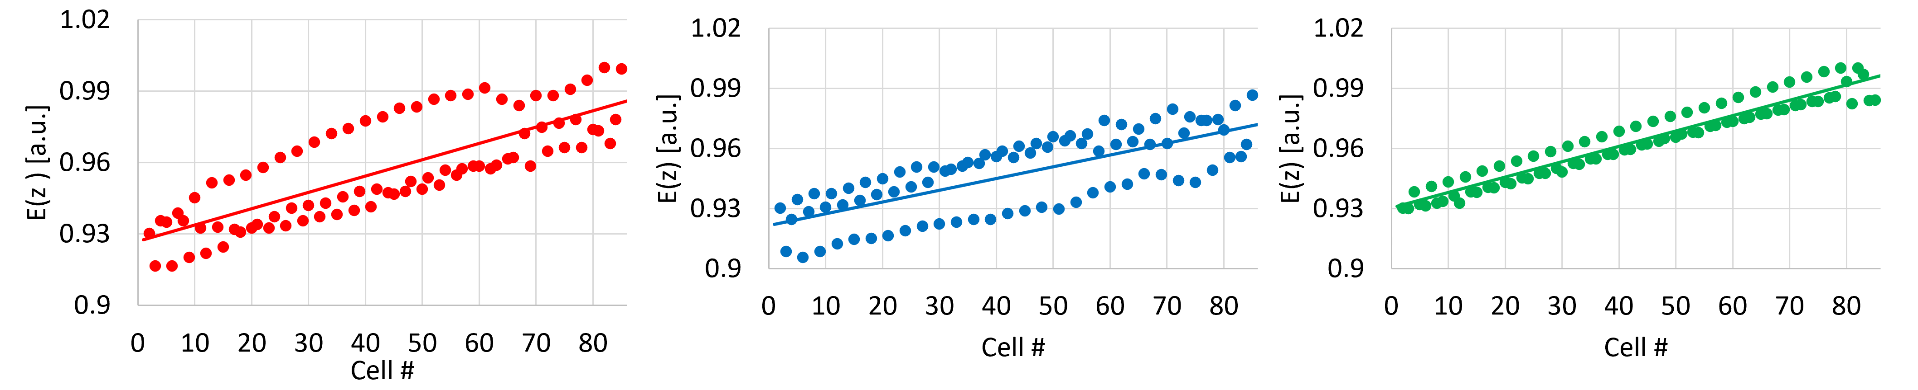
The First HG Module
Low Power Measurements
N. Shafqat, et al, “Fabrication, conditioning and installation of the 1st high gradient S-band accelerating module for the energy upgrade of the FERMI free electron laser linac”, Nuclear Instruments and Methods in Physics Research A,1055 (2023) 168543
Notes:
Slide 3 – (..) : Content of the presentation
Insert a new slide: Home > “New Slide” and choose a slide Layout:
For Title & Subtitle
For text with bullet points
For Text
For Picture, graphs, visuals
Two columns
Blank
If you want Copy & paste an element from the Clip Board to the particular slide:
1. Click on a box to mark it.
2. Position the mouse pointer on the box frame: Copy!
3. Click on the particular slide: Paste!
How you intend to use the elements is your choice.
You can combine the text block style with the background colour in different manner.

Slide 16
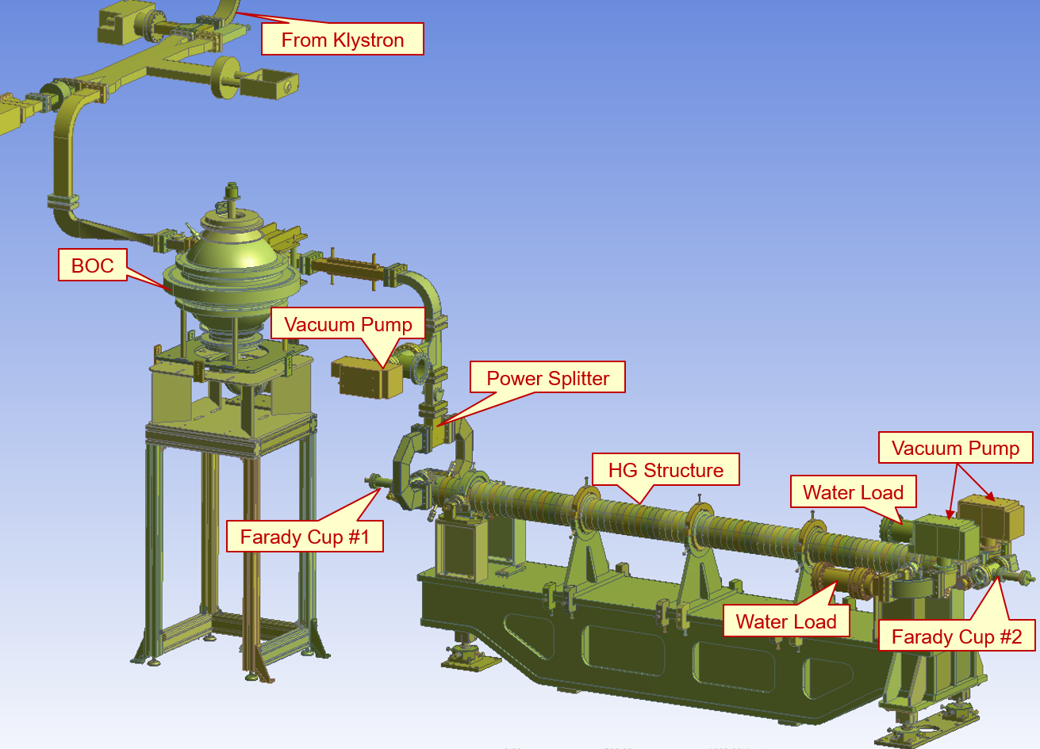
The First HG Module
Conditioning (HG1)
Notes:
Slide 3 – (..) : Content of the presentation
Insert a new slide: Home > “New Slide” and choose a slide Layout:
For Title & Subtitle
For text with bullet points
For Text
For Picture, graphs, visuals
Two columns
Blank
If you want Copy & paste an element from the Clip Board to the particular slide:
1. Click on a box to mark it.
2. Position the mouse pointer on the box frame: Copy!
3. Click on the particular slide: Paste!
How you intend to use the elements is your choice.
You can combine the text block style with the background colour in different manner.

Slide 17
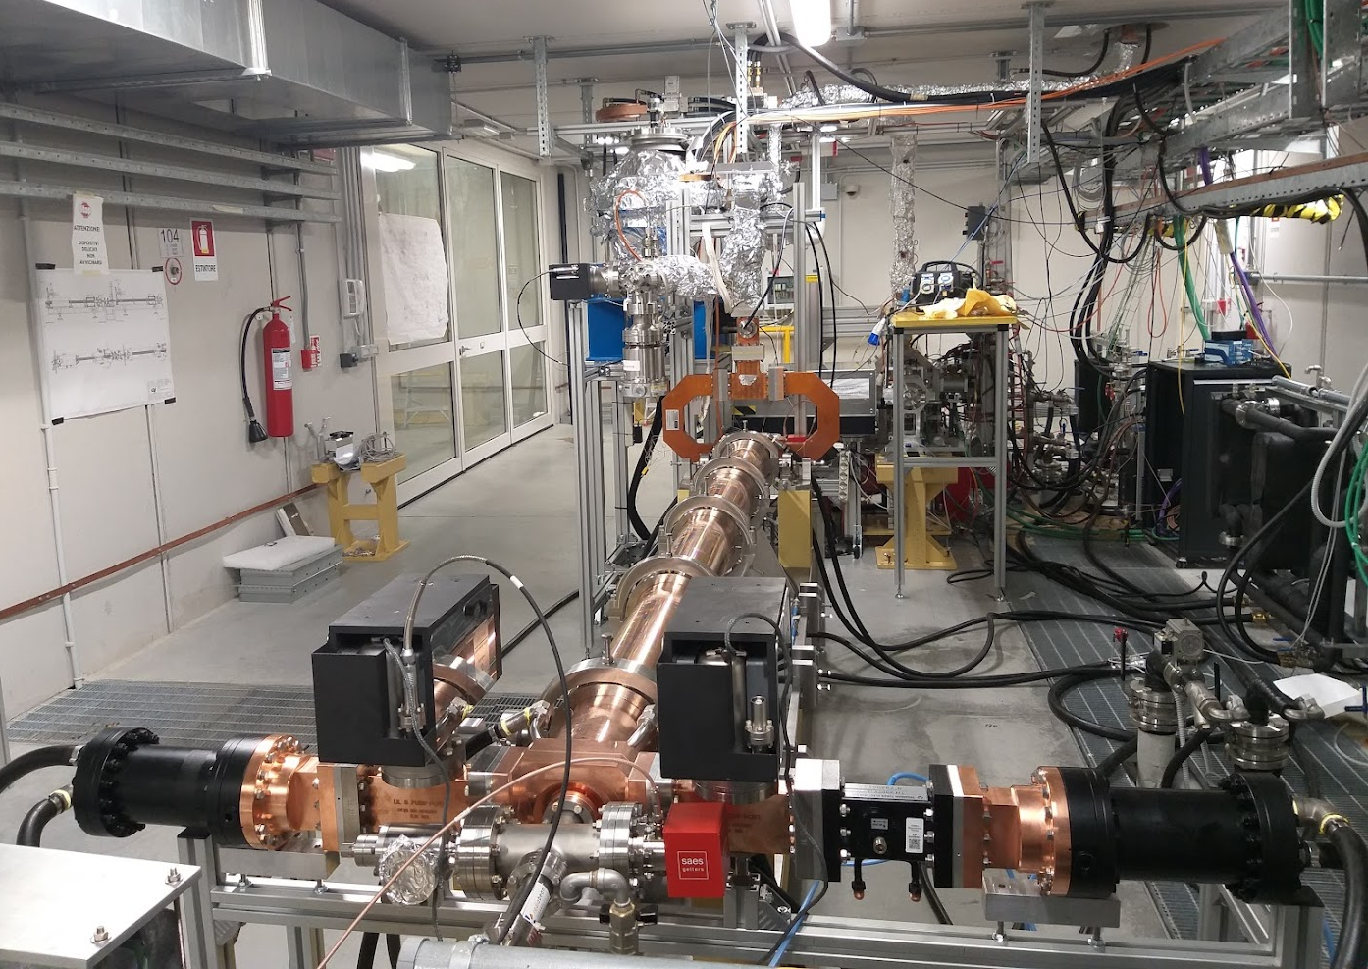
The First HG Module
Conditioning Setup (HG1)
Phase I (conditioning)
Rep. Rate: 50 Hz
Start Date: 28-04-2022
End Date: 17-05-2022
Level Achieved:
  Pulse Width:350 ns
  Power Level:72 MW
  # of pulses [million]: 80
During the Spring Shutdown (April 2022) the HG structure was installed in FERMI Test Facility.
From Klystron
BOC
Phase II (conditioning)
Rep. Rate: 50 Hz
Start Date: 17-05-2022
End Date: 11-06-2022
Level Achieved:
  Pulse Width:700 ns
  Power Level:72 MW
  # of pulses [million]: 100
Power Splitter
Vacuum Pump
Vacuum Pump
Phase III (constant power op.)
Rep. Rate: 50 Hz
Start Date: 11-06-2022
End Date: 25-07-2022
Operating level:
  Pulse Width:700 ns
  Power Level:75 MW
  # of pulses [million]: 180
Water Load
Water Load
Farady Cup
Notes:
Slide 3 – (..) : Content of the presentation
Insert a new slide: Home > “New Slide” and choose a slide Layout:
For Title & Subtitle
For text with bullet points
For Text
For Picture, graphs, visuals
Two columns
Blank
If you want Copy & paste an element from the Clip Board to the particular slide:
1. Click on a box to mark it.
2. Position the mouse pointer on the box frame: Copy!
3. Click on the particular slide: Paste!
How you intend to use the elements is your choice.
You can combine the text block style with the background colour in different manner.

Slide 18
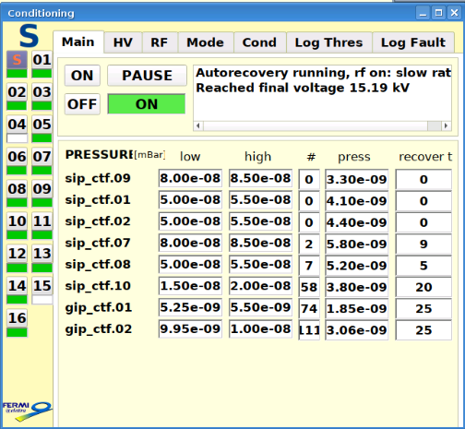
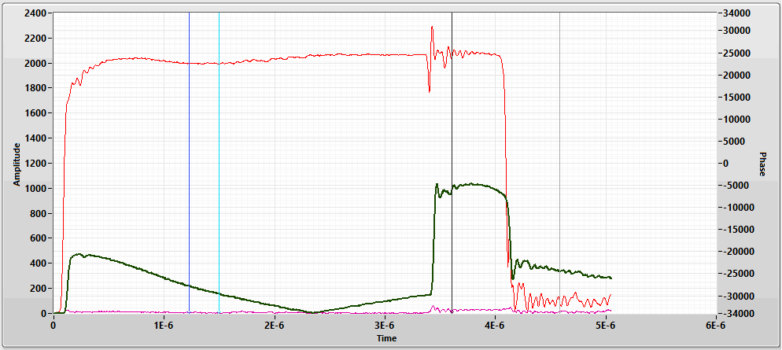
The First HG Module
Conditioning (HG1)
Conditioning Pulse
700ns
Vacuum pressure in all CTF at full power
4000ns
Notes:
Slide 3 – (..) : Content of the presentation
Insert a new slide: Home > “New Slide” and choose a slide Layout:
For Title & Subtitle
For text with bullet points
For Text
For Picture, graphs, visuals
Two columns
Blank
If you want Copy & paste an element from the Clip Board to the particular slide:
1. Click on a box to mark it.
2. Position the mouse pointer on the box frame: Copy!
3. Click on the particular slide: Paste!
How you intend to use the elements is your choice.
You can combine the text block style with the background colour in different manner.

Slide 19
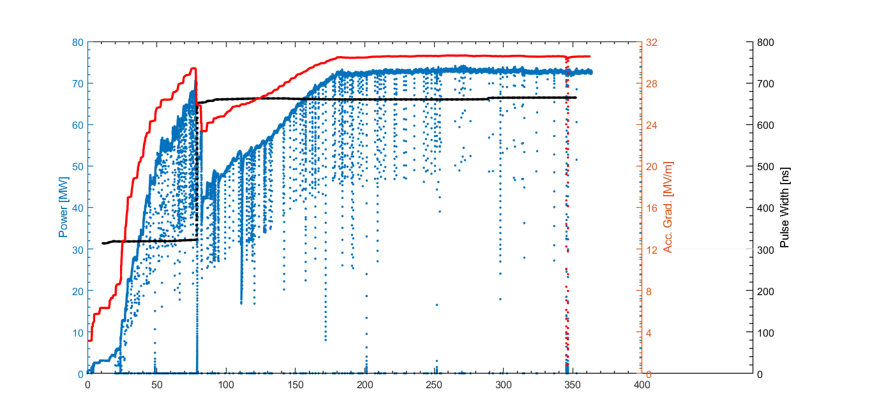
The First HG Structure
History Plot (HG1)
Pulse count [Millions]
Notes:
Slide 3 – (..) : Content of the presentation
Insert a new slide: Home > “New Slide” and choose a slide Layout:
For Title & Subtitle
For text with bullet points
For Text
For Picture, graphs, visuals
Two columns
Blank
If you want Copy & paste an element from the Clip Board to the particular slide:
1. Click on a box to mark it.
2. Position the mouse pointer on the box frame: Copy!
3. Click on the particular slide: Paste!
How you intend to use the elements is your choice.
You can combine the text block style with the background colour in different manner.

Slide 20
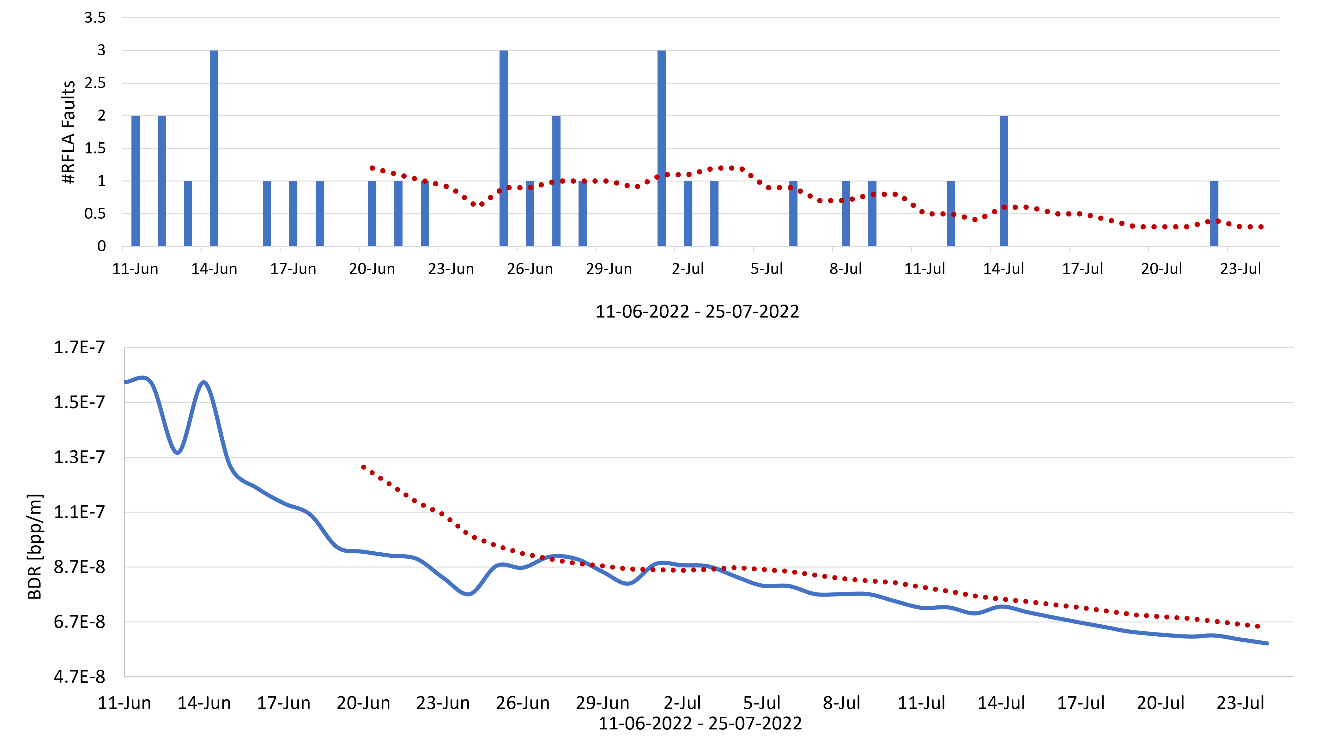
The First HG Structure
Estimated BDR (HG1)
Notes:
Slide 3 – (..) : Content of the presentation
Insert a new slide: Home > “New Slide” and choose a slide Layout:
For Title & Subtitle
For text with bullet points
For Text
For Picture, graphs, visuals
Two columns
Blank
If you want Copy & paste an element from the Clip Board to the particular slide:
1. Click on a box to mark it.
2. Position the mouse pointer on the box frame: Copy!
3. Click on the particular slide: Paste!
How you intend to use the elements is your choice.
You can combine the text block style with the background colour in different manner.

Slide 21
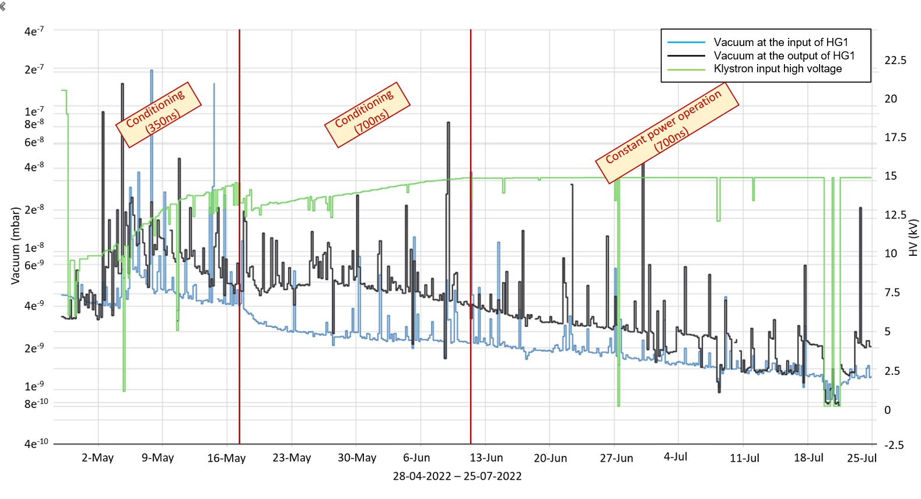
The First HG Module
Vacuum (HG1)
Notes:
Slide 3 – (..) : Content of the presentation
Insert a new slide: Home > “New Slide” and choose a slide Layout:
For Title & Subtitle
For text with bullet points
For Text
For Picture, graphs, visuals
Two columns
Blank
If you want Copy & paste an element from the Clip Board to the particular slide:
1. Click on a box to mark it.
2. Position the mouse pointer on the box frame: Copy!
3. Click on the particular slide: Paste!
How you intend to use the elements is your choice.
You can combine the text block style with the background colour in different manner.

Slide 22
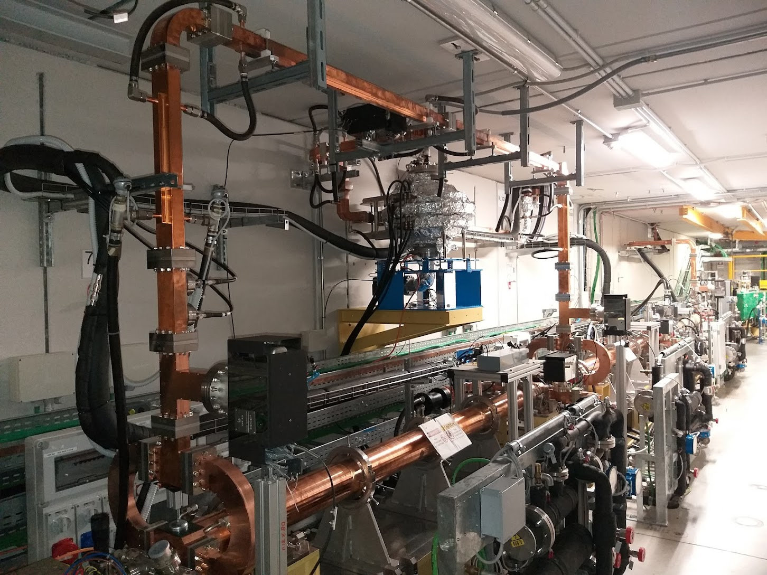
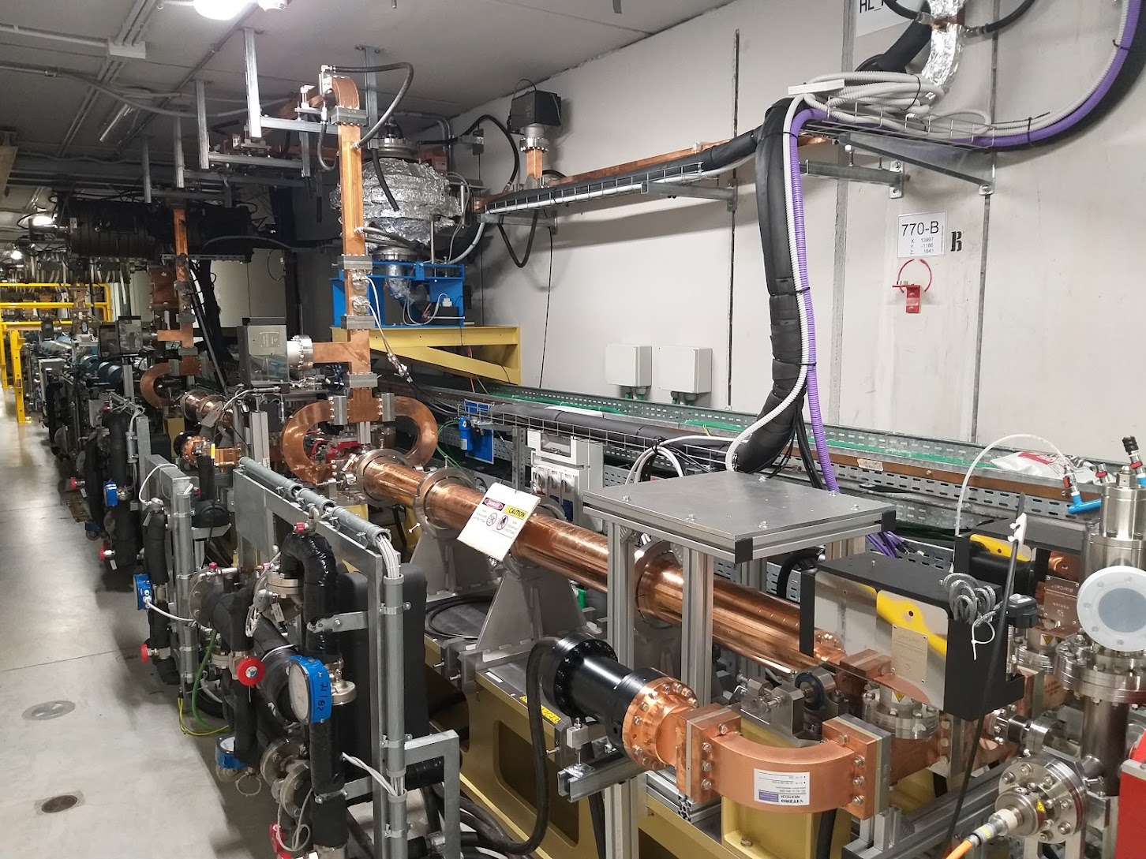
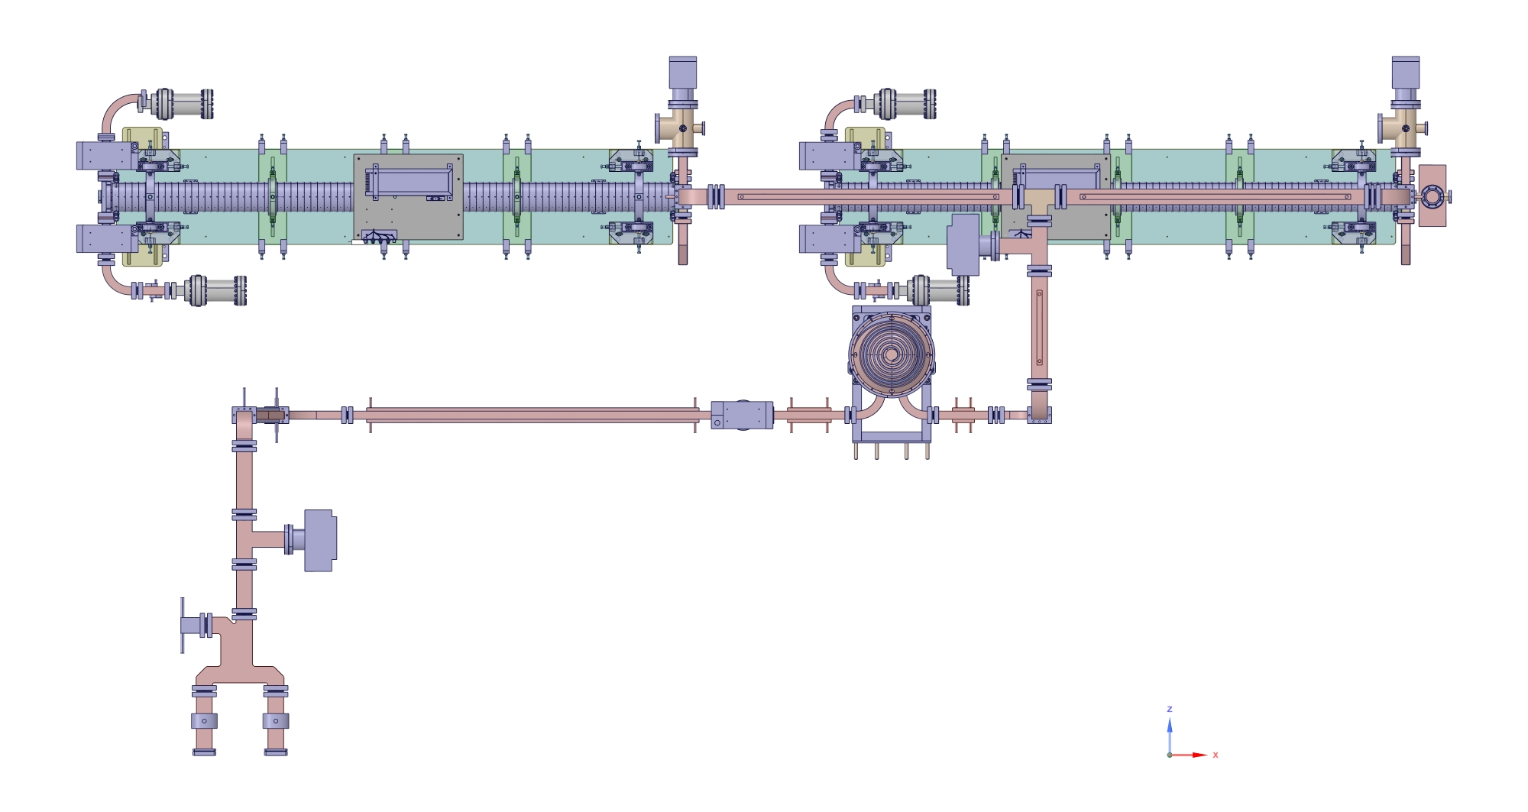
The First HG Module
Installation
Main Power Splitter
BOC PC
Klystron Gallery
Klystron
BOC PC
HG1
HG2 Power Splitter
HG2
HG2
Re-combiner
RF Load
HG1 Power Splitter
HG1
Directional Coupler
RF Load
Linac Tunnel
RF Load
BOC Pulse Compressor
RF Load
HG1
HG2
Main Power Splitter
RF Load
RF Load
Notes:
Slide 3 – (..) : Content of the presentation
Insert a new slide: Home > “New Slide” and choose a slide Layout:
For Title & Subtitle
For text with bullet points
For Text
For Picture, graphs, visuals
Two columns
Blank
If you want Copy & paste an element from the Clip Board to the particular slide:
1. Click on a box to mark it.
2. Position the mouse pointer on the box frame: Copy!
3. Click on the particular slide: Paste!
How you intend to use the elements is your choice.
You can combine the text block style with the background colour in different manner.

Slide 23
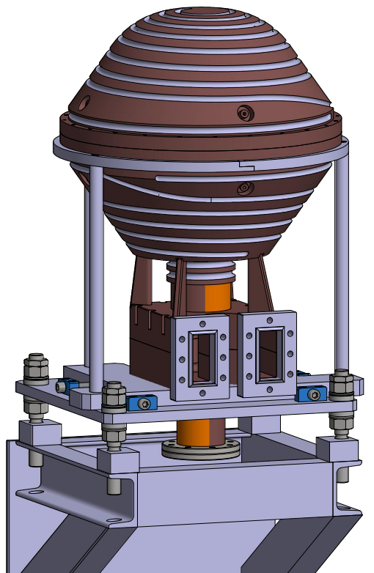
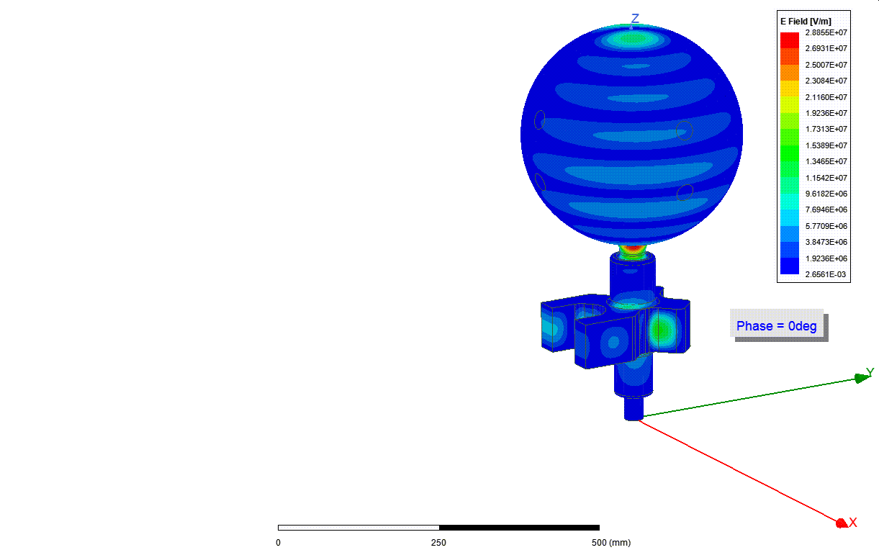
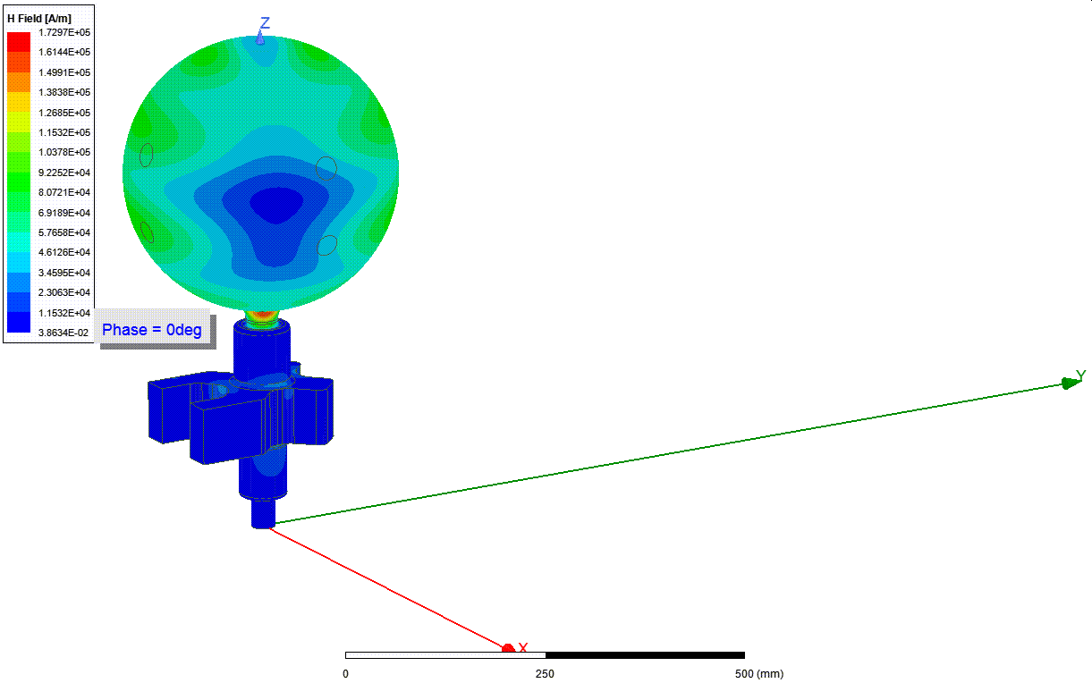
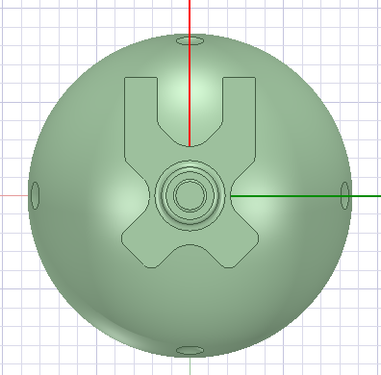
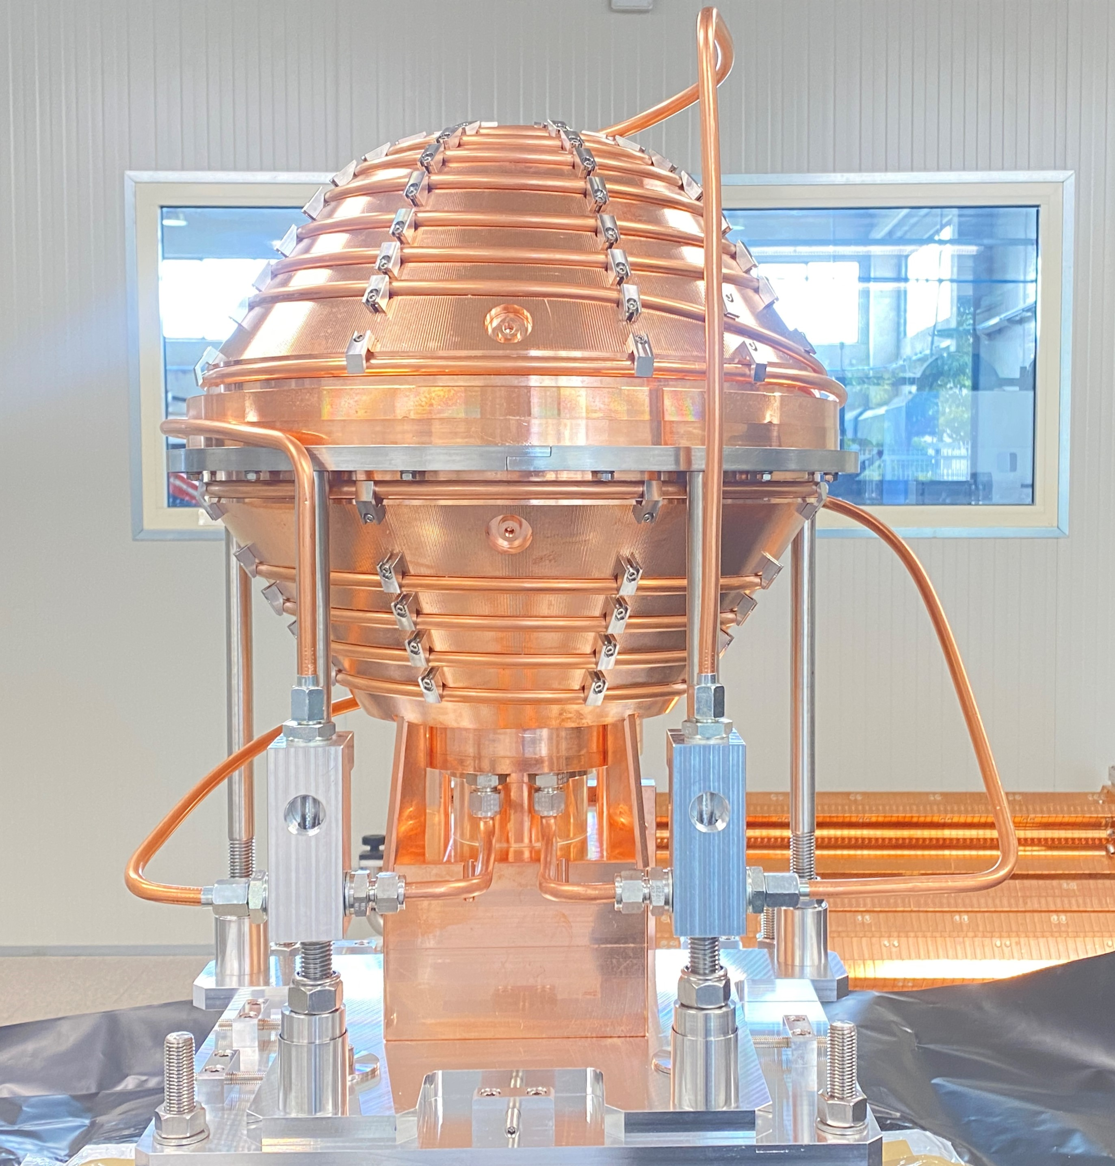

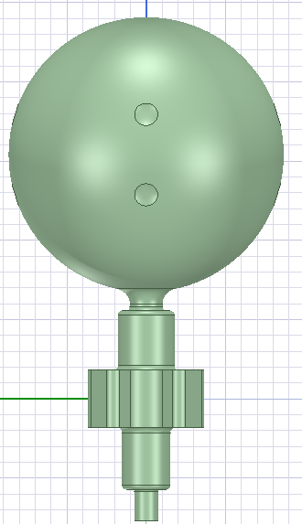
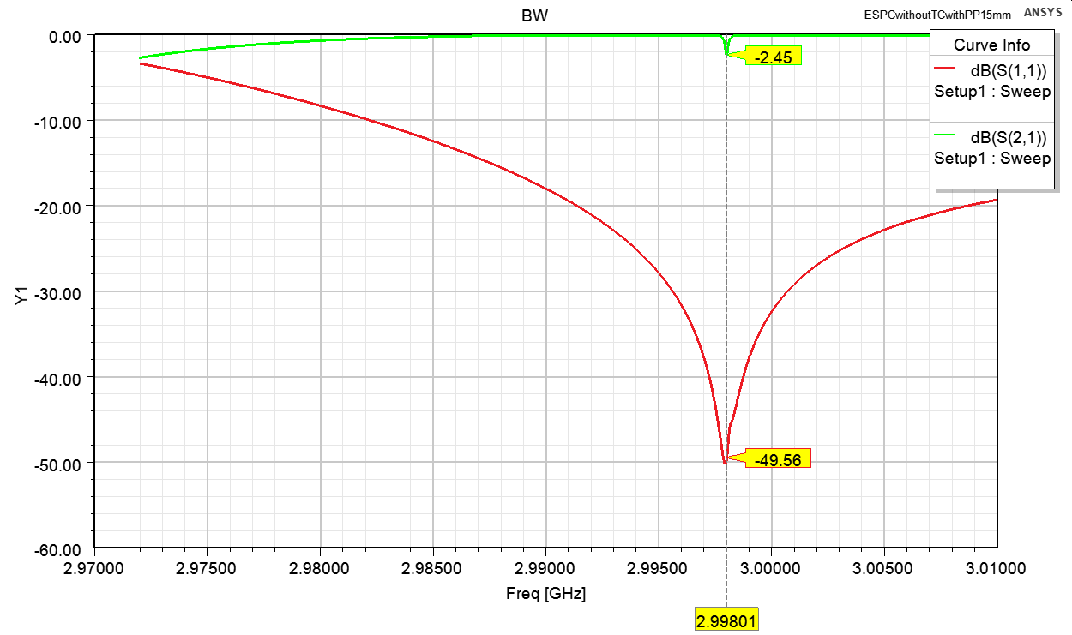
Spherical Pulse Compressor
RF Design
140 mm
200 mm
347 mm
RF Parameters
f₀ | 2.99801 | GHz
Nominal Temperature | 35 | ºC
Mode | TM13
Q0 | ≈140000
Coupling Coefficient | 7.2±0.1
E @ 45 MW | 28.16 | MV/m
H @ 45 MW | 169.75 | kA/m
Push points
640 mm
Notes:
Slide 3 – (..) : Content of the presentation
Insert a new slide: Home > “New Slide” and choose a slide Layout:
For Title & Subtitle
For text with bullet points
For Text
For Picture, graphs, visuals
Two columns
Blank
If you want Copy & paste an element from the Clip Board to the particular slide:
1. Click on a box to mark it.
2. Position the mouse pointer on the box frame: Copy!
3. Click on the particular slide: Paste!
How you intend to use the elements is your choice.
You can combine the text block style with the background colour in different manner.

Slide 24

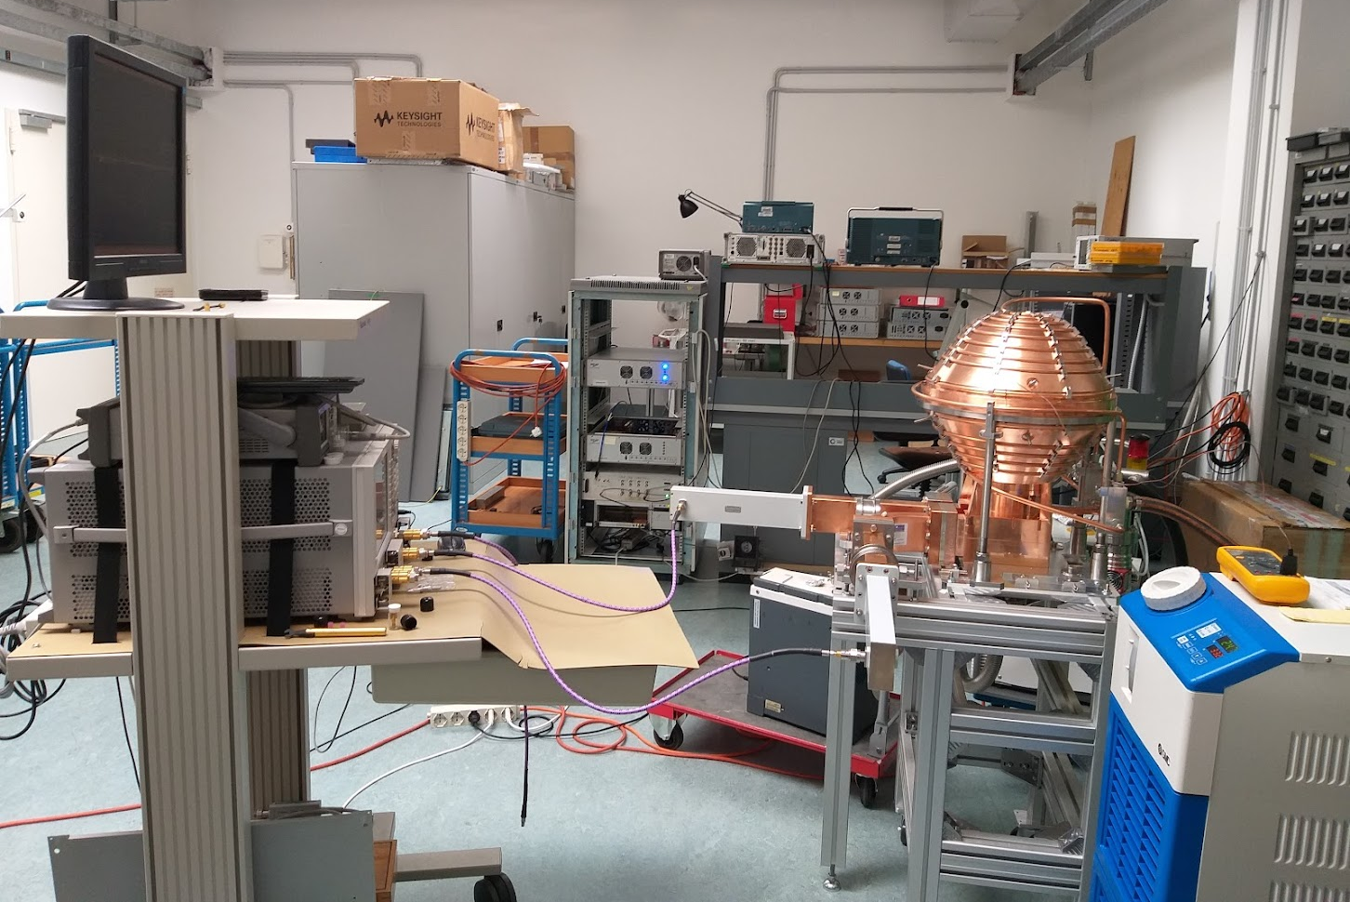
Spherical Pulse Compressor
Low Power Mesurements
Before Tuning
HFSS
Measurement Setup
Water Temperature: 33,4 C
Coupling frequency: 2998,01 MHz
Courtesy Ping Wang
Input
Output
Spherical Pulse Compressor
ThermoChiller
After Tuning
Vector Network Analyzer
Fabricated
Vacuum Pump
Input
Output
The frequency difference of 15 KHz in the two polarizations would reduce the PAF of SPC by 2%
 | SPC (HFSS) | SPC (Fabricated)
S11 (dB) | -59 | -47
S21(dB) | -58 | ⁻48
S31 (dB) | -3.01 | -3.02
S32 (dB) | -3,01 | -3.02
Phase Diff. | 90.09º | 89.3º
Notes:
Slide 3 – (..) : Content of the presentation
Insert a new slide: Home > “New Slide” and choose a slide Layout:
For Title & Subtitle
For text with bullet points
For Text
For Picture, graphs, visuals
Two columns
Blank
If you want Copy & paste an element from the Clip Board to the particular slide:
1. Click on a box to mark it.
2. Position the mouse pointer on the box frame: Copy!
3. Click on the particular slide: Paste!
How you intend to use the elements is your choice.
You can combine the text block style with the background colour in different manner.

Slide 25
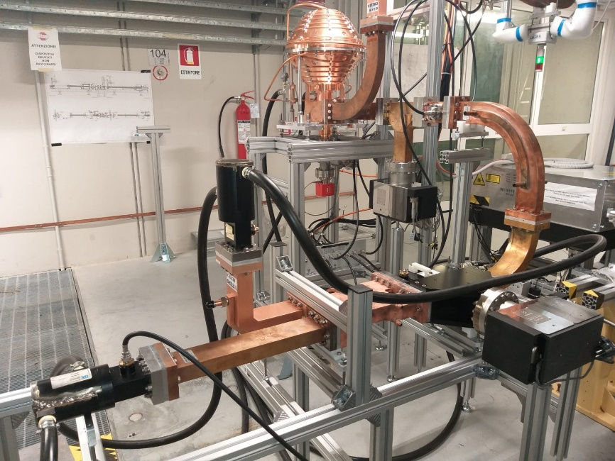
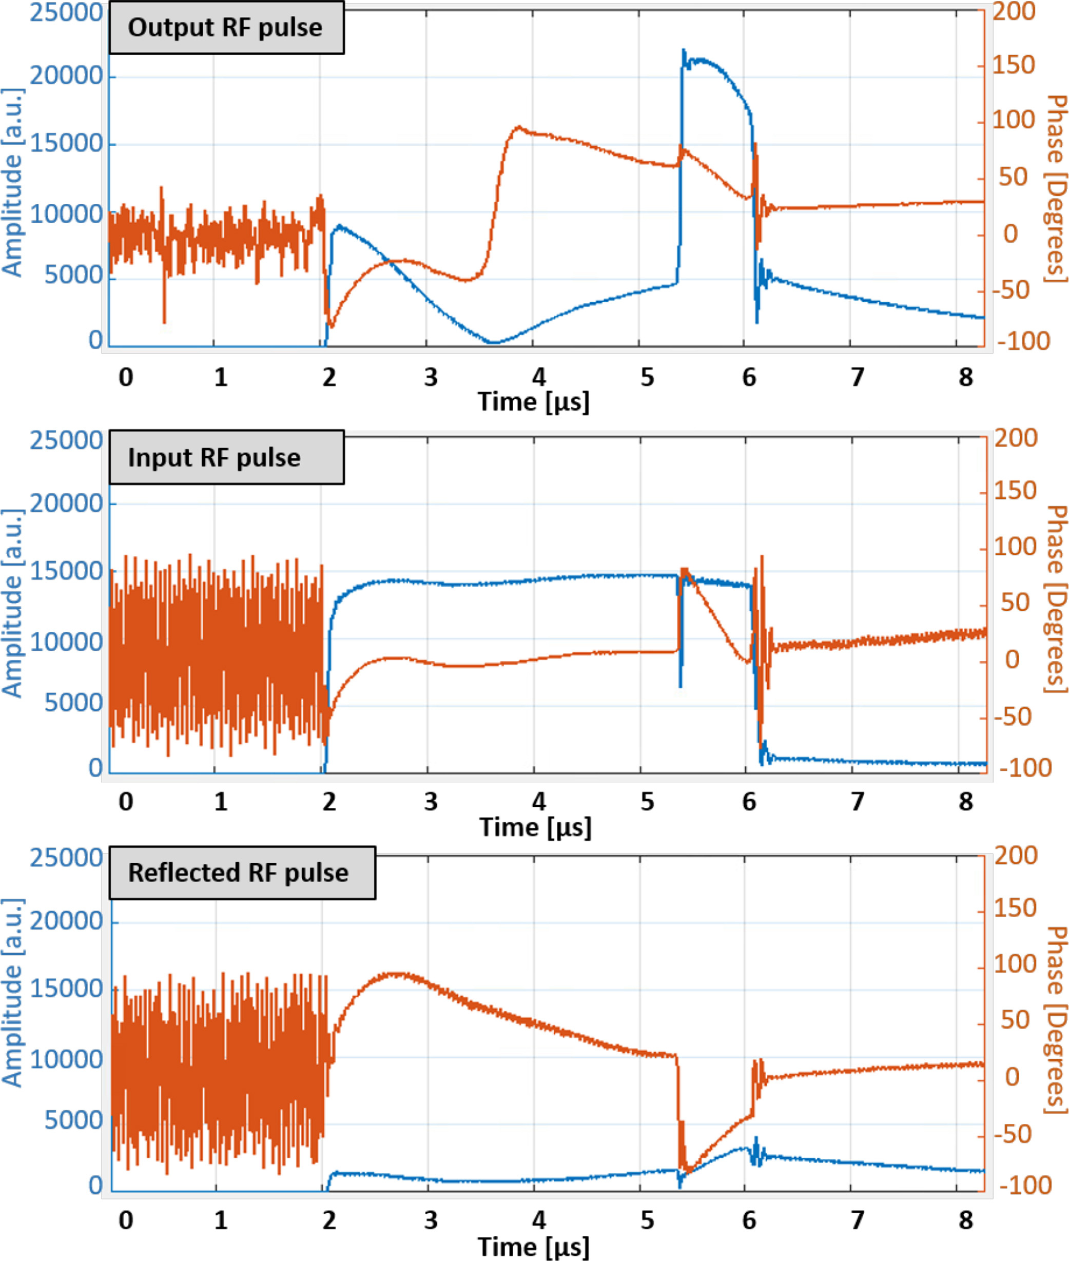
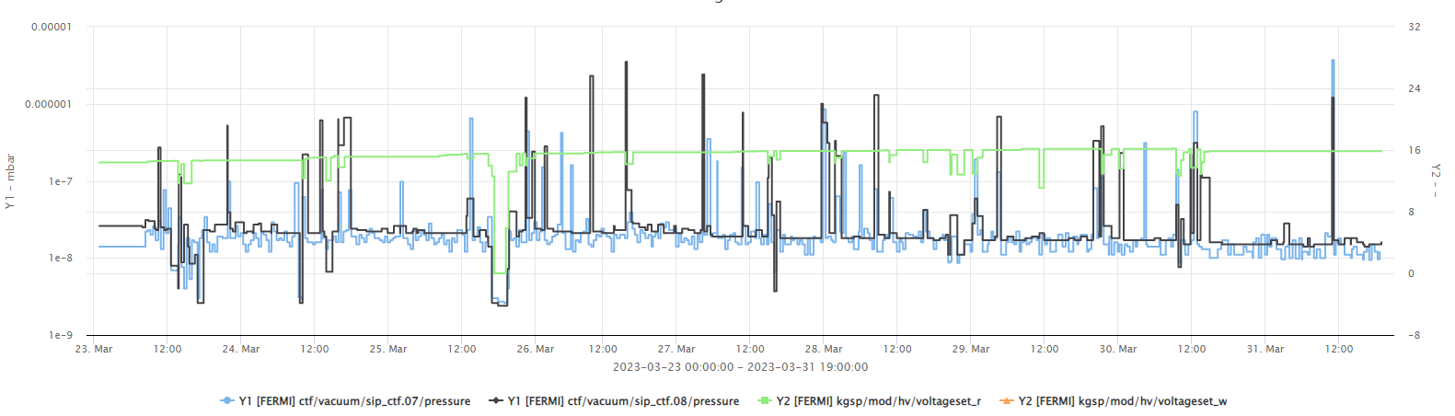
Spherical Pulse Compressor
Conditioning-High Power Opr.
Phase I (90 MW)
Rep. Rate: 50 Hz
Start Date: 06-12-2022
End Date: 21-12-2022
Output power: 90MW, 700 ns
Input power: 26 MW, 4000 ns
Operating temperature: 32.25 ºC
Spherical Pulse Compressor
From klystron
RF Water Load #1
Vacuum Pump
Pumping Port
Phase II (100 MW)
Rep. Rate: 50 Hz
Start Date: 23-03-2023
End Date: 31-03-2023
Output power: 100 MW, 700 ns
Input power: 29 MW, 4000 ns
Operating temperature: 31.47 ºC
3dB Hybrid
Vacuum Pump
RF Water Load #2
Notes:
Slide 3 – (..) : Content of the presentation
Insert a new slide: Home > “New Slide” and choose a slide Layout:
For Title & Subtitle
For text with bullet points
For Text
For Picture, graphs, visuals
Two columns
Blank
If you want Copy & paste an element from the Clip Board to the particular slide:
1. Click on a box to mark it.
2. Position the mouse pointer on the box frame: Copy!
3. Click on the particular slide: Paste!
How you intend to use the elements is your choice.
You can combine the text block style with the background colour in different manner.

Slide 26
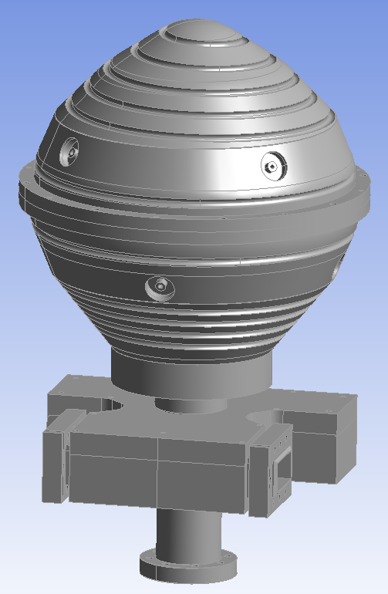
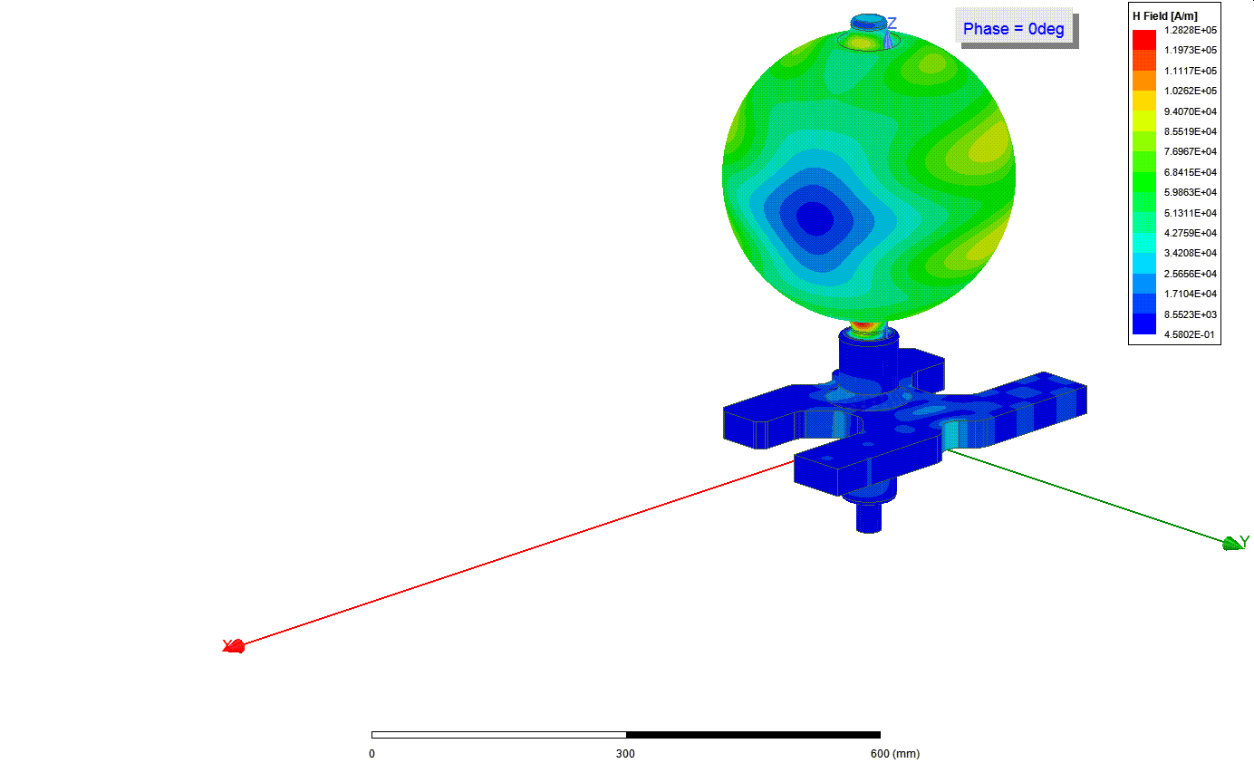
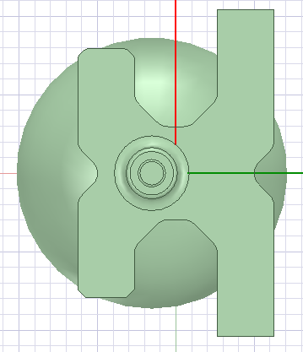
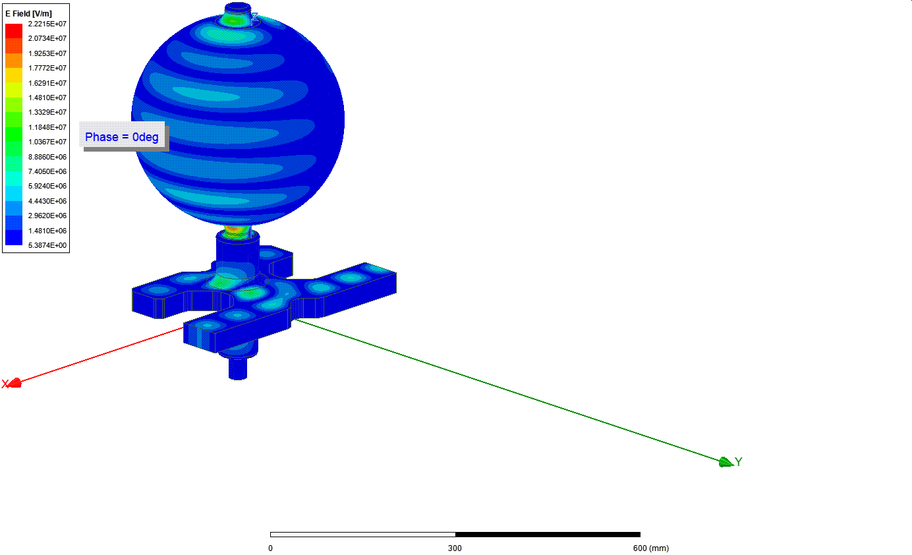



Spherical Pulse Compressor
Version 2.0
178mm
205 mm
RF Parameters
f₀ | 2.99801 | GHz
Nominal Temperature | 35 | ºC
Mode | TM13
Q0 | ≈140000
Coupling Coefficient | 7.1±0.1
E @ 45 MW | 29.79 | MV/m
H @ 45 MW | 130 | kA/m
347 mm
Push points
640 mm
Notes:
Slide 3 – (..) : Content of the presentation
Insert a new slide: Home > “New Slide” and choose a slide Layout:
For Title & Subtitle
For text with bullet points
For Text
For Picture, graphs, visuals
Two columns
Blank
If you want Copy & paste an element from the Clip Board to the particular slide:
1. Click on a box to mark it.
2. Position the mouse pointer on the box frame: Copy!
3. Click on the particular slide: Paste!
How you intend to use the elements is your choice.
You can combine the text block style with the background colour in different manner.

Slide 27














https://www.elettra.eu/technology/industry/hp-waveguide-components.html.
Notes:
Slide 3 – (..) : Content of the presentation
Insert a new slide: Home > “New Slide” and choose a slide Layout:
For Title & Subtitle
For text with bullet points
For Text
For Picture, graphs, visuals
Two columns
Blank
If you want Copy & paste an element from the Clip Board to the particular slide:
1. Click on a box to mark it.
2. Position the mouse pointer on the box frame: Copy!
3. Click on the particular slide: Paste!
How you intend to use the elements is your choice.
You can combine the text block style with the background colour in different manner.

Slide 28
Conclusions
Conditioning of 1st 3.0m HG structure
Installation of HG structures at FERMI linac
First 3.0m HG structure is succesfully conidtioned at the cavity test facility of Elettra up to an acc. gradient of 30 MV/m with the the BDR of $6×{10}^{−8} bpp/m$.
First 3.0m HG structure is succesfully conidtioned at the cavity test facility of Elettra up to an acc. gradient of 30 MV/m with the the BDR of 𝟔×〖𝟏𝟎〗^(−𝟖) 𝒃𝒑𝒑/𝒎.
One HG module consisting of two HG structures is installed at the FERMI linac in September 2022 and 2nd HG strcuture is under conditioning.
S-Band Spherical Pulse Compressor
The first prototype of S-band spherical pulse compressor has been successfully conditioned up to 100 MW output RF power with the pulse length of 700 ns at the cavity test facility of Elettra.
Notes:
Slide 3 – (..) : Content of the presentation
Insert a new slide: Home > “New Slide” and choose a slide Layout:
For Title & Subtitle
For text with bullet points
For Text
For Picture, graphs, visuals
Two columns
Blank
If you want Copy & paste an element from the Clip Board to the particular slide:
1. Click on a box to mark it.
2. Position the mouse pointer on the box frame: Copy!
3. Click on the particular slide: Paste!
How you intend to use the elements is your choice.
You can combine the text block style with the background colour in different manner.

Slide 29







Acknowledgements
FERMI RF Team!!!
Engineering office & Vacuum Group
M. Trovo
M. Milloch
I. Cudin
L. Rumiz
F. Gelmetti
A. Milocco
Special thanks to...
Luca Giannessi, Claudio Masciovecchio, Michele Svandrlik - FERMI, Elettra
Walter Wuensch, Alexej Grudiev, Ping Wang - CERN
M. Pedrosi, P. Craievich, R. Fortunati, F. Marcellini, R. Zennaro- Paul Scherrer Institute (PSI)I

Slide 30
Notes:
Last Slide 1: Thanks to the audience

Slide 31
Notes:
Last Slide 2: Aerial Photo of Elettra

Slide 32
Backup Slides
Notes:
Slide 2: Title of the Presentation
Before you start editing the slides of your talk change to the Master Slide view:
Microsoft Office :Menu: View > Slide Master;
Macintosh – View > Master > Slide Master
Edit the following items:
On the Slide Master (first master slide) – lower area
a) On the left Delete the text and write the title of the event/Conference, Location
b) On the right delete the text and write the name and surname of the speaker and the date (day, month , year)
Close Master View
To start adding slides insert a new slide and select a Layout:
For Title & Subtitle
For text with bullet points
For Text
For Picture, graphs, visuals
Two columns
Blank

Slide 33




RF Analysis of Full HG Structure (3.0 meter)
Normalized Magnitude of Ez
Bandwidth
ImEz vs ReEz
Notes:
Slide 3 – (..) : Content of the presentation
Insert a new slide: Home > “New Slide” and choose a slide Layout:
For Title & Subtitle
For text with bullet points
For Text
For Picture, graphs, visuals
Two columns
Blank
If you want Copy & paste an element from the Clip Board to the particular slide:
1. Click on a box to mark it.
2. Position the mouse pointer on the box frame: Copy!
3. Click on the particular slide: Paste!
How you intend to use the elements is your choice.
You can combine the text block style with the background colour in different manner.

Slide 34
Fermi Cavity Test Facility
FERMI linac stations hot spare, has been upgraded to act also as a complete S-Band RF Cavity Test Facility (CTF)
Test Facility @ Elettra
Test Facility Diagnostic
N. Shafqat et al., “Commissioning of S-Band cavity test facility at Elettra for conditioning of high gradient structures for the FERMI Linac upgrade” , in Proc. 10th Int. Particle Accelerator Conf. (IPAC’19), Melbourne, Australia, JACOW-IPAC19-WEPRB021

Slide 35
Fermi Cavity Test Facility
FERMI linac stations hot spare, has been upgraded to act also as a complete S-Band RF Cavity Test Facility (CTF)
Test Facility Diagnostic
Test Facility @ Elettra
Test of Standing Wave structures/RF Guns to 25MW peak power.
Test of Travelling Wave structures & RF components up to 150 MW peak power.
Hardware for breakdown diagnostic is subset of CERN breakdown diagnostic
National Instrument (NI) hardware is integrated with FERMI LLRF for breakdown rate measurements and localization
N. Shafqat et al., “Commissioning of S-Band cavity test facility at Elettra for conditioning of high gradient structures for the FERMI Linac upgrade” , in Proc. 10th Int. Particle Accelerator Conf. (IPAC’19), Melbourne, Australia, JACOW-IPAC19-WEPRB021

Slide 36


Complete Conditioning
Breakdown Locations
39MV/m
Constant PWR
39MV/m Conditioning
35MV/m
Constant PWR
35MV/m Conditioning
Waveguide Section
30MV/m
Constant PWR
30MV/m Conditioning
Waveguide Section

