Slide 1
Notes:
Slide 1: Company Logo Full Page
Before you start editing the slides of your talk change to the Master Slide view:
Microsoft Office :Menu: View > Slide Master;
Macintosh – View > Master > Slide Master
Edit the following items:
On the Slide Master (first master slide) – lower area
a) On the left Delete the text and write the title of the event/Conference, Location
b) On the right delete the text and write the name and surname of the speaker and the date (day, month , year)
Close Master View

Slide 2
Elettra – Elettra 2.0 RF Status & Upgrade
C. Pasotti, M. Bocciai, L. Bortolossi, M. Rinaldi
Notes:
Slide 2: Title of the Presentation
Before you start editing the slides of your talk change to the Master Slide view:
Microsoft Office :Menu: View > Slide Master;
Macintosh – View > Master > Slide Master
Edit the following items:
On the Slide Master (first master slide) – lower area
a) On the left Delete the text and write the title of the event/Conference, Location
b) On the right delete the text and write the name and surname of the speaker and the date (day, month , year)
Close Master View
To start adding slides insert a new slide and select a Layout:
For Title & Subtitle
For text with bullet points
For Text
For Picture, graphs, visuals
Two columns
Blank

Slide 3
Talk Content
Elettra Cavity water leak
130 kW -500 MHz Solid State Amplifier: installation and set into operation of the first unit.

Slide 4
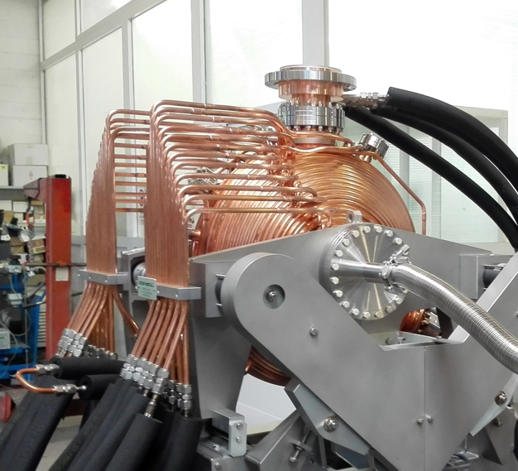
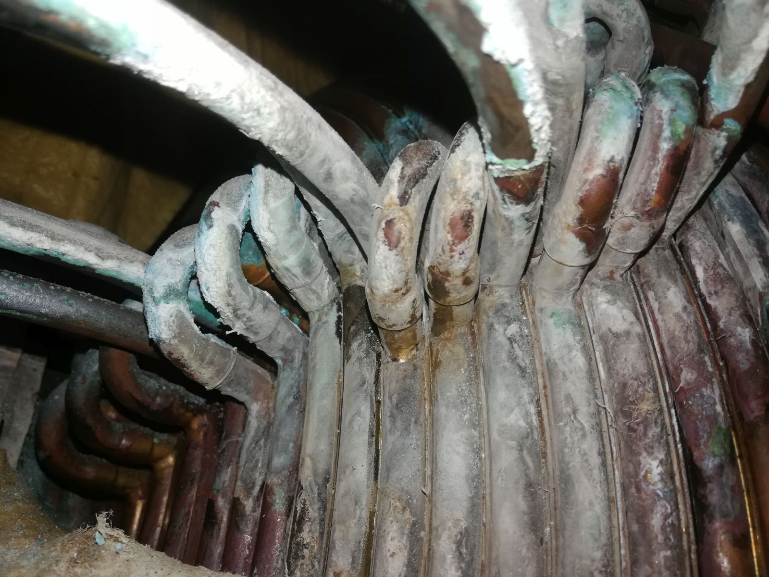
Cavity RF#3
In June 2021, during the first day of Elettra the shut-down, a water leak was found at the brazed junction of the U-bend section of the external cooling system.
The storage ring water leak detector was giving the alarm one week before the shut down, The warning was ignored, as usual.
Cavity with cooling pipes - new one
Water leak on the cavity pipes in section RF#3

Slide 5
Cavity RF#3
Water leak did not stop the cavity operation nor the storage ring since there is an automatic refill of the water tank of the circuit.
Cavity was running since 2003 with no faults at all.
Water quality checked last year and compared with SLS. Elettra cooling water was looking great!
Leakage is very likely due to the operating cooling water pressure 9 bar. Cooling circuit flow is 200 l/m.
The leaking pipes have been by-passed and the cavity was restarted with 15% less of cooling efficiency. Tcavity-reference moved from 46.3 ˚C to 54.6 ˚C.
No troubles for the storage ring operations.
A spare cavity is available in the RF lab but there was no time for the replacement this June.
Replacing the cavity and fixing the leak in the laboratory – if it will be worth it - is scheduled in 2022.

Slide 6
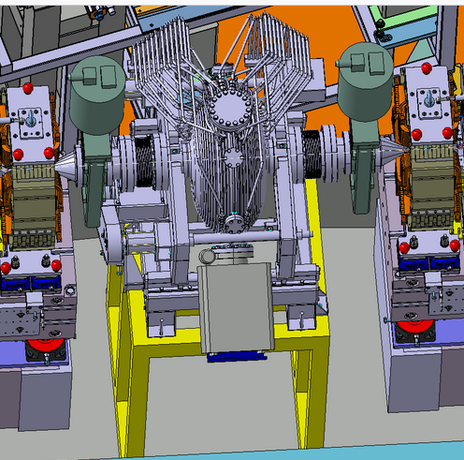
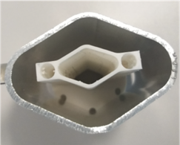
Cavity & Elettra 2.0
The Elettra cavity was chosen for the Elettra 2.0 project (no budget for new cavities)
Today this water leak adds to the “cons list” of using this cavity for Elettra 2.0.
Any different choice of the cavity shall take into account the dimension of the Elettra 2.0 vacuum chamber, the available room for the cavity installation in the short sections, 1200 mm, including the required tapers.
In the first stage Elettra 2.0 will start the operations with the very same cavities.
Elettra 2.0 storage ring and room from the cavity installation in the short straight section
The Elettra vacuum chamber transverse section, outer size 88 x 60 mm and the Elettra 2.0 one, 30 x 20 mm, 3D printed prototype. Comparison with the same scale.

Slide 7
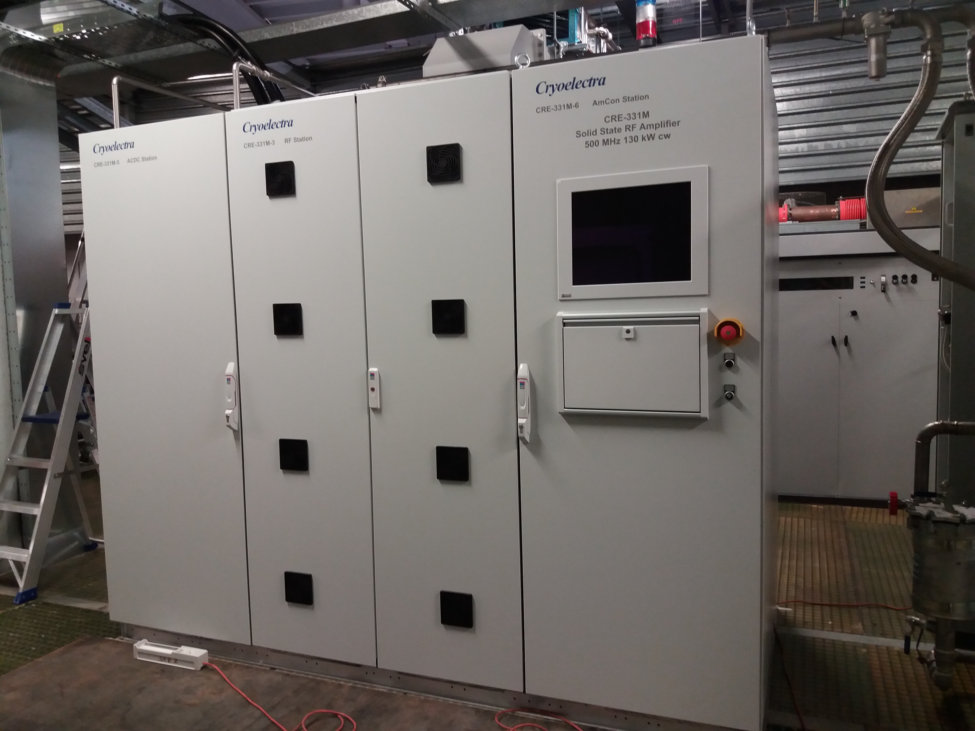
CRE-331M
AC/DC Power Supply Rack
Control System & H.M.I. Rack
RF Rack
CRE-331M 130 kW 500 MHz solid state amplifier from Cryoelectra installed in the Elettra service area composed by 3 racks (800 +1200+ 800). Total length 2800 mm, width 1400 mm, max height 2897 mm.

Slide 8
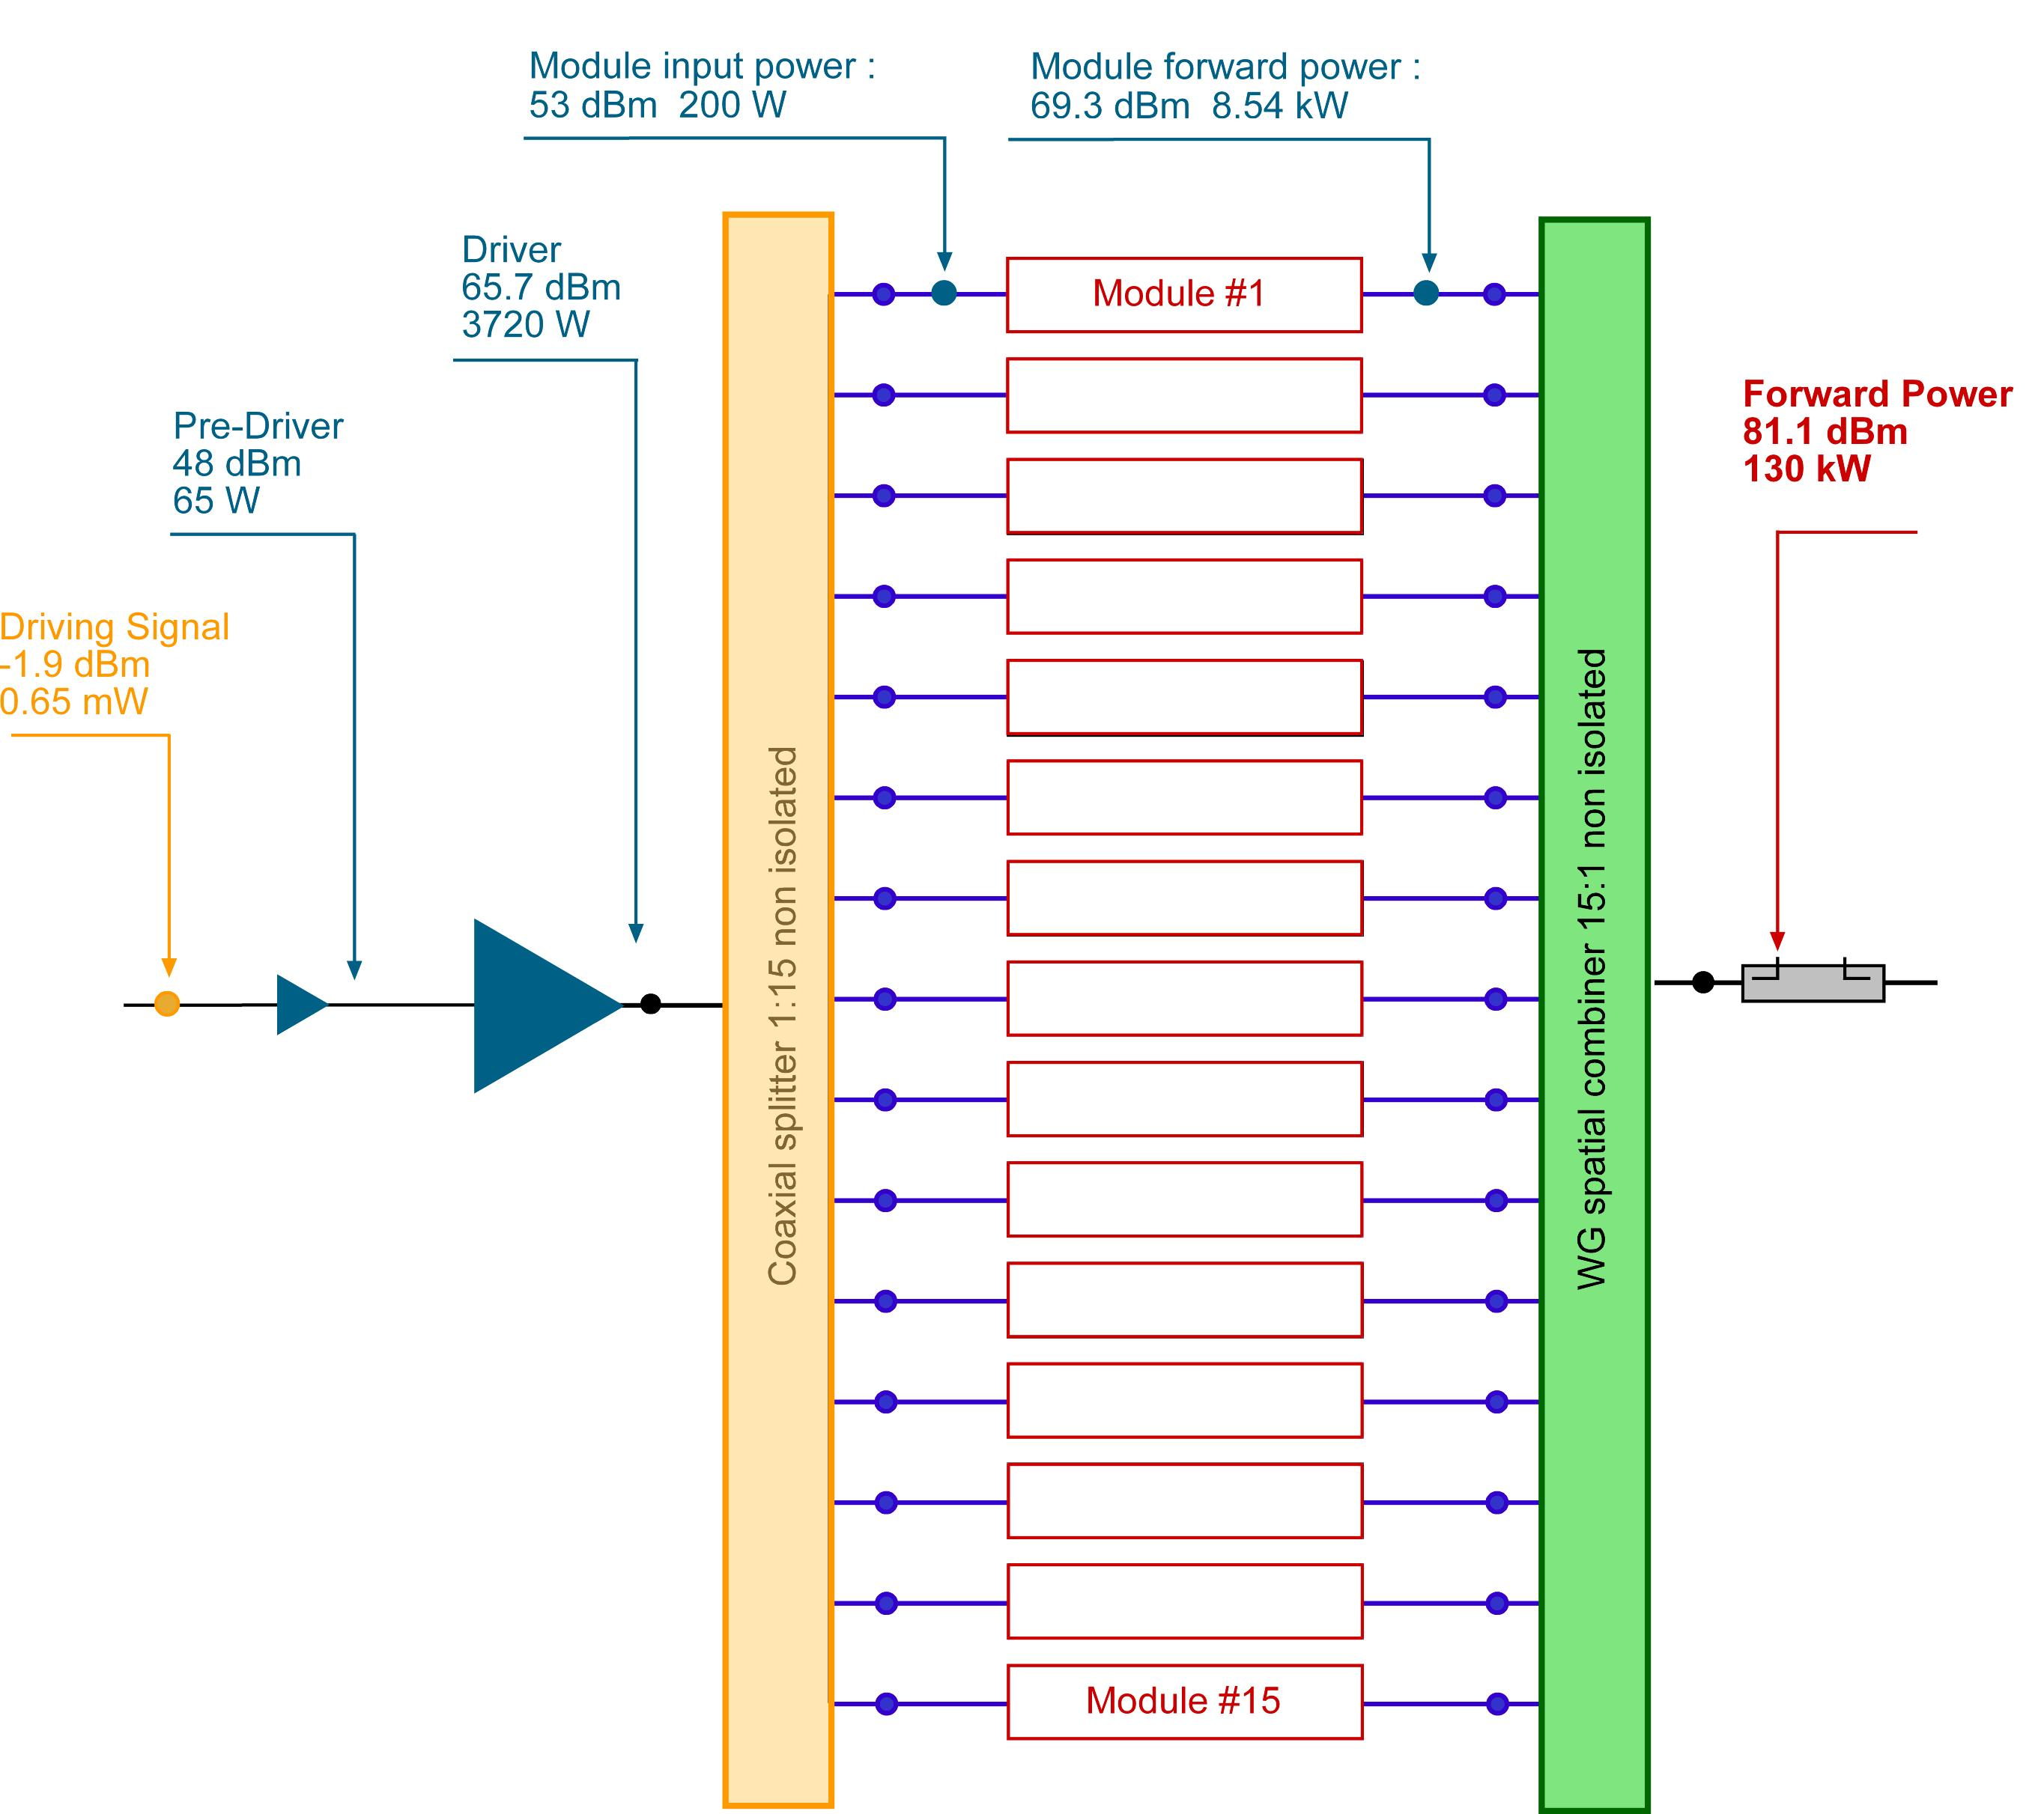
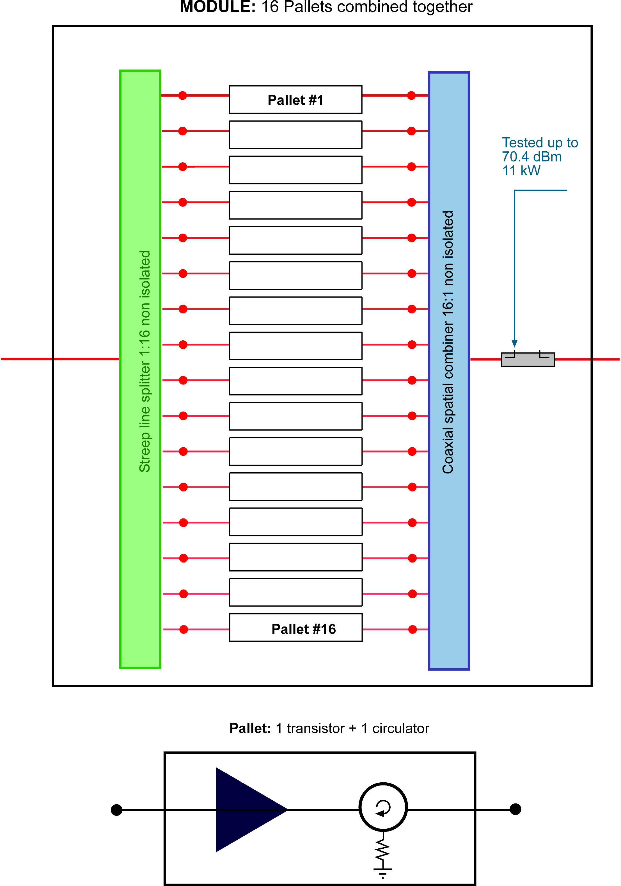
130 kW - 500 MHz RF design
15 RF power modules are combined together to obtain 130 kW. Each module hosts 16 pallet made by one transistor + one circulator. Total transistors # 240 , model BLF578XR, + Driver+ Pre-driver.
#84 AC/DC power supplies, model GE 52 V - 3.5 kW , feed in parallel the transistors.

Slide 9
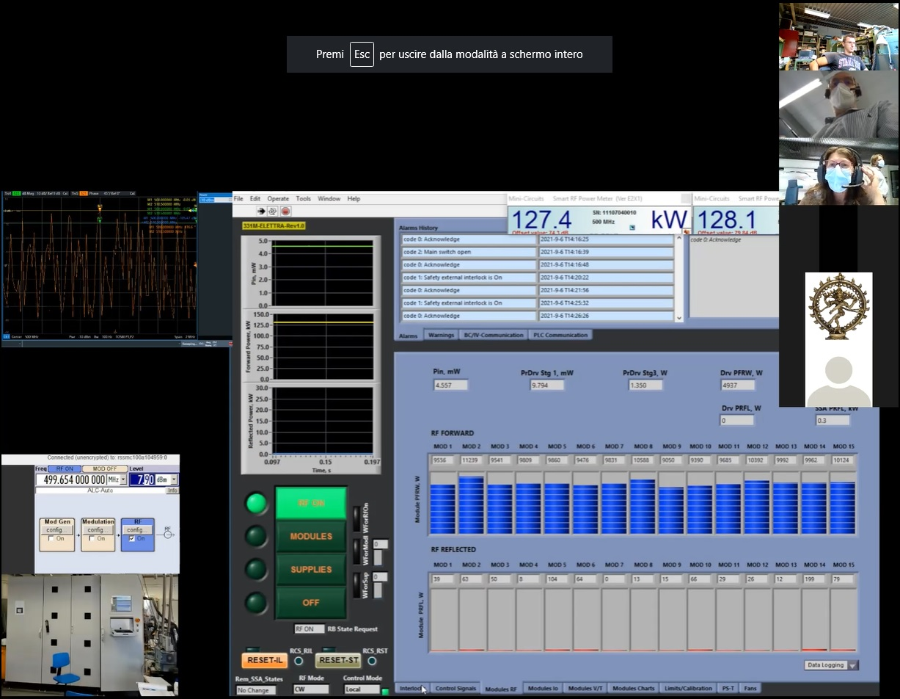
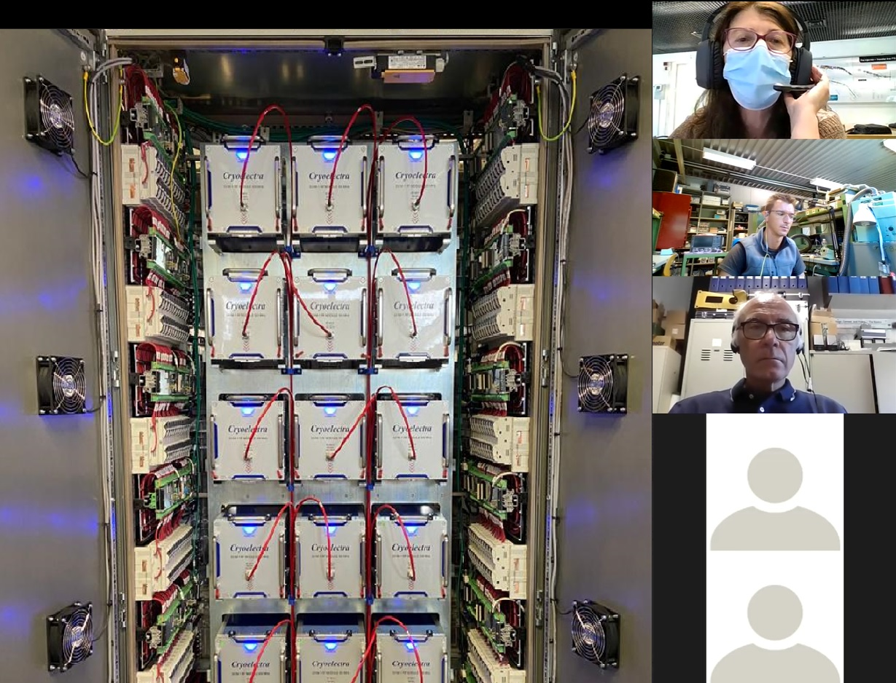
FAT Remote Session
The 130 kW 500 MHz amplifier model CRE-331M , was never seen “in person” before its delivery. FAT sessions hold by means of remote connections. FAT was done following a written agreed protocol
Notes:
Slide 3 – (..) : Content of the presentation
Insert a new slide: Home > “New Slide” and choose a slide Layout:
For Title & Subtitle
For text with bullet points
For Text
For Picture, graphs, visuals
Two columns
Blank
If you want Copy & paste an element from the Clip Board to the particular slide: 1. Click on a box to mark it.
2. Position the mouse pointer on the box frame: Copy! 3. Click on the particular slide: Paste!
How you intend to use the elements is your choice. You can combine the text block style with the background colour in different manner.

Slide 10
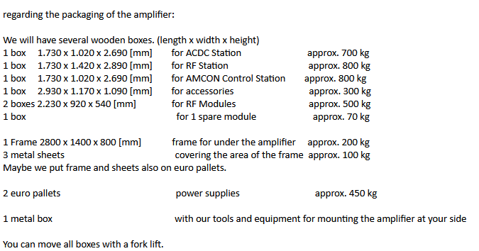
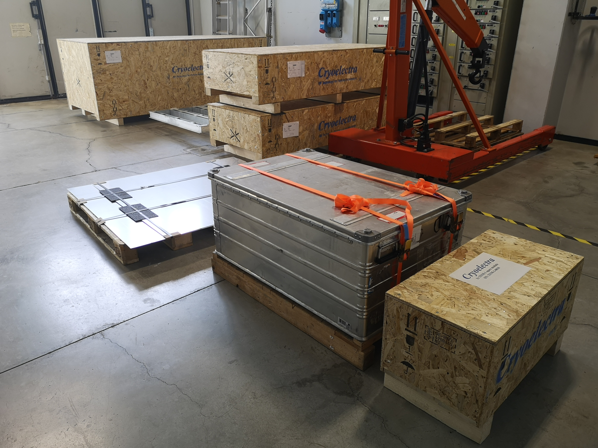
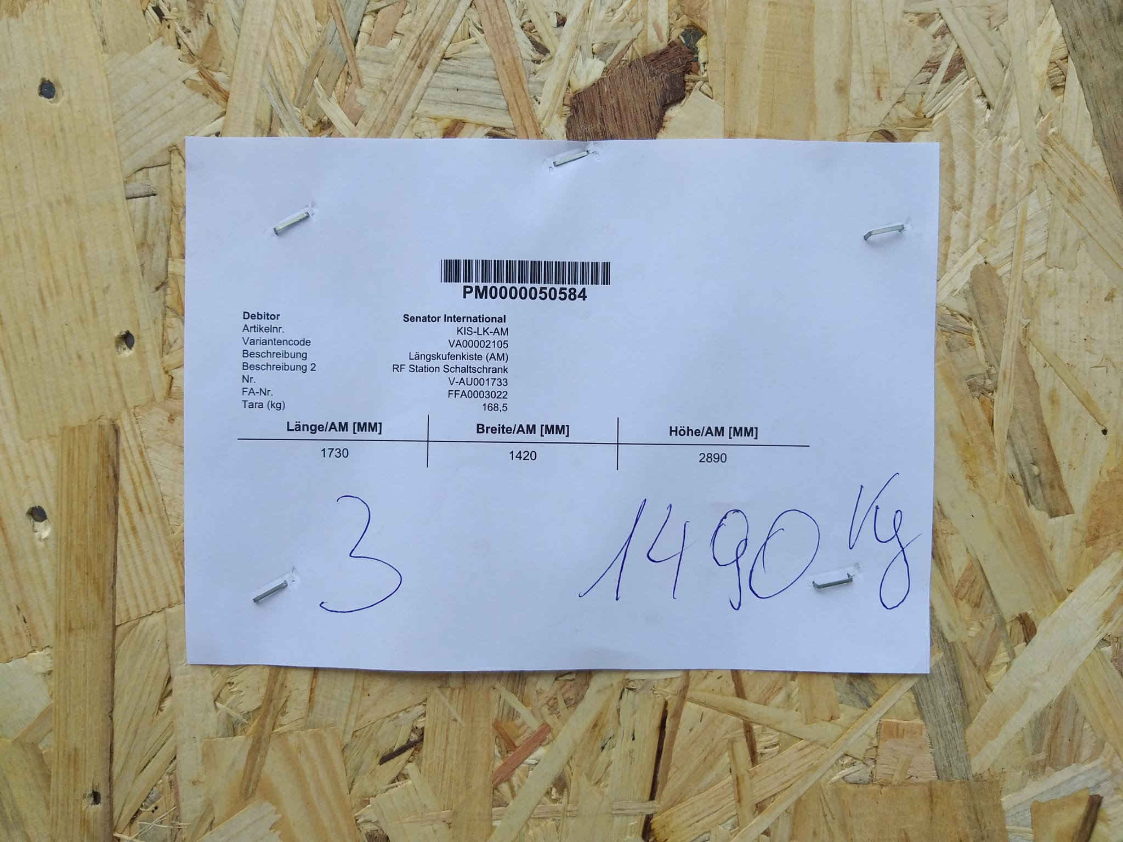
Delivery
FAT ended on Sep 13th. Delivery within end of September. Installation started on October 4th.
Notes:
Slide 3 – (..) : Content of the presentation
Insert a new slide: Home > “New Slide” and choose a slide Layout:
For Title & Subtitle
For text with bullet points
For Text
For Picture, graphs, visuals
Two columns
Blank
If you want Copy & paste an element from the Clip Board to the particular slide: 1. Click on a box to mark it.
2. Position the mouse pointer on the box frame: Copy! 3. Click on the particular slide: Paste!
How you intend to use the elements is your choice. You can combine the text block style with the background colour in different manner.

Slide 11
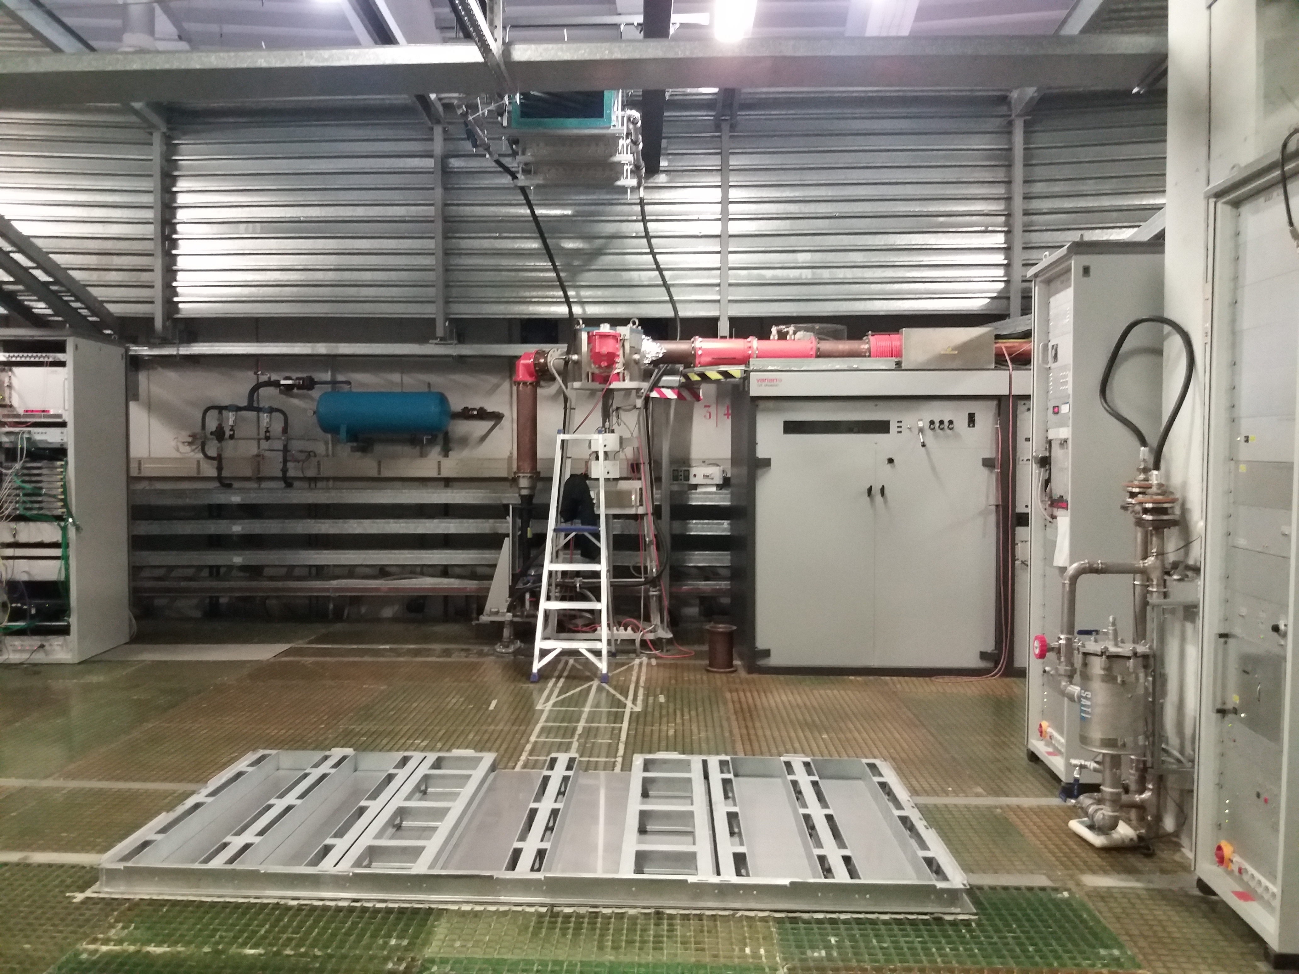
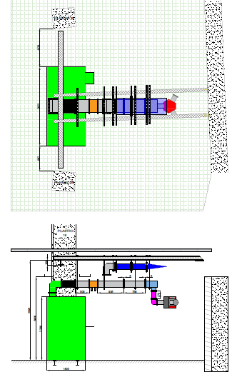
130 kW RF Installation
Goal: Minimize the Impact of the Installation on the Elettra Operation
New frame ready for the CRE-331M installation. In the background the klystron-based amplifier and the rigid coaxial run are visible. The 6 1/8” rigid coaxial line and the circulator will be used also for the new amplifier towards the cavity connection. On the right all the plans for the installation.
Notes:
Slide 3 – (..) : Content of the presentation
Insert a new slide: Home > “New Slide” and choose a slide Layout:
For Title & Subtitle
For text with bullet points
For Text
For Picture, graphs, visuals
Two columns
Blank
If you want Copy & paste an element from the Clip Board to the particular slide: 1. Click on a box to mark it.
2. Position the mouse pointer on the box frame: Copy! 3. Click on the particular slide: Paste!
How you intend to use the elements is your choice. You can combine the text block style with the background colour in different manner.

Slide 12
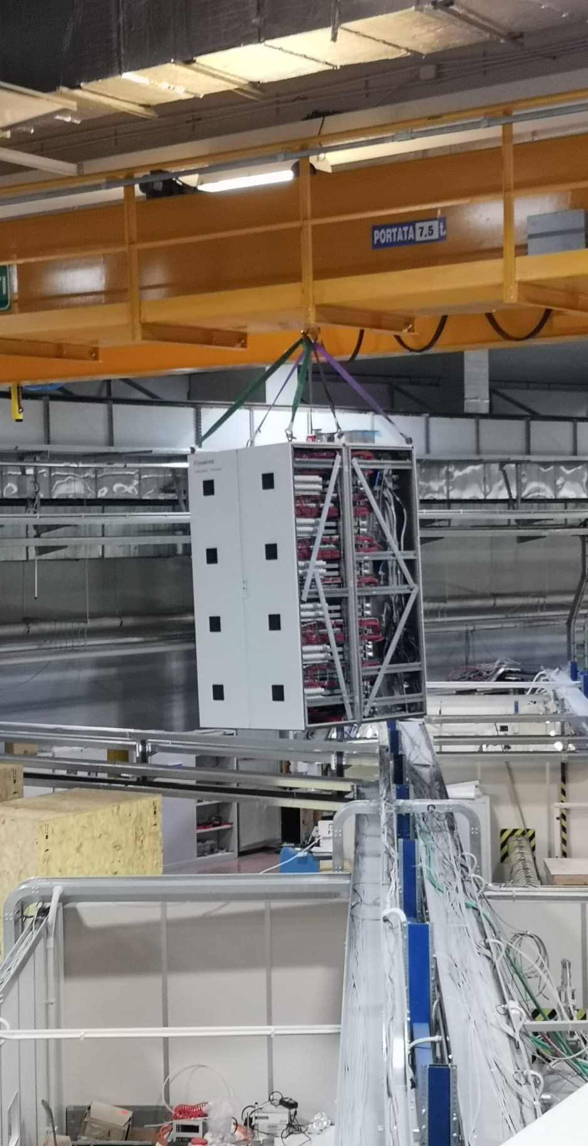
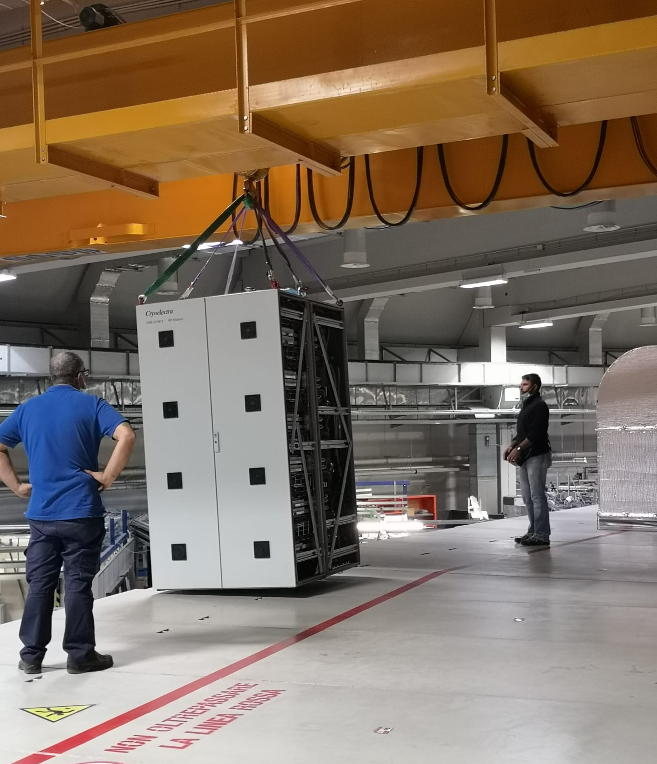
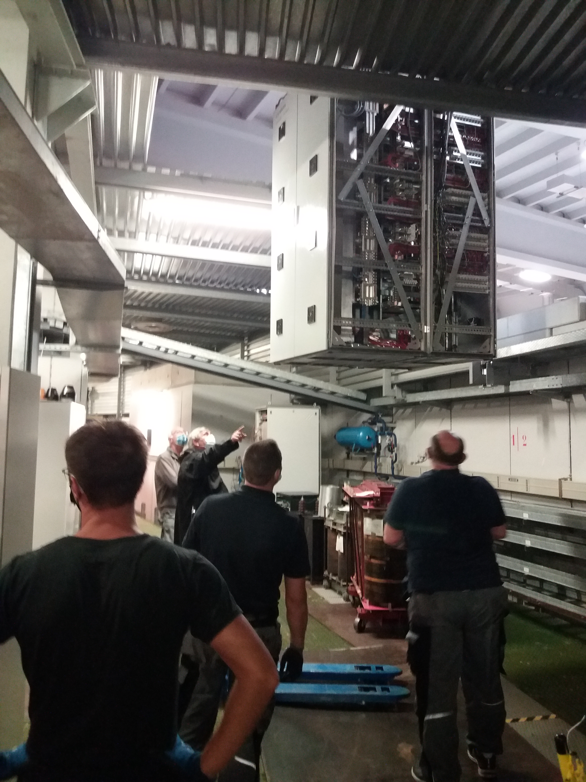
Installation
Handling the CRE-331M RF station. The “emptied rack” – 700 kg only – almost crawled the Elettra storage ring roof because of the crane maximum height. Rack’s feed have been removed.
Original RF station eyebolts bended: replaced by enhanced ones.
Notes:
Slide 3 – (..) : Content of the presentation
Insert a new slide: Home > “New Slide” and choose a slide Layout:
For Title & Subtitle
For text with bullet points
For Text
For Picture, graphs, visuals
Two columns
Blank
If you want Copy & paste an element from the Clip Board to the particular slide: 1. Click on a box to mark it.
2. Position the mouse pointer on the box frame: Copy! 3. Click on the particular slide: Paste!
How you intend to use the elements is your choice. You can combine the text block style with the background colour in different manner.

Slide 13
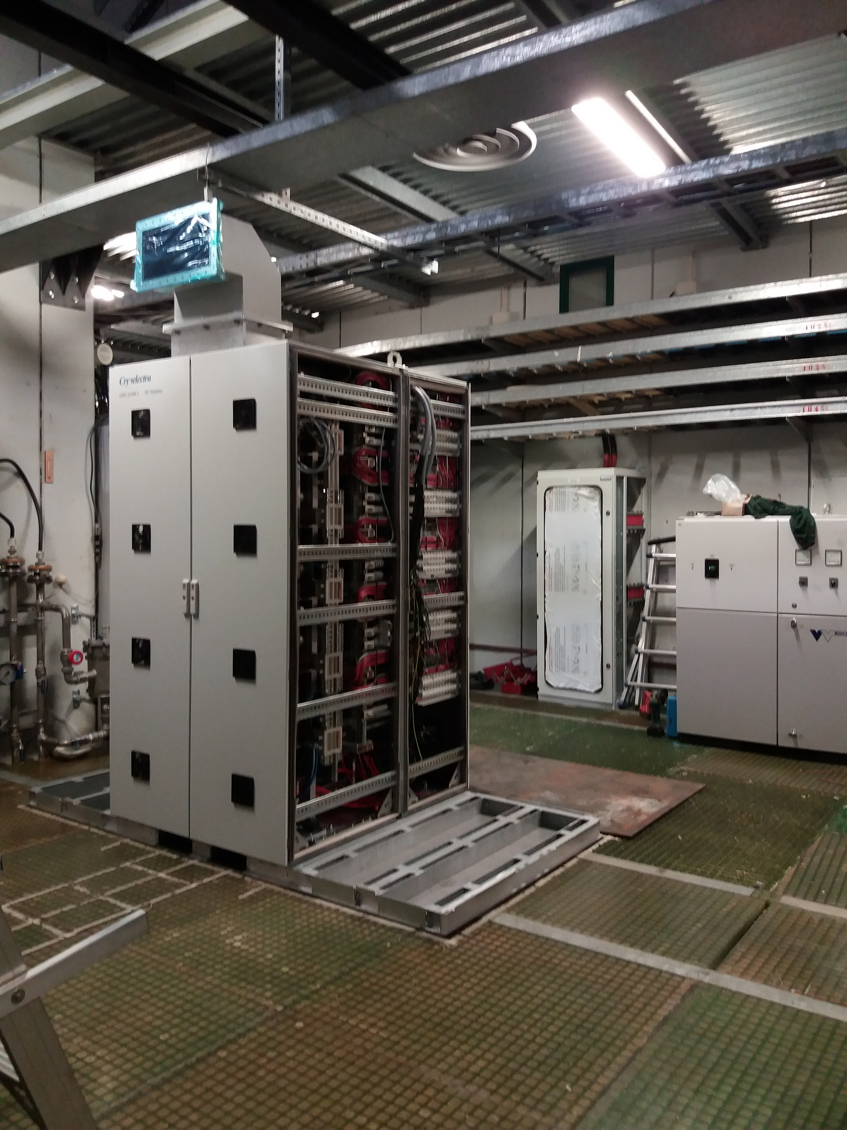
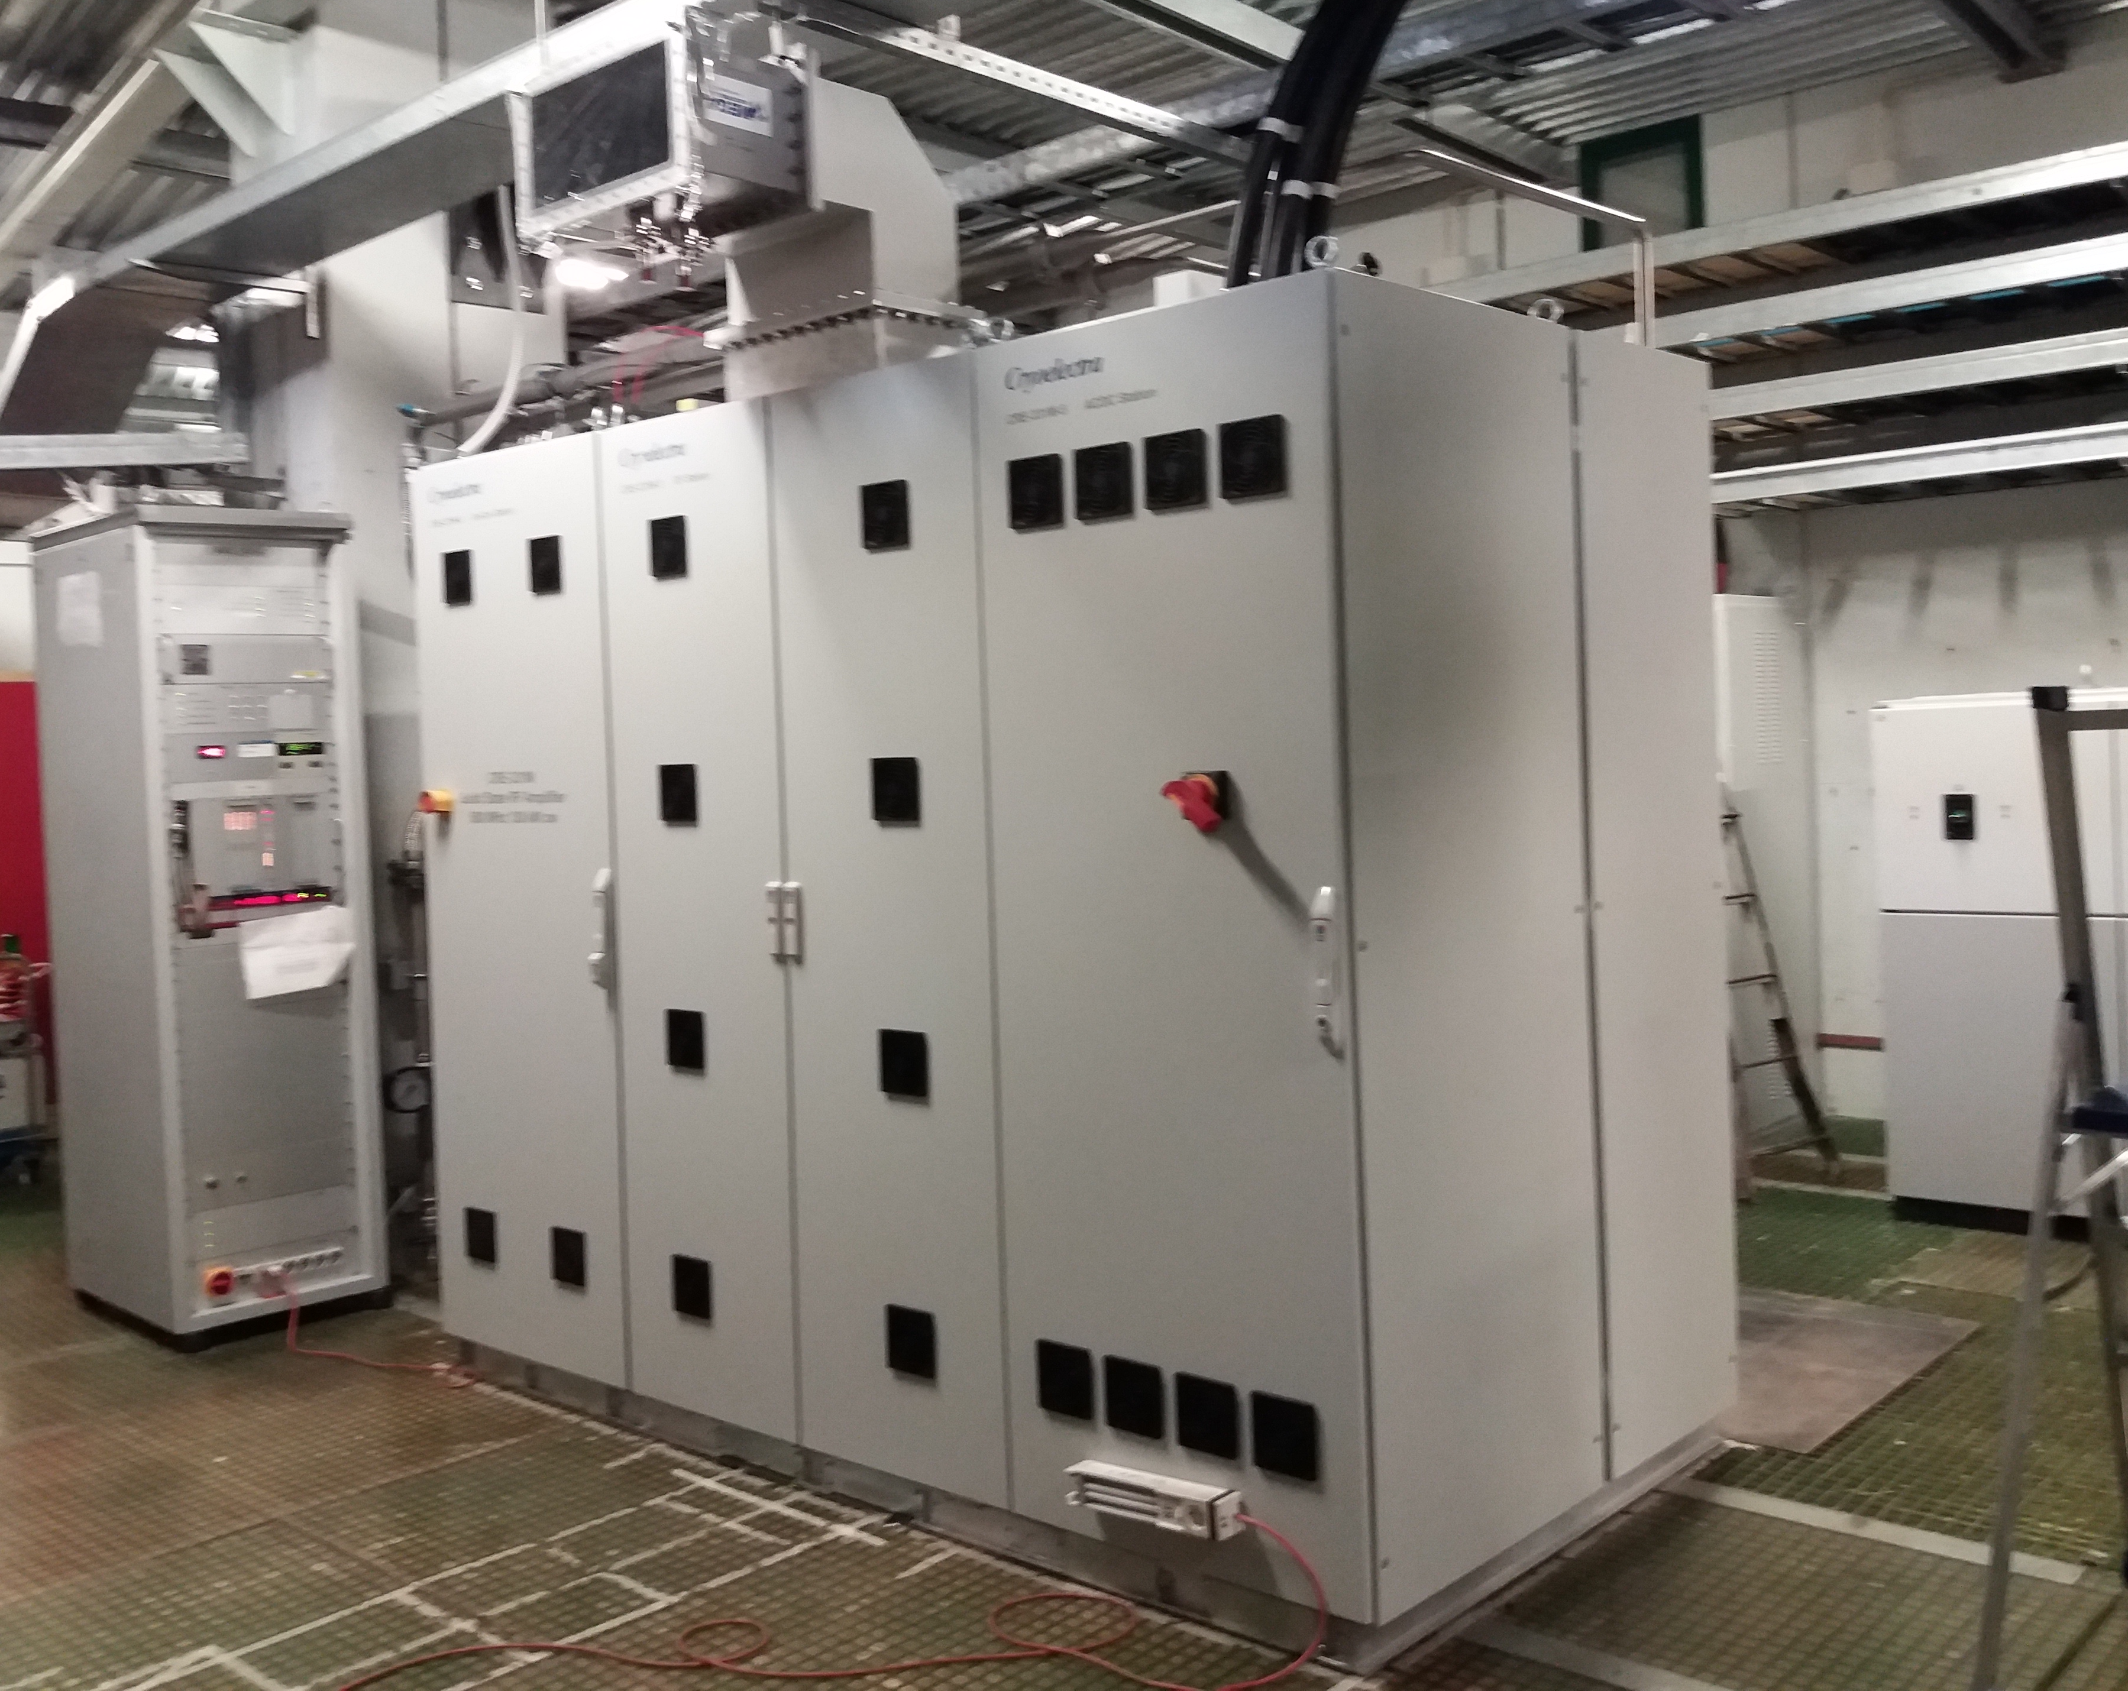
Installation
Goal: 5 days for the machine handling, precise positioning, installation of all the components and connection towards the electricity, water cooling and RF load.
The central rack, “RF station” was installed first. Precise alignment was needed between the waveguide flange and the rigid coaxial line. All the alignment efforts being spoiled by the Elettra service area false floor lack of rigidity. Electrical panel to energize the CRE-331M was installed together with the new machine. Only one electrical line is available for the RF power: either we energize the klystron or the solid state amplifier.
Notes:
Slide 3 – (..) : Content of the presentation
Insert a new slide: Home > “New Slide” and choose a slide Layout:
For Title & Subtitle
For text with bullet points
For Text
For Picture, graphs, visuals
Two columns
Blank
If you want Copy & paste an element from the Clip Board to the particular slide: 1. Click on a box to mark it.
2. Position the mouse pointer on the box frame: Copy! 3. Click on the particular slide: Paste!
How you intend to use the elements is your choice. You can combine the text block style with the background colour in different manner.

Slide 14
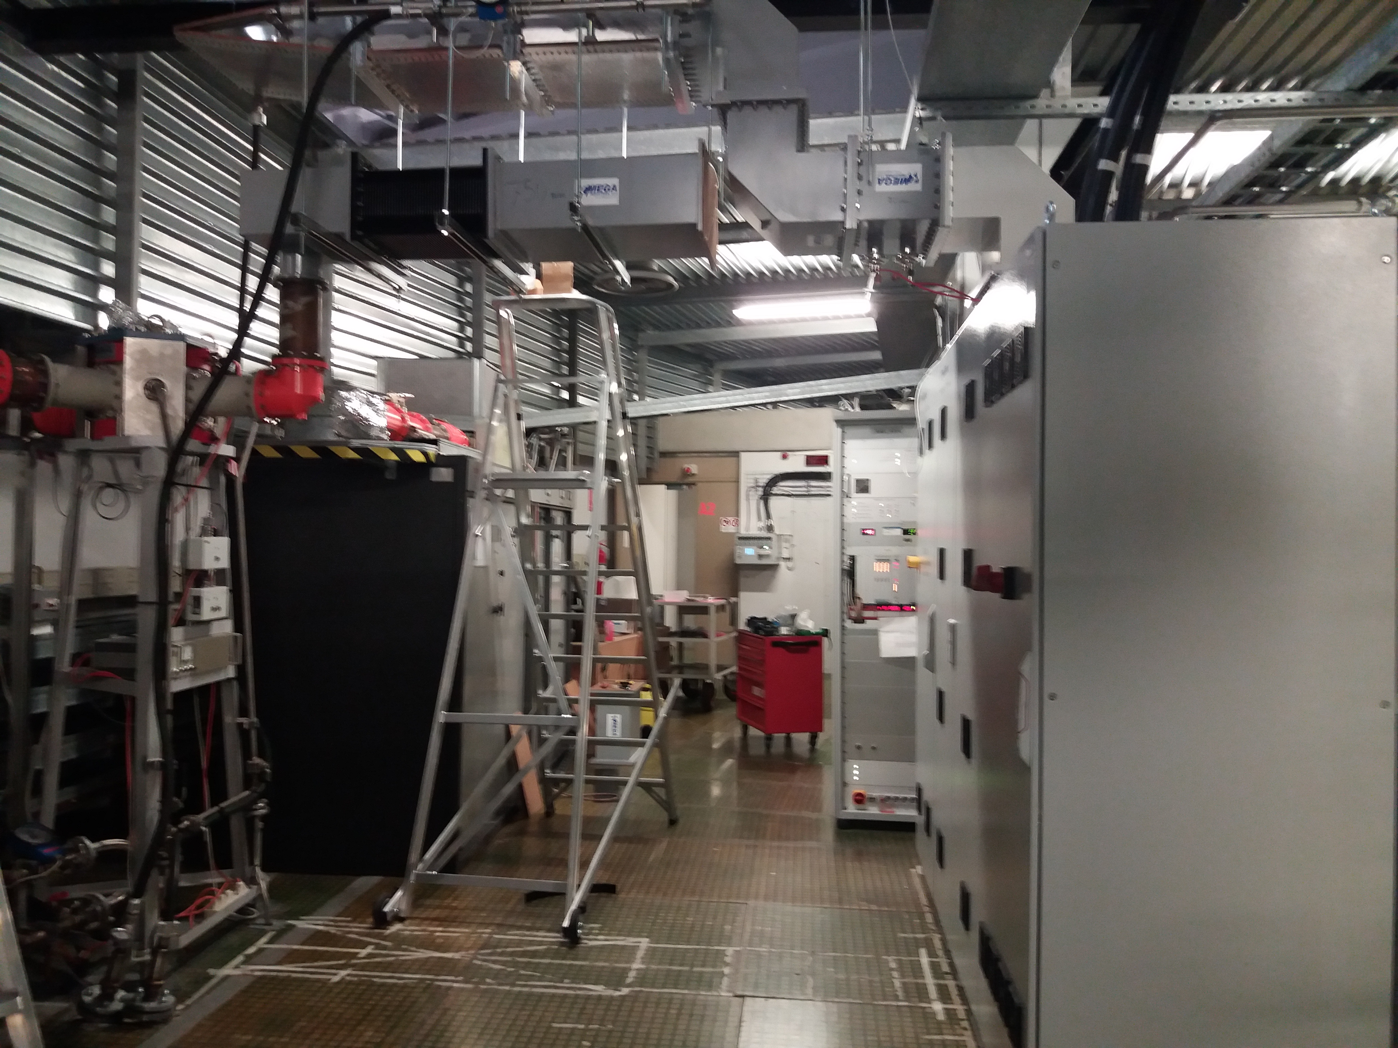
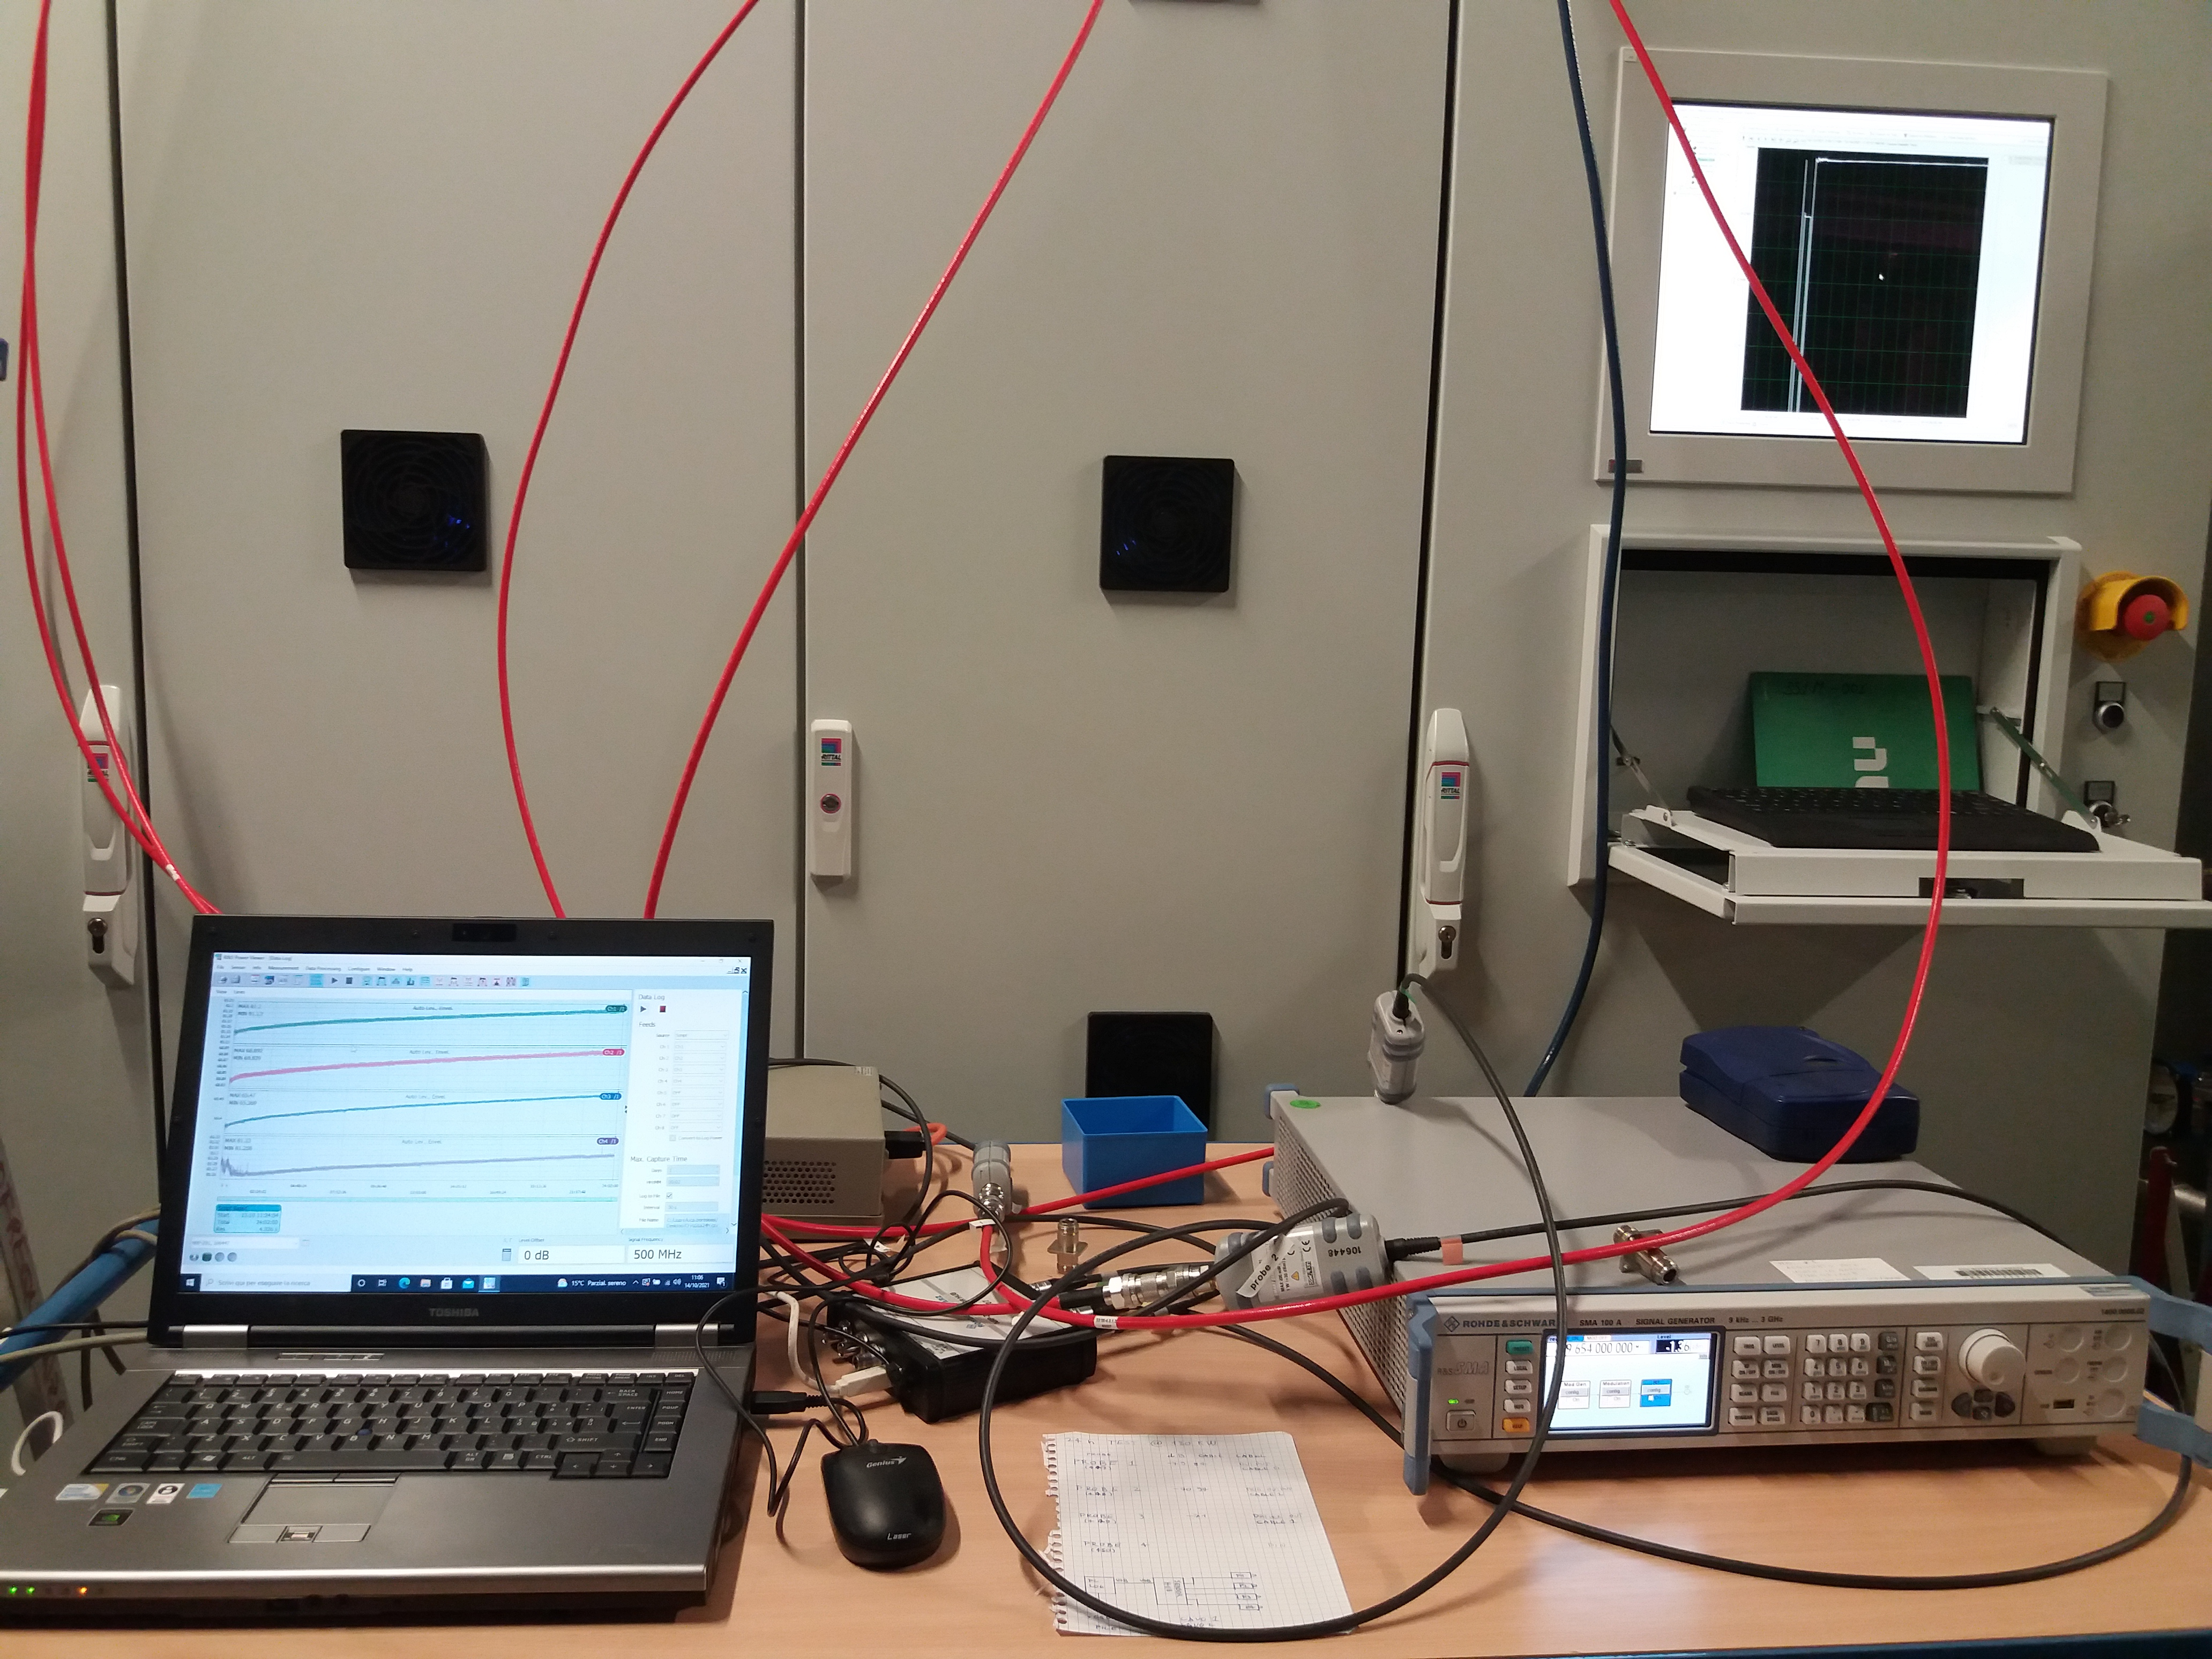
SAT set up
Goal: 5 days for SAT, including interlock check, RF performances, supervisory system and the 24 hours non-stop test duration at nominal RF output power.
CRE-331M SAT performed on the AFT 140 kW 50 ohm water cooled ferrite load. The CRE-331M RF driving signal was directly applied using manually the SMA 100 A S.G.
Notes:
Slide 3 – (..) : Content of the presentation
Insert a new slide: Home > “New Slide” and choose a slide Layout:
For Title & Subtitle
For text with bullet points
For Text
For Picture, graphs, visuals
Two columns
Blank
If you want Copy & paste an element from the Clip Board to the particular slide: 1. Click on a box to mark it.
2. Position the mouse pointer on the box frame: Copy! 3. Click on the particular slide: Paste!
How you intend to use the elements is your choice. You can combine the text block style with the background colour in different manner.

Slide 15
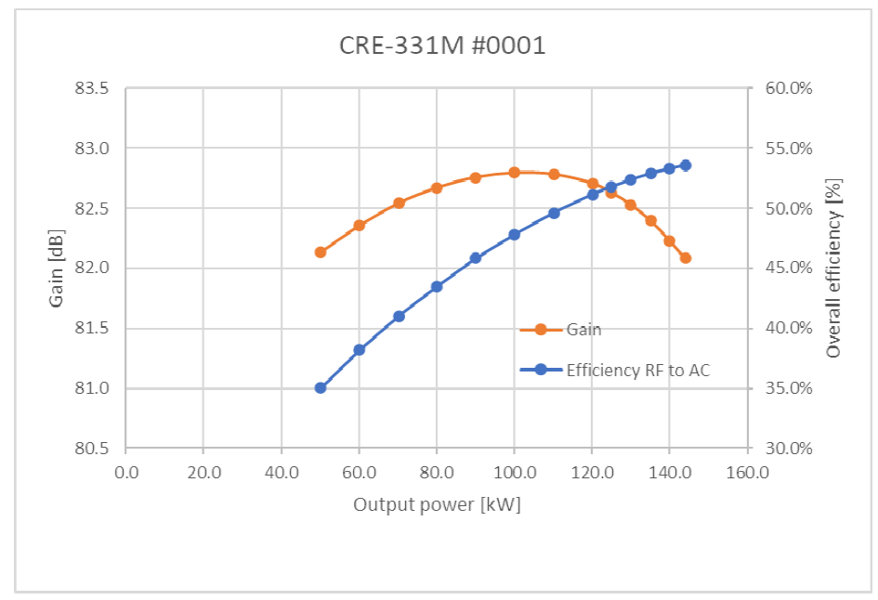
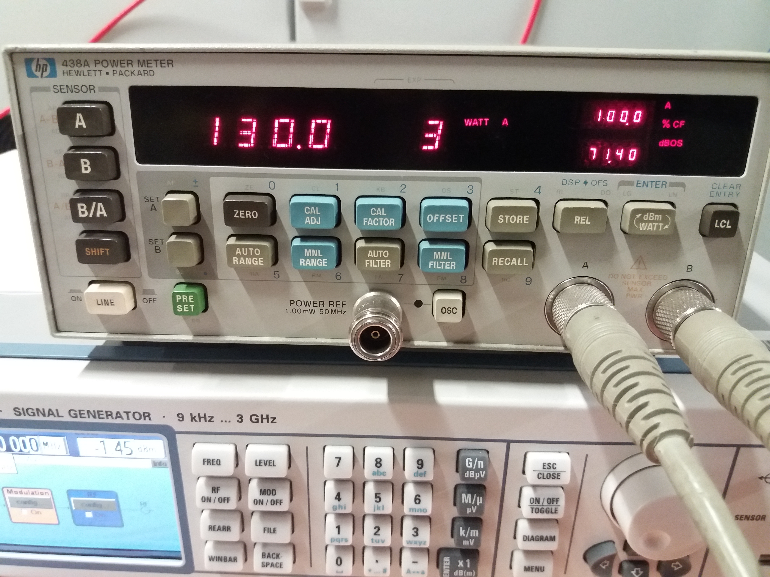
Gain and Efficiency
Power Line Electrical Panel Instrument:
real, reactive and apparent Power when CRE- 331M is running at 130 kW
Power Factor = 0.995
Wall-Plug Efficiency @ 130 kW RF : 52% but the Control line losses ( < 1 kW). Drain Voltage 44 V. Efficiency drops for lower RF forward power levels. From next machine will have the chance to adjust the V-drain to optimize the consumption (custom ADC/DC PS controller)
6.5 kW are lost running the machine in stand-by – Machine ready but no RF driving signal
Notes:
Slide 3 – (..) : Content of the presentation
Insert a new slide: Home > “New Slide” and choose a slide Layout:
For Title & Subtitle
For text with bullet points
For Text
For Picture, graphs, visuals
Two columns
Blank
If you want Copy & paste an element from the Clip Board to the particular slide: 1. Click on a box to mark it.
2. Position the mouse pointer on the box frame: Copy! 3. Click on the particular slide: Paste!
How you intend to use the elements is your choice. You can combine the text block style with the background colour in different manner.

Slide 16
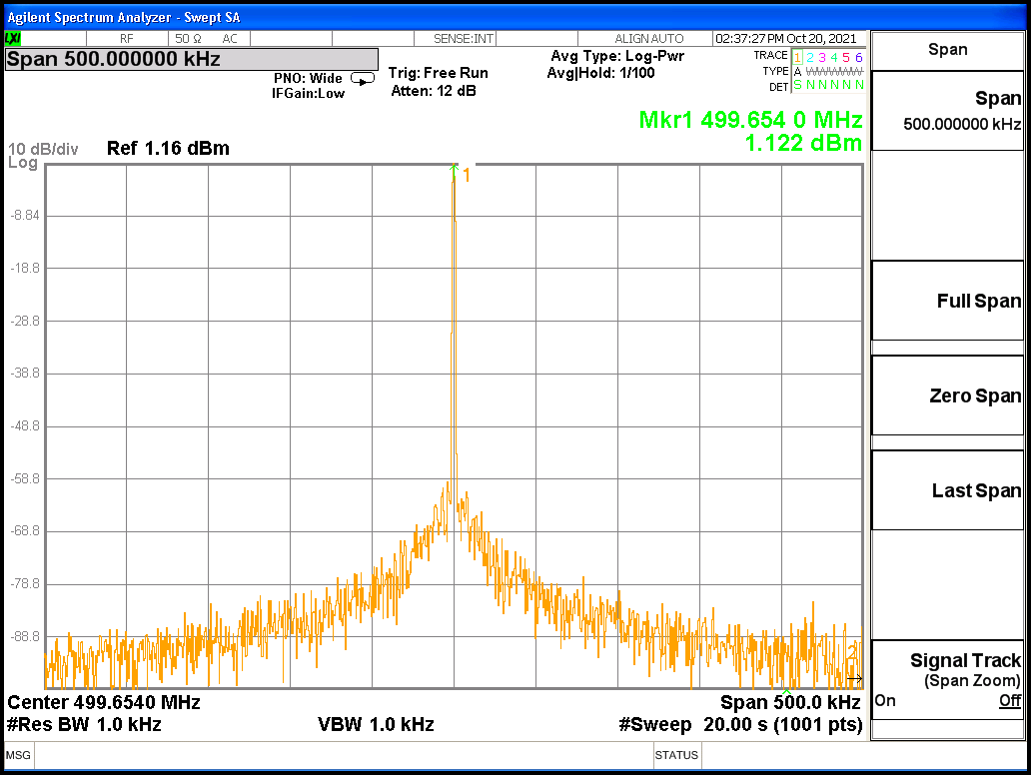
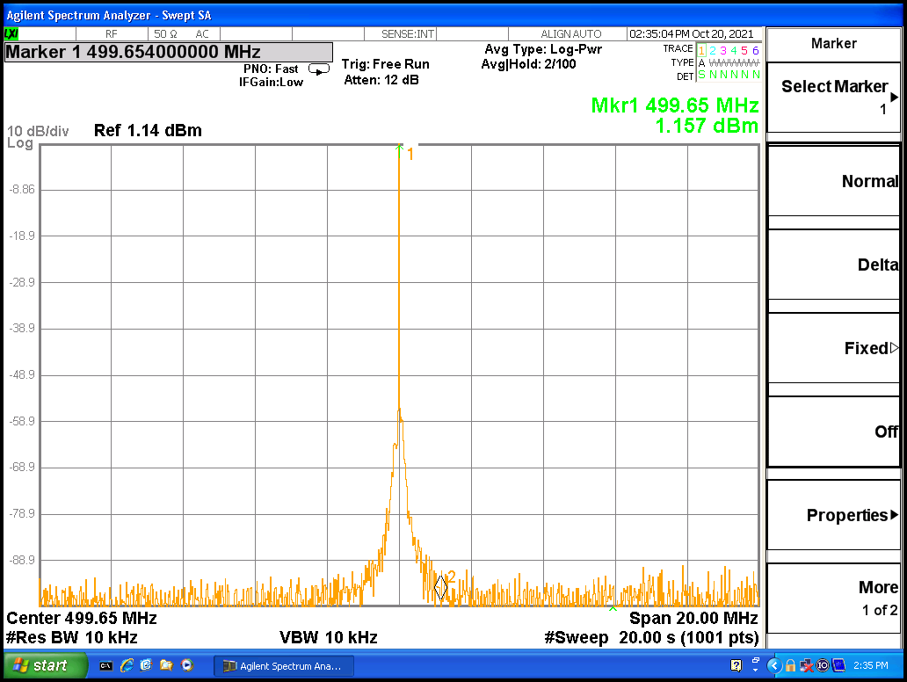
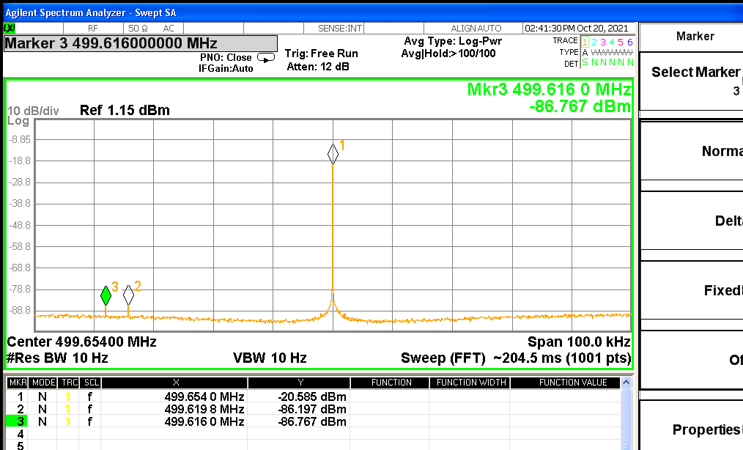
RF quality
Spurios around 500 kHz and 20 MHz, pick up signal from forward power at 130 kW
Reducing the instrument Resolution BW < 10 Hz, the signal is digitalized and the FFT is shown
Notes:
Slide 3 – (..) : Content of the presentation
Insert a new slide: Home > “New Slide” and choose a slide Layout:
For Title & Subtitle
For text with bullet points
For Text
For Picture, graphs, visuals
Two columns
Blank
If you want Copy & paste an element from the Clip Board to the particular slide: 1. Click on a box to mark it.
2. Position the mouse pointer on the box frame: Copy! 3. Click on the particular slide: Paste!
How you intend to use the elements is your choice. You can combine the text block style with the background colour in different manner.

Slide 17
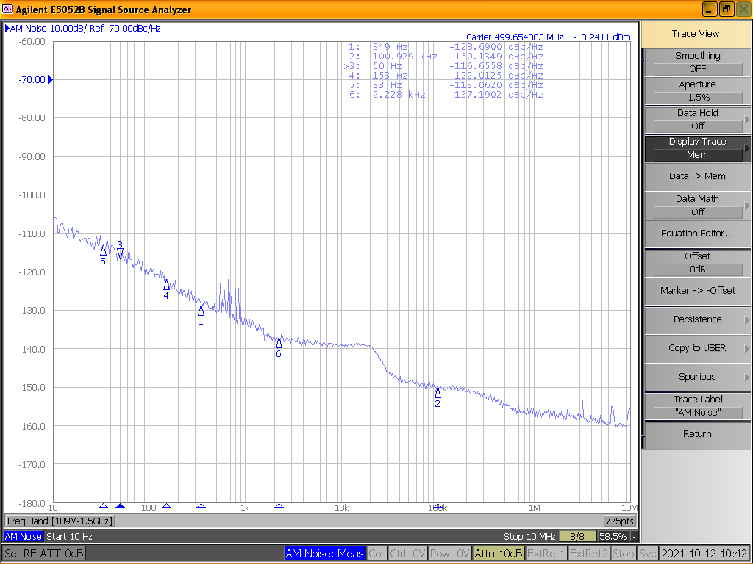
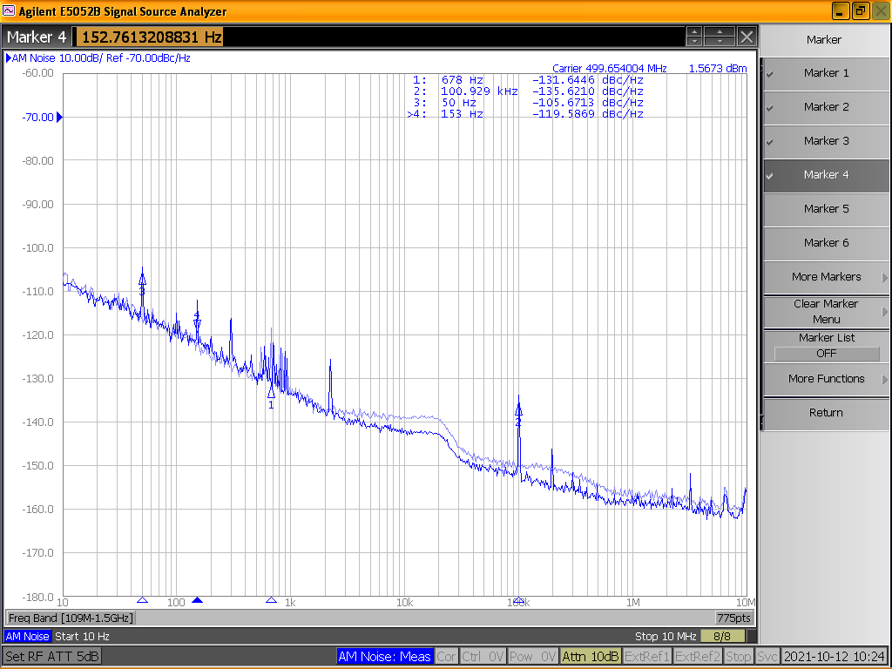
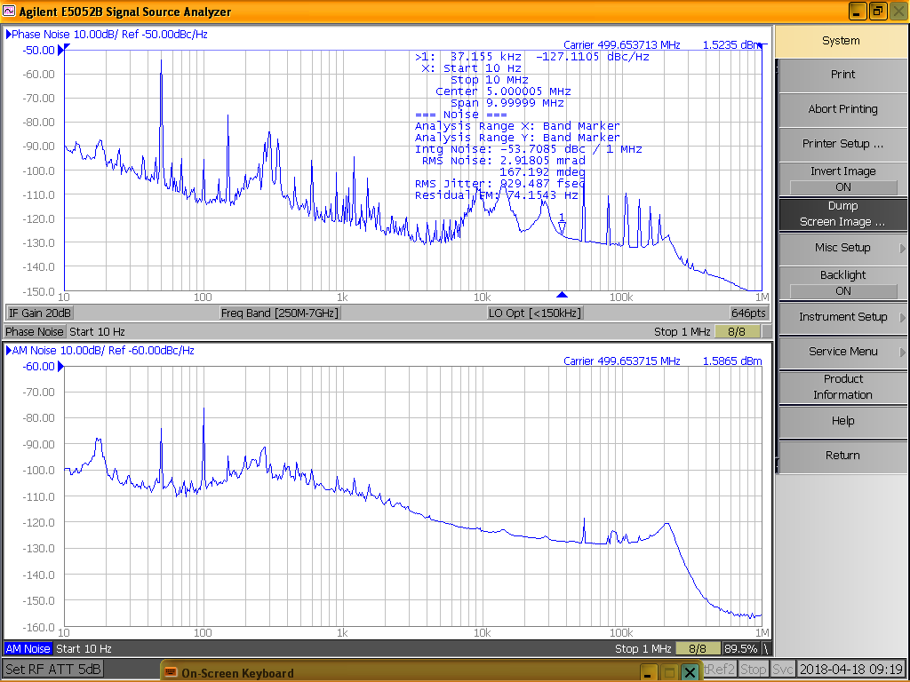
AM and Phase noise
CRE-331M AM and Phase noise well below specs
-100 dBc/Hz
SMA Signal Generator AM noise
˚
-100 dBc/Hz
CRE-331M @ 130 kW cw Forward Power pick up AM noise
25 years old Klystron-based Amplifier @ 40 kW
Forward Power AM and Phase noise
Notes:
Slide 3 – (..) : Content of the presentation
Insert a new slide: Home > “New Slide” and choose a slide Layout:
For Title & Subtitle
For text with bullet points
For Text
For Picture, graphs, visuals
Two columns
Blank
If you want Copy & paste an element from the Clip Board to the particular slide: 1. Click on a box to mark it.
2. Position the mouse pointer on the box frame: Copy! 3. Click on the particular slide: Paste!
How you intend to use the elements is your choice. You can combine the text block style with the background colour in different manner.

Slide 18
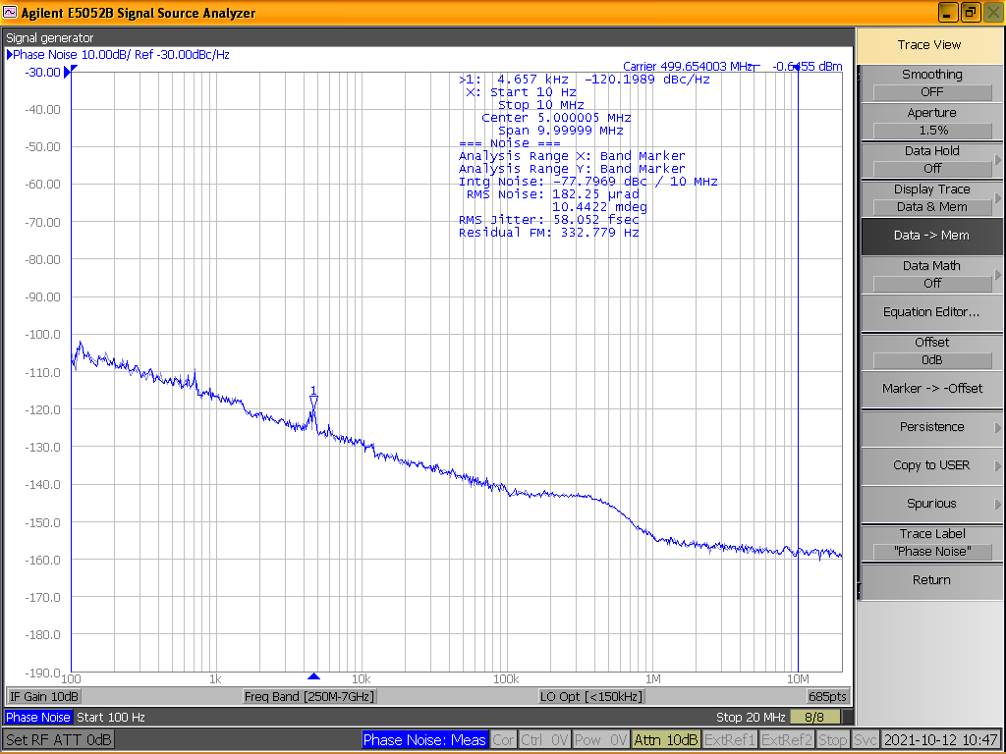
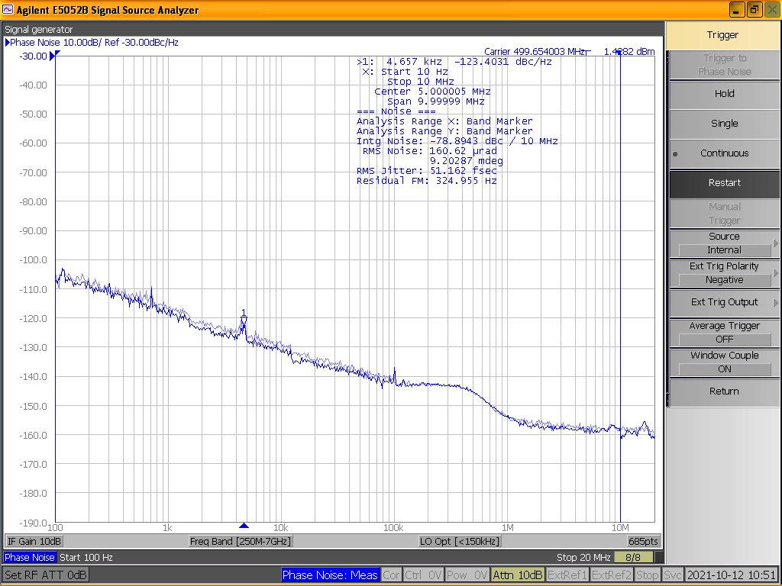
AM and Phase noise
CRE-331M AM and Phase noise well below specs
SMA Signal Generator Phase noise
-100 dBc/Hz
-100 dBc/Hz
CRE-331M @ 130 kW cw Forward Power pick up Phase noise
25 years old Klystron-based Amplifier @ 40 kW
Forward Power AM and Phase noise
Notes:
Slide 3 – (..) : Content of the presentation
Insert a new slide: Home > “New Slide” and choose a slide Layout:
For Title & Subtitle
For text with bullet points
For Text
For Picture, graphs, visuals
Two columns
Blank
If you want Copy & paste an element from the Clip Board to the particular slide: 1. Click on a box to mark it.
2. Position the mouse pointer on the box frame: Copy! 3. Click on the particular slide: Paste!
How you intend to use the elements is your choice. You can combine the text block style with the background colour in different manner.

Slide 19
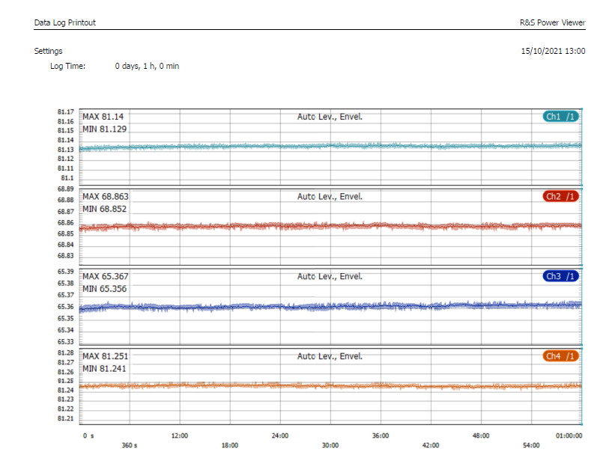
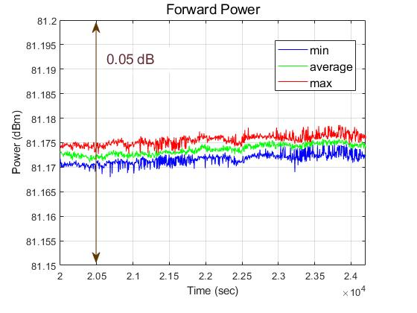
Gain stability
3 hours power log, sub-set of data taken during the 24 hour test
Minimum, average and maximum data legged each 4.3 seconds by the power sensor
Total vertical scale 0.05 dB
One hour test: 1data record each180 ms.
Ch1: Elettra WR1800 directional coupler,
Ch2: Mod 1, Ch3: Driver, Ch4: SSA FWD Power from diagnostic patch panel.
Δ = 0.011dB
Long term RF power data log taken with 4 R&S NRP-Z81 power sensors, relative uncertainty for RF power measure: 0.039 to 0.148 dB and the Power Viewer Software.

Slide 20
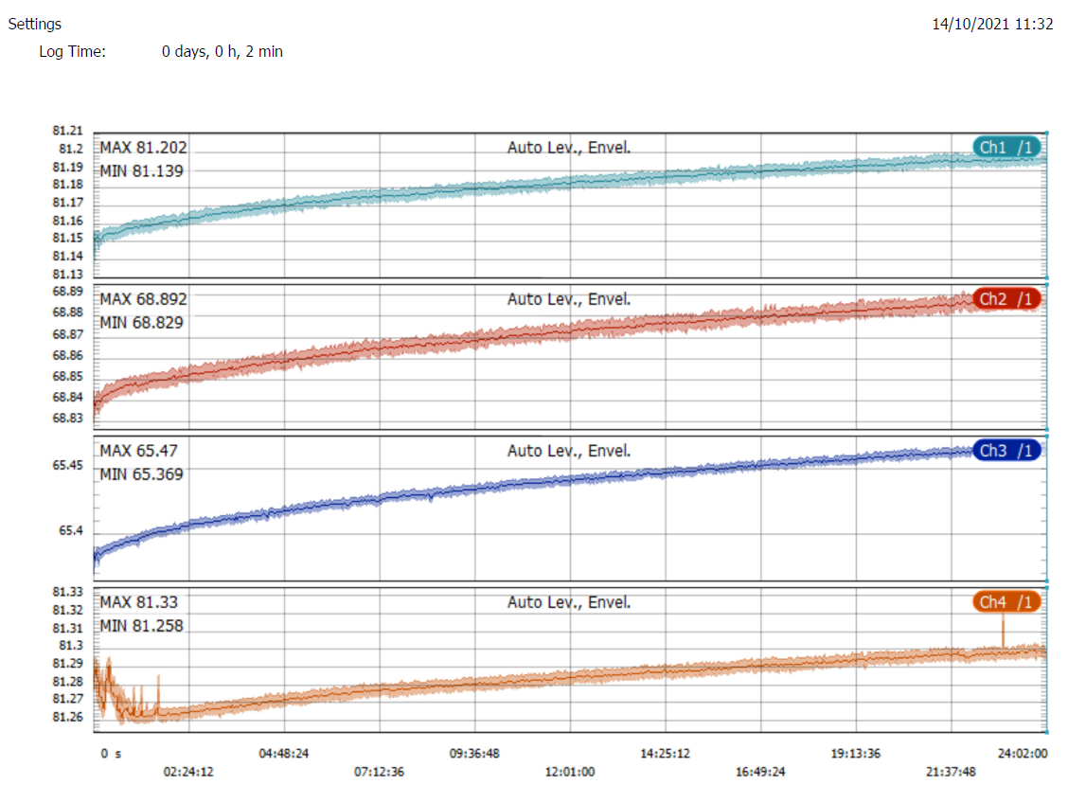
24 h non-stop run
Ch1 : Elettra WR1800 directional coupler
Δ = 0.06 dB
Ch2: Module #1 FWD PWR
Δ = 0.06 dB
Ch3: Driver FWD PWR
Δ = 0.10 dB
Ch4: SSA amplifier FWD PWR
Δ = 0.06 dB
Initial data glitches max stroke
Δ = 0.025 dB
RF rack cooling water ΔT = 6.7 ºC with 200 l/m; AC/DC rack cooling water ΔT = 2.7 ºC with 70 l/m
Losses cooled by water ≈ 107 kW ; losses dissipated “in air” ≈ 11 kW
During the week-end a second non-stop test at nominal power was successfully completed, duration 66 hours.

Slide 21
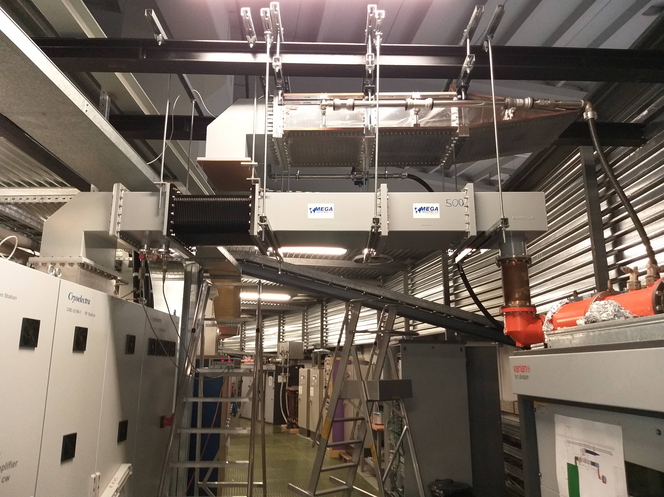
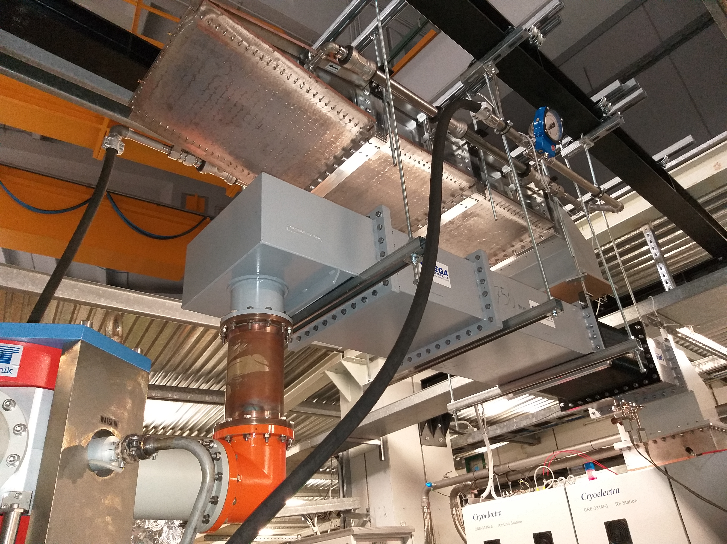
Elettra storage ring operation
The CRE-331M transmitter was running for 8 working days on the 140 kW load with long duration tests 24+66 hours at 130 kW. It was also running 12 + 4 hours at 100 kW with some transistors and PS in OFF state to check the redundancy.
Temporary lay out of the RF power run towards the accelerating cavity. WG components have been ordered and will be installed upon their delivery
2 weeks for installation and SAT
1 week + 3 days to connect the CRE-331M transmitter to the cavity and integrate it in the Elettra system (radioprotection and remote control)
Elettra cavity needs roughly 45 - 50 kW. Maximum forward power has been hardware limited to 75 kW due to the 6 1/8” coaxial line and 80 kW circulator.

Slide 22
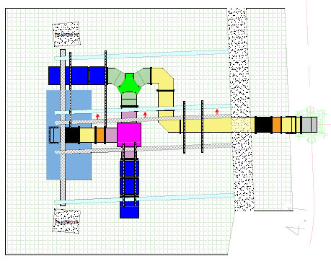
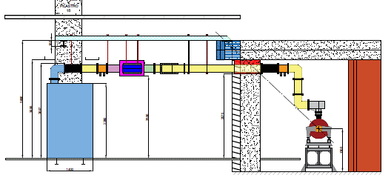
Next plans
Today the 4 Elettra RF systems run:
2 with klystron-based amplifier,
1 with IOT amplifier,
1 SSA amplifier.
The contract foresees a total of 4 SSA units.
In 2022 the second CRE-331M transmitter will be installed in RF#8 during the standard shut down ( minimum impact on the user time). Installation of the last 2 SSA needs more time since there is no available free room.
Next year the final RF run lay out will be carried out in RF#3 with a useful waveguide switch to test the amplifier and full WG run towards the cavity.
Contract with AFT and MEGA Ind. for loads, circulators and WG components are running. The time delivery of these components is pivotal for the next SSA installation.

Slide 23
Conclusion
Elettra cavity, after 18 years of operation, has shown a mechanical weakness (cooling pipe water leak). It is working with no trouble but it moves us to ponder its choice for the Elettra 2.0 project.
Installation and set into operation of the first 130 kW SSA for the Elettra 2.0 project was successful. The machine is now running on the cavity at 45 kW of output power (level required by Elettra).
The new SSA is well built and in compliance with the specifications. Ready to deliver the full RF power in one week.
Second SSA installation foreseen in 2022 April or June Elettra shut down. It will be performed upon the availability of the wave guide components that have been already ordered.
Even if the SSA belongs to the Elettra 2.0 project, they are really needed for the today operation for Elettra.

Slide 24
Notes:
Last Slide 1: Thanks to the audience

Slide 25
Notes:
Last Slide 2: Aerial Photo of Elettra

